Slide 1

MAKING A DIFFERENCE
Careers in care
www.skillsforcare.org.uk/thinkcarecareers

Slide 2
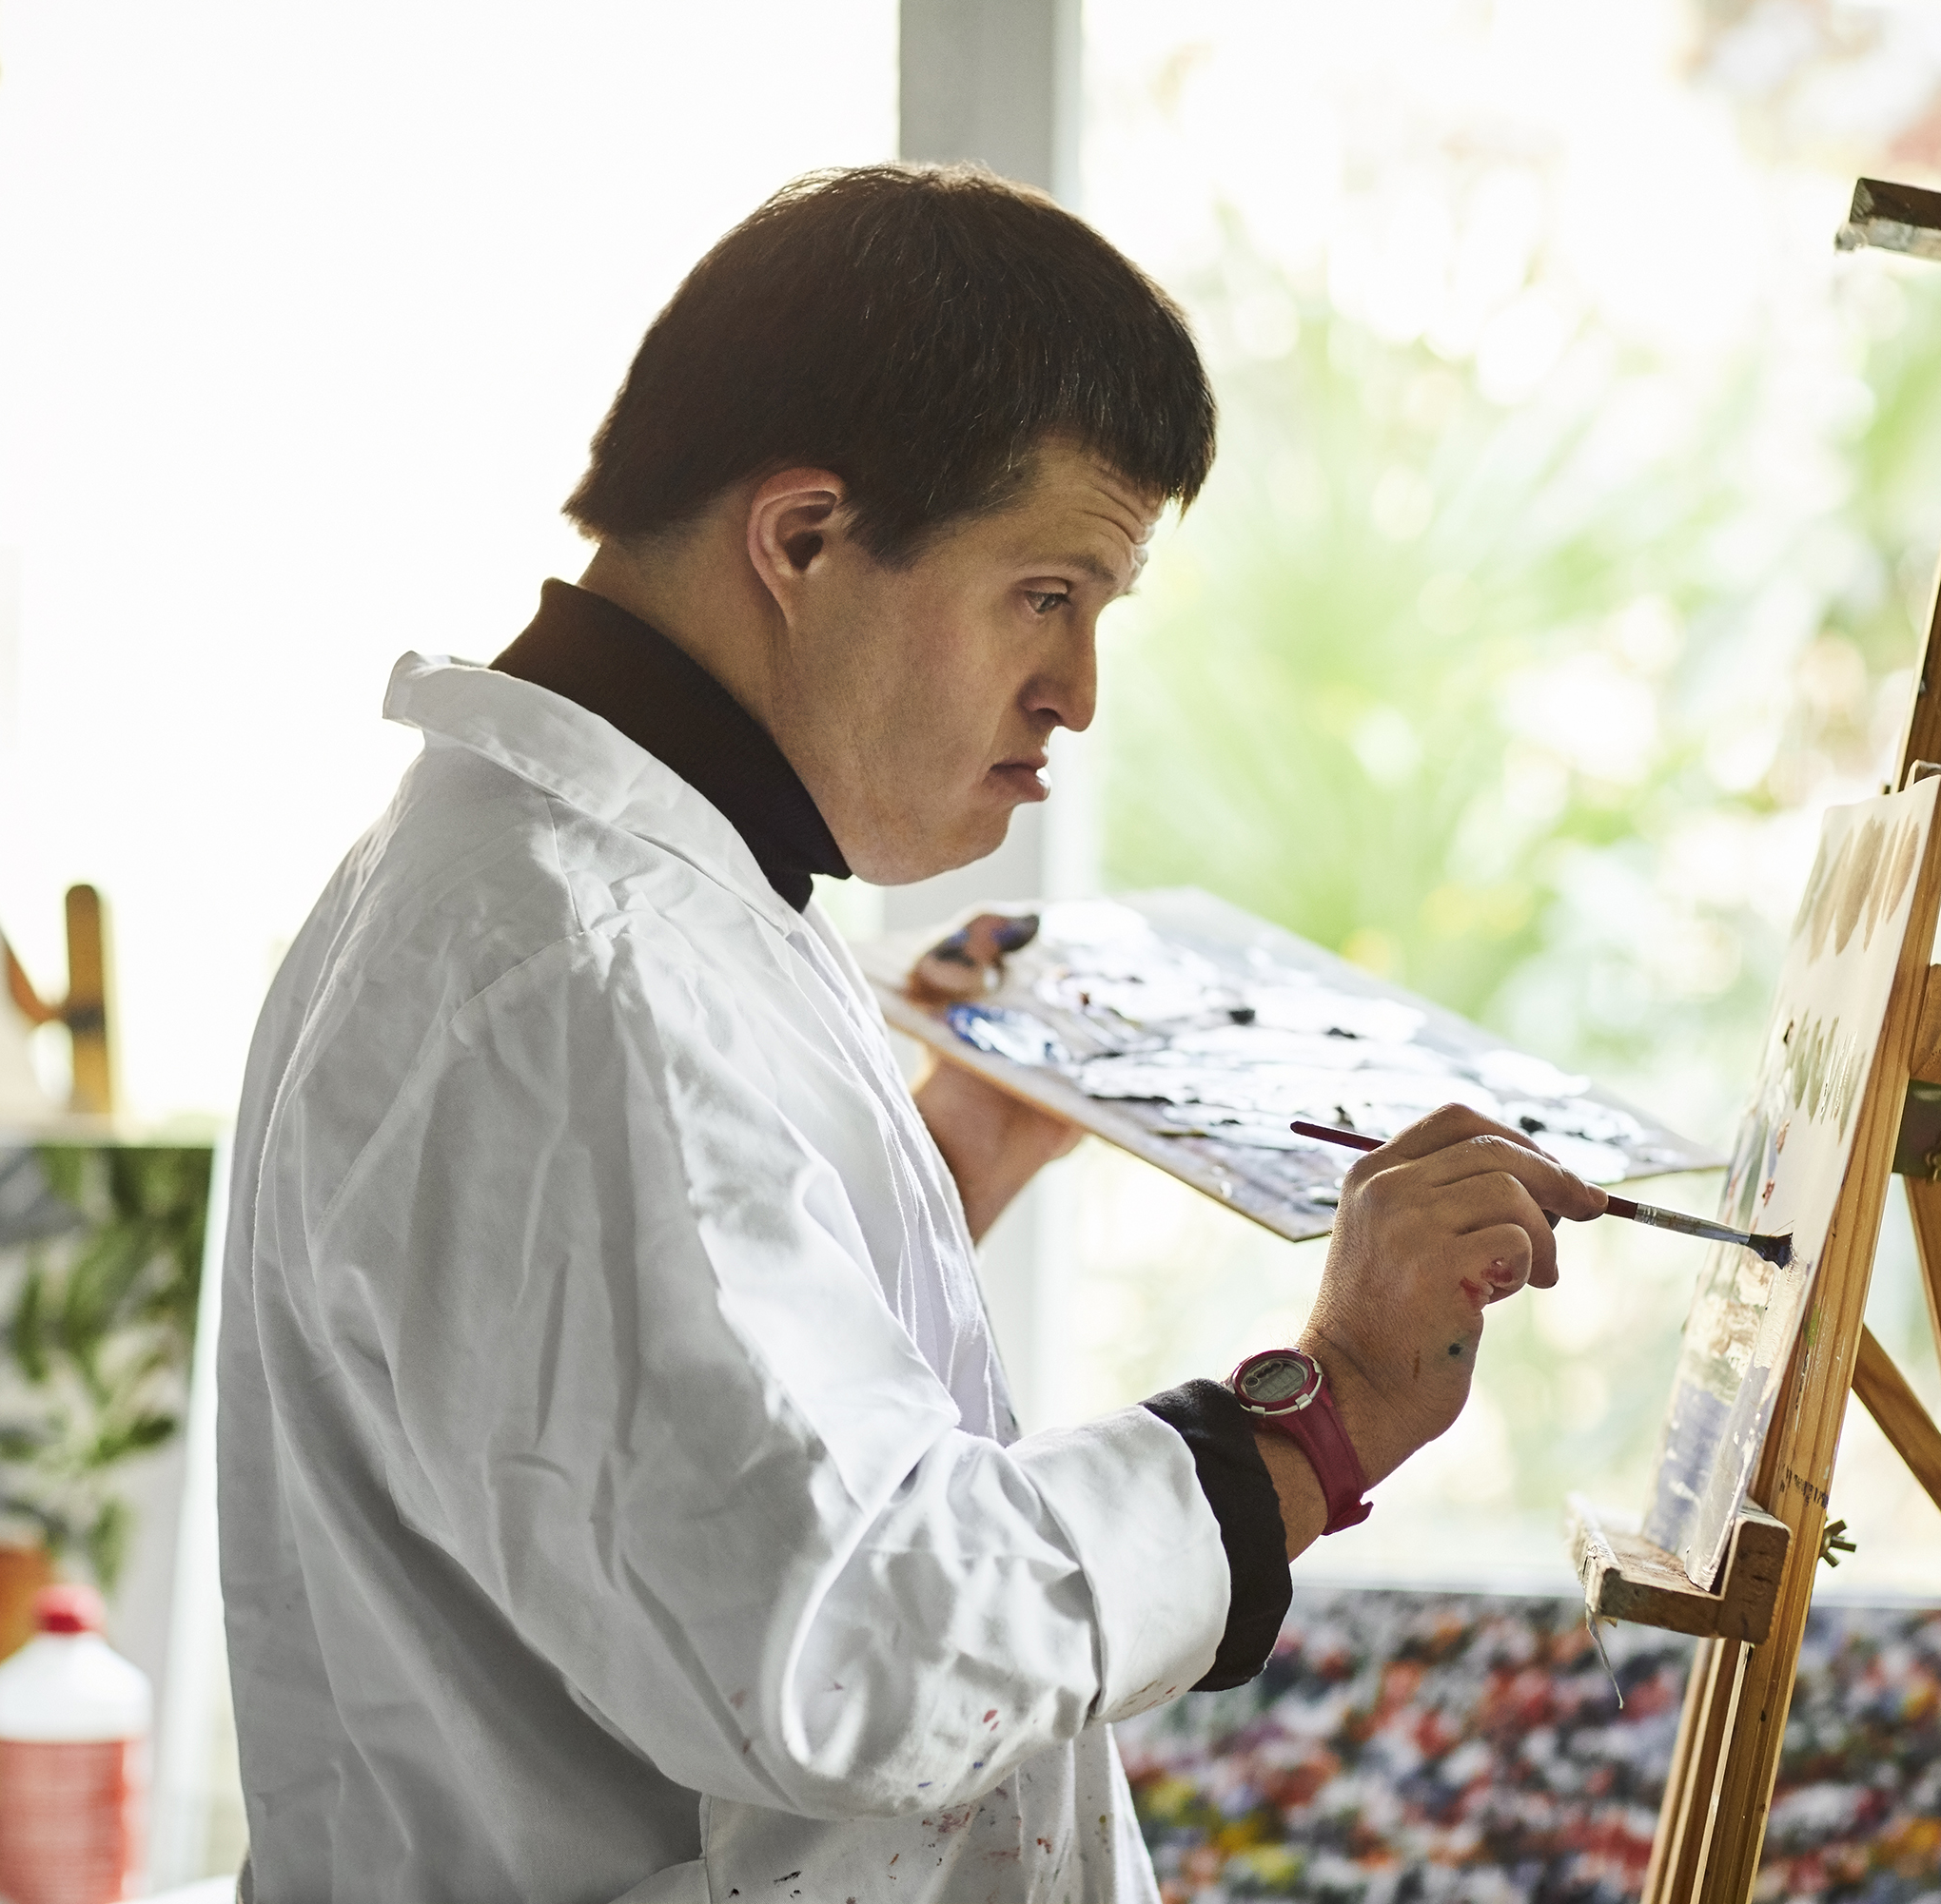
Learning outcomes
To help you understand what social care is all about
To tell you what it's like to work in social care
To encourage you to think about working in social care
www.skillsforcare.org.uk/thinkcarecareers

Slide 3
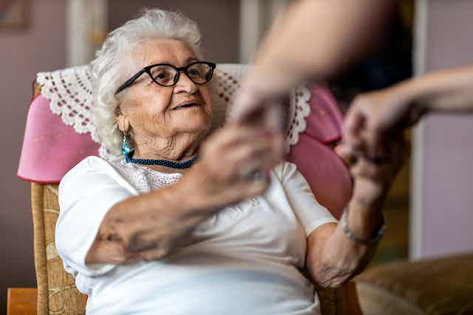
So, what is
social care?
www.skillsforcare.org.uk/thinkcarecareers

Slide 4

Social care is all about providing care and support for people in their home or community.
Social care helps these people to have the best quality of life and be as independent as possible.
www.skillsforcare.org.uk/thinkcarecareers

Slide 5


Let's hear from someone
who works in social care
www.skillsforcare.org.uk/thinkcarecareers

Slide 6
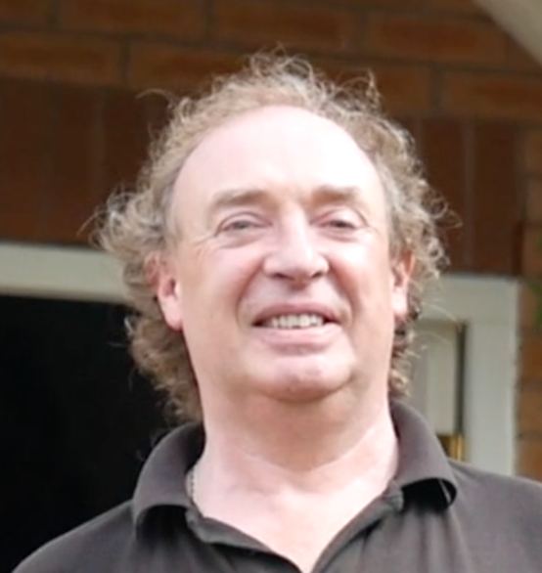

Let's hear from a person
who receives this care
www.skillsforcare.org.uk/thinkcarecareers

Slide 7
There are lots of other jobs too.
Here are some other examples:
Care worker
Mental health worker
Activities worker
Play worker
Social worker
Community support worker
www.skillsforcare.org.uk/thinkcarecareers

Slide 8
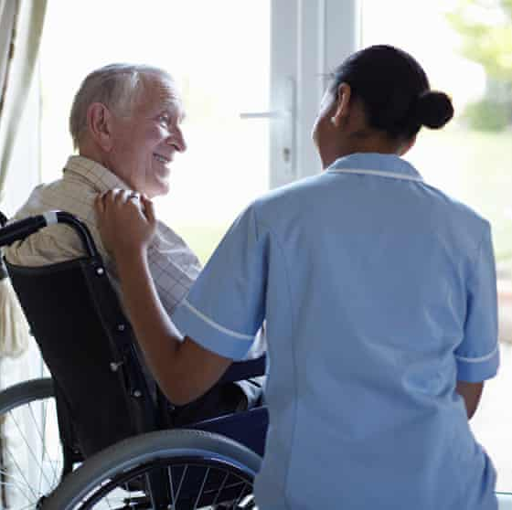
Why do people like working in
Social care?
Work with people
Make a difference
Flexible working
Every day is different
Career progress
Challenging
Rewarding
Part of a team
www.skillsforcare.org.uk/thinkcarecareers

Slide 9

How many people
work in social care
in the UK?
An estimated 1.5 million people
That means (on average) 1 person in every class will work in social care in the future
There will be another 300,000 jobs in social care by 2025
www.skillsforcare.org.uk/thinkcarecareers

Slide 10

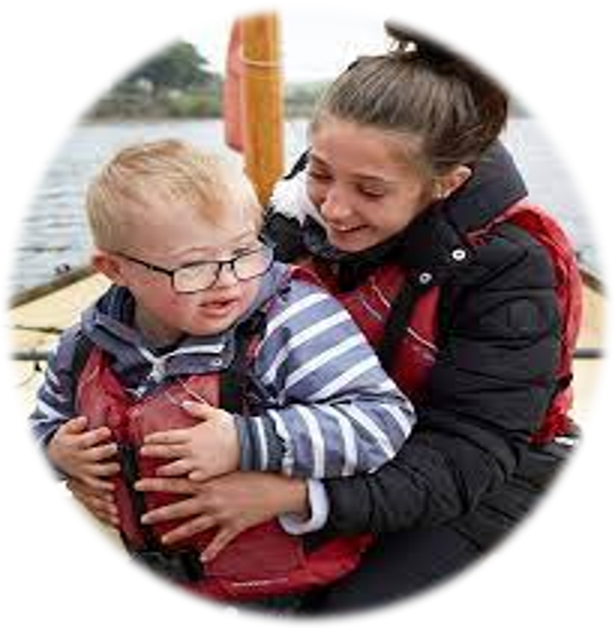
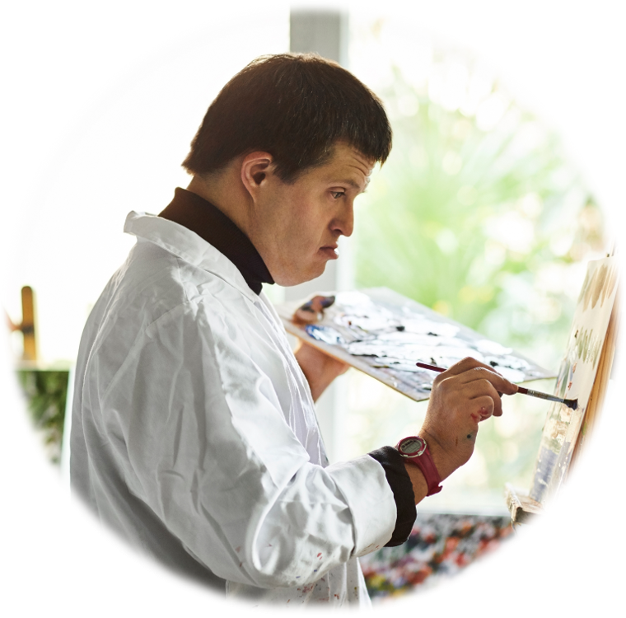

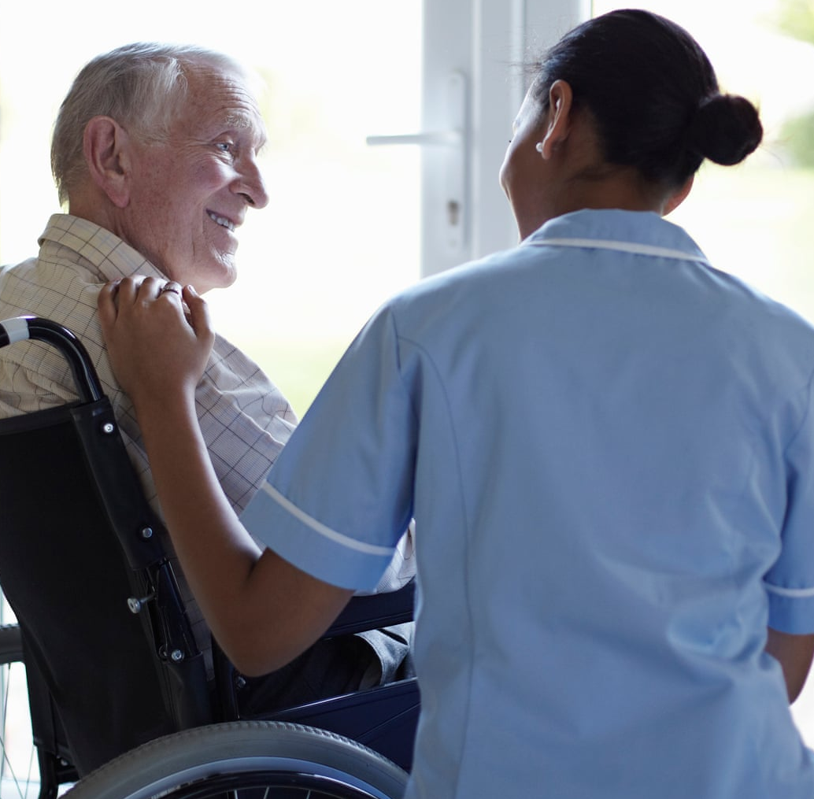
People who work in care look after lots of different people
Teenagers
Children
Young adults
Working adults
Older
people
www.skillsforcare.org.uk/thinkcarecareers

Slide 11


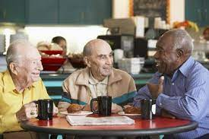
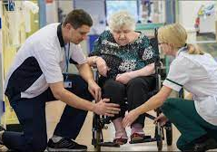

People who work in care work in lots of different places
Private
Home
Care
Home
Day Care
Centre
Rehabilitation
Centre
Community
www.skillsforcare.org.uk/thinkcarecareers

Slide 12
People who work in social care have these values
Able to work with people
Interested in other people
Flexible
Listen to others
Communicate well
Respect others
Willing to learn
Responsible
Understand the needs of others
Calm in difficult situations
Consider other people's feelings
www.skillsforcare.org.uk/thinkcarecareers

Slide 13

You can have a career in
social care
Every year we need more and more people to work in social care
There are lots of different jobs to suit different people
There are lots of opportunities to train and progress – just like other careers such as medicine or law
As you progress you can change where you work and choose to specialise in one area of social care
www.skillsforcare.org.uk/thinkcarecareers

Slide 14
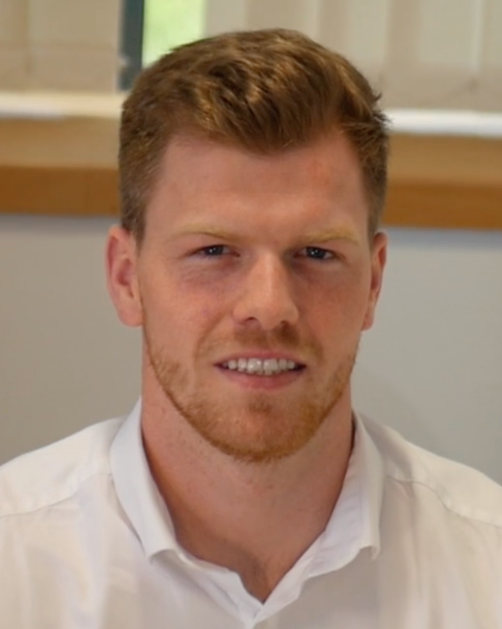
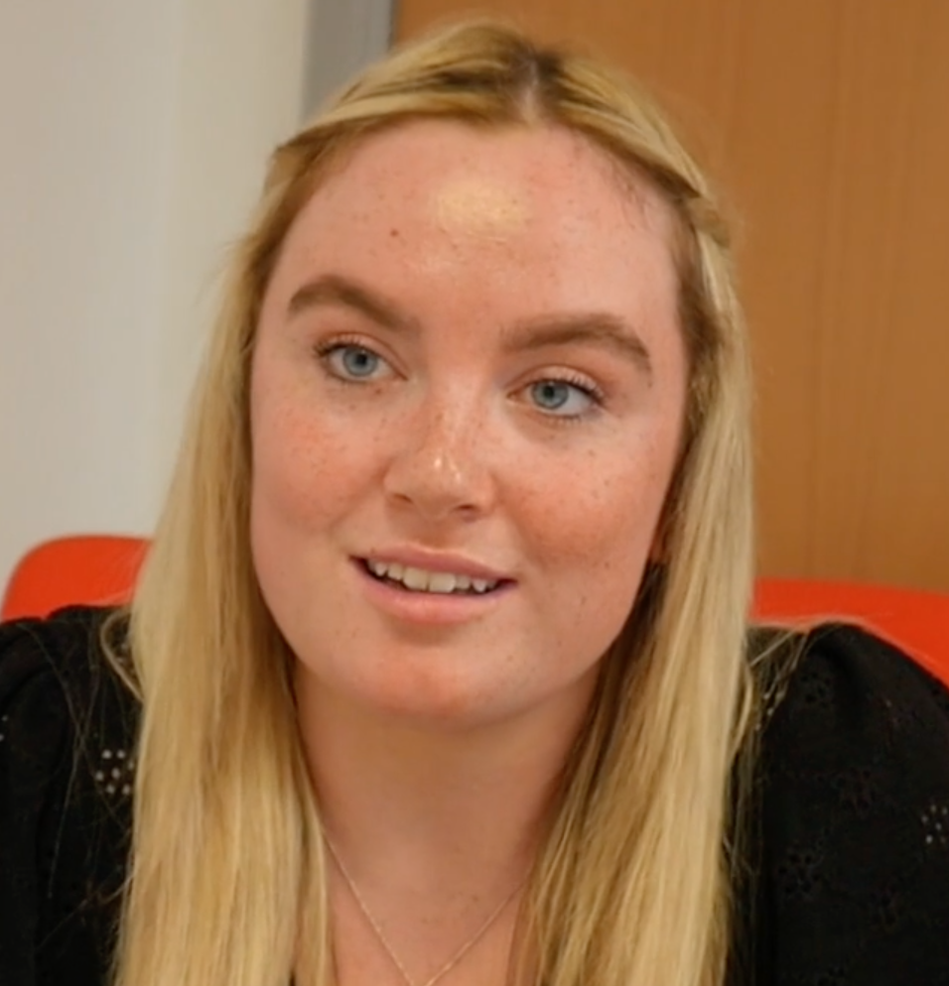


Let's hear from two more
people who care for Martin
www.skillsforcare.org.uk/thinkcarecareers

Slide 15
People who work in social care
really make a difference
www.skillsforcare.org.uk/thinkcarecareers

Slide 16
Can you answer these questions
about social care?
How many people work in social care in the UK?
Can you name three different jobs in social care
Can you name three different types of people you might work with if you had a career in social care
Can you name three different places you might work?
www.skillsforcare.org.uk/thinkcarecareers

