Slide 1
A Workforce Strategy for Adult Social Care in England: A bit of background

Slide 2
Why did the sector develop the strategy?
The workforce makes the most important contribution to the timeliness, quality and effectiveness of the care people receive in England
To address long-term challenges with recruitment, retention, training and our ability to respond to current and future need and demand
To provide a set of proposals that could be owned and acted upon by the whole sector and could be adopted by a new government
In the context of likely challenges to wider reform, addressing the workforce is likely to be the most cost-effective contribution to service improvement

Slide 3
Why did we do it? Social Care in England in 2023-24
Number of employees
1.44 million
Vacancies on
any given day
131,000
Turnover rate
26%
Extra posts needed by 2040
540,000

Slide 4
How did we do it?
Engagement with
people with experience drawing on care and support
workforce and employers
wider sector
Expert working groups
Science, technology, AI and pharmaceuticals, integration, prevention, new service models and multidisciplinary working, recruit and retain, develop and train, leadership
Economic modelling

Slide 5
Who led the development of the strategy?
Strategy created by the sector, for the sector
Oversight Executive Group
Local Government Association
Care Quality Commission
NHS
England
Royal College of Nursing
Social Care Future
Social Work England
UNISON
Notes:
The Oversight Executive Group is responsible for overseeing the successful implementation of the Workforce Strategy. The members are system leaders representing voices from across social care, with responsibility using their role, position and influence to deliver workforce strategy recommendations in the spaces they operate within. Most of the members were part of the Steering Group that developed the strategy. The strategy includes 56 recommendations and commitments under the 3 areas; 1. Attract and retain. ​ 2. Train, and ​ 3. Transform. ​ ​ As guardians of the Strategy, this group meets quarterly to: 1. Govern and oversee successful implementation of the Strategy 2. Responsibility for delivering specific Workforce Strategy recommendations within the parts of the sector they operate in and are connected to 3. Be ambassadors for the Strategy and communicating the Strategy; driving energy, momentum and influence.

Slide 6
What will make the most impact?
1
Focusing on quality of role
2
Training and developing our people
3
Improving organisational culture and leadership

Slide 7
What are the three strategy themes?
Attract and retain
Includes
Action on pay, terms and conditions
10-year attraction plan
International recruitment plan
People Promise
Champions
Wellbeing and equality, diversity and inclusion
Train
Includes
Ensuring and funding high-quality training
Expanding skills through the Care Workforce Pathway
Delegated healthcare
Overhauling apprenticeships
Transform
Includes
Legislative mandate and central body for workforce planning
Digital skills
New roles
Coastal and rural communities
Investigating registration
Regulated Professionals and Registered Managers
Recruiting, retaining and developing more Social Workers, Occupational Therapists and Registered Nurses
Recruiting, retaining and developing Registered Managers
Notes:
The recommendations and commitments are grouped into three themes with a number of recommendations and commitments within each. Regulated professionals and registered managers are recognised as a small but might part of the workforce and have dedicated recommendations and commitments within each theme.

Slide 8
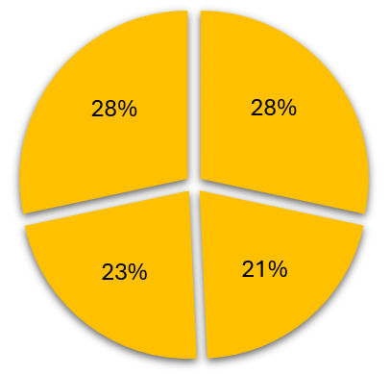
How is the strategy being delivered?
T
Over half of the recommendations and commitments are being implemented by the sector
ti
Commitments from the sector
Recommendations for government alone
Recommendations for government in partnership with others
Recommendations for others
Notes:
Whilst there is so much in the Strategy that the social care sector can – and already is - delivering, there are some things we also need the government to support and do.
This chart shows the break down of the who we think needs to deliver the recommendations and commitments of the strategy between the sector and the government.
Really exciting that just over half of the recommendations are things that systems leaders across social care can make happen – and were already making great progress!
Saying that, the government are still have a role in to 49% of the recommendations – we are keen to collaborate with government to explore these and how we can work together to achieve long-term positive change in social care.

Slide 9
Head to the strategy website for resources and to find out how the recommendations are being delivered
ascworkforcestrategy.co.uk

