Slide 1
Adult Social Care
Workforce Data Set
(ASC-WDS)
Notes:
This presentation is designed for local authorities (or other third parties) to use in conversation with care providers. It gives an overview of the benefits of ASC-WDS and how the data is used across the sector.

Slide 2
The Adult Social Care Workforce Data Set
ASC-WDS is a data collection service, commissioned and funded by the Department of Health and Social Care. It is the leading source of intelligence for the adult social care workforce. It helps you to manage your team and provides crucial information to decision makers.
Notes:
The Adult Social Care Workforce Data Set (ASC-WDS) is a data collection service, commissioned and funded by the Department of Health and Social Care and run by Skills for Care. It is the leading source of intelligence for the adult social care workforce.
It helps providers to manage their teams, can save you thousands of pounds, and also provides crucial information to key decision makers such as Government, DHSC, CQC and local authorities.

Slide 3

Introducing ASC-WDS…

Slide 4



Benefits to your business
Funding for training your staff
Safe and free storage of staff records
Manage training records
Benchmark your workplace
Access the ASC-WDS Benefits Bundle
Notes:
So what are the benefits to having an ASC-WDS account? Well…
You can gain access to funding for training your staff
The system provides safe and free storage of staff records and can help you to manage your training records… it’s effectively a free LMS system.
You can benchmark your workplace against other providers in your area, for metrics like pay or turnover rates.
You’ll also get discounts and special offers in the ASC-WDS Benefits Bundle

Slide 5
Claiming funding for training
The Workforce Development Fund
  Eligible qualifications and apprenticeships
  Started before 31 March 2024 and completed by 31 March 2025
  Claim from Skills for Care
Adult Social Care Learning and Development Support Scheme
  Eligible training courses and qualifications
  Started between 1 April 2024 and 31 March 2025
  Claim from NHS BSA
Both funds
  Will have the same eligibility requirements from ASC-WDS
  Easy to check your data meets requirements using the checker tool inside ASC-WDS
  Adult Social Care Workforce Data Set requirements
Notes:
In 2024/25 ASC-WDS is linked to two different funding sources- The Workforce Development Fund and the Adult Social Care Learning and Development Support Scheme. The webpages linked provide more information about what can be claimed and the process to do so. The key point is that you must have an up to date ASC-WDS account to claim from the funds, and that these funding sources have saved care providers thousands of pounds.

Slide 6
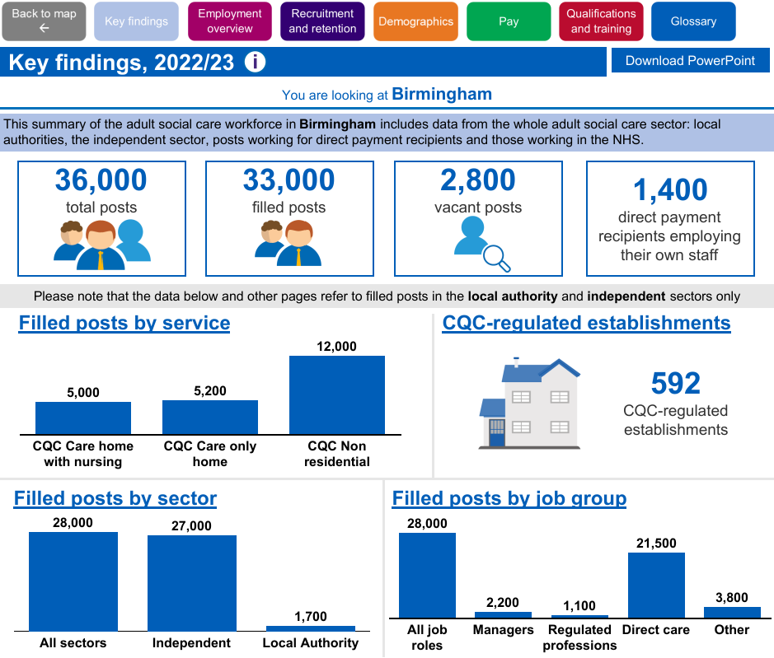
Data example
www.skillsforcare.org.uk/workforceintelligence
Notes:
Here’s an example of some of the workforce data that you can find on the Skills for Care website. You can view information on a national level, regionally, or by local authority or ICS area.

Slide 7
How is the data used nationally?
The Department of Health and Social Care use ASC-WDS to measure the impact of reform.
  Care certificate
  Digital job roles and training
  International recruitment
Increase government’s understanding of the issues faced by the sector, including ad-hoc requests.
By trade associations in their role as advocates for change. E.g. the Sector Pulse Check by Care England and Hft.
Notes:
Here are some great examples of how the data is used on a national level.
DHSC use ASC-WDS to measure the impact of reform.
For example, ASC-WDS asks 'Would you accept a Care Certificate from a worker's previous employer?'. The responses are being used to determine the cost to the social care sector of staff moving between employers and to monitor whether DHSC policies make training more transferable. It is also being used to check the effectiveness of the Care Certificate.
They’ve also asked SfC to look at gathering data on digital job roles and training in the sector & more about international recruitment.
Trade associations use the data in their role as advocates for change. E.g. the Sector Pulse Check by Care England and Hft, which used Skills for Care data extensively and made some strong practical recommendations for government and other stakeholders.

Slide 8
How is the data used locally?
Anonymised ASC-WDS data is used to gain insight on
  the local labour market
  future demand for care services in your areas
  trends and patterns in workforce issues such as turnover and pay rates.
Data can be used to inform workforce planning and help local authorities meet their market shaping responsibilities.
[INSERT YOUR LOCAL EXAMPLES HERE]

Slide 9
How do providers use the data?
One registered manager used their turnover rate data to develop a retention plan for their staff
This included a survey with staff to find out what helped them feel supported in their first few months. They made changes such as bringing in a new in-house trainer and increasing the amount of shadowing new starters do. They are going to use ASC-WDS benchmarks to monitor changes in turnover rate.
Using the Training and Qualification feature to monitor appraisals
One employer had a great idea to use this to audit the dates of supervision and appraisal. You can add 'formal supervision / 1-2-1' as a mandatory field on the staff members record, then put the date when supervision took place and set an expiry date for when the next session is due.
Staying competitive
The benchmarks functionality within the system allows us to compare what our competitors are paying… This also gave us a good starting point when evaluating the rate of pay for apprentices and staff under the age of 19.

Slide 10
Information to register:
Is your service CQC registered?
  If yes - find your workplace using your CQC location ID or postcode
  If no – find your workplace using your postcode
Main service
Employer type
Number of staff
User account details: your name, job title, email address and contact number
User name, password and security question.
Submit your registration
Notes:
Getting set up is really easy, you’ll just need to answer a few questions, then your registration goes to the support team to be approved.
Is your service CQC registered? Yes/no options. Doesn't matter if you are or not, you can still create an account.
Find your workplace using your CQC location ID or the postcode for your workplace.
It will ask you what the main service you provide is.
What is your employer type? Local authority, Private sector, Voluntary, charity, not for profit, other
How many members of staff does your workplace have? The number should include all staff (care-providing and none care-providing, those on permanent or temporary contracts, pool, bank and agency workers). You can enter an estimate at this stage and update once your registration is confirmed.
The service will then ask for your user account details: your name, job title, email address and contact number
Set your user name, password and security question.
Submit your registration which gets checked and validated by the ASC-WDS support team.
They’ll notify you by email when you can log in to your account.

Slide 11

Get started today!
Find out more and create your account at
www.skillsforcare.org.uk/ASCWDS
Or contact the ASC-WDS support team for more information
T. 0113 241 0969
E. ascwds-support@skillsforcare.org.uk.
Notes:
We can’t recommend ASC-WDS enough. It will help you manage your organisation, get you access to funding and will ensure the sector has enough information to make the right decisions.
There is e a dedicated support team there to help out as you get started, and you only need a few basic details about your workplace to get set up.
Head to www.skillsforcare.org.uk/ASCWDS to create your account or find out more.

