Slide 1
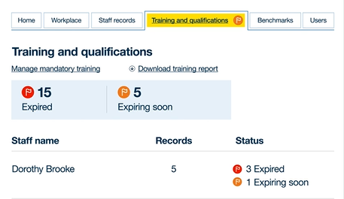
Remember to add this training to your ASC-WDS staff record
The Adult Social Care Workforce Data Set provides a free and simple way to
manage your staff training and qualifications. There are also other benefits, including access to funding for training and discounts from training providers.
Already have an account?
Remember to log this training!
Don’t have an account yet?
Visit www.skillsforcare.org.uk/ASCWDS
to get started
The ASC-WDS support team are on
hand to help.
Call: 0113 241 0969
Email: ascwds-support@skillsforcare.org.uk
Did you know you can bulk upload your training and qualification records?
This makes it quick and easy to update your records when multiple staff complete the same training or a qualification.

