Slide 1
A practical guide to adopting the Care Workforce Pathway
How others are using the Pathway and practical advice from sector peers

Slide 2
Content
 | Page(s)
Background to the guidance in this document | 3 – 6
Section 1: Things to consider before getting started | 7
Guiding principles for adopting the Care Workforce Pathway | 8 - 9
Flexible options for adopting the Care Workforce Pathway | 10
Section 2: The 5-stages to planning for the Care Workforce Pathway | 11
Overview of the 5-stages to adoption | 12
Section 2a: Practical checklist for small organisations | 13 - 14
Section 2b: Practical checklist for medium to large sized organisations | 15 – 20
Appendices | 21
Appendix 1: Detail on what Early Adopters did and how they used the Pathway resources Appendix 2: Feedback from Early Adopters that shaped the guiding principles Appendix 3: Suggested example activities to adopt the Pathway | 22 – 25
Purpose of this guide
Every care organisation is different. This guide shows you how you can adapt the pathway to meet your organisation’s needs.
It contains the following:
background to the guidance in this document
practical steps and options to consider in planning your Pathway adoption
The document references a numbers of toolkits and templates which can be found on the Skills for Care website

Slide 3
Background to the practical advice
in this document
This document is built on insights from 30 diverse social care organisations, including care homes and domiciliary care with a range of specialisms. They are known as the Early Adopters and have worked with us to test the care pathway over a period of 10 months. This document contains their lessons learned and practical advice, acting as a supportive guide for enhancing recruitment, retention, and career development strategies.
Most of these organisations have started to use the Pathway and have shared their advice with the sector in this document. As part of this process, additional resources have been developed with the help of these organisations, which can be found on the Skills for Care website. You’ll find names of the Pathway resources in this pack in blue text which can be found on the Skills for Care website.
If you’re thinking about adopting the Pathway, consider these suggestions to help you get started. You may feel there are additional activities needed or decide not all steps in this document are necessary. The document has been created to be as flexible as possible. Additionally, you may want to focus on short-term alignment for now, and plan for greater integration over time. It’s up to you.
The pathway is designed to support recruitment, retention, and career development in the adult social care sector. It is not mandated.

Slide 4




























A number of organisations have
already started their journey

Slide 5





How they began adopting the Pathway - and what support is available for you to do the same
2. They mapped existing people policies and job descriptions against the Pathway
3. They learned how to improve recruitment and retention
1. They planned their Pathway adoption activities
Using the Pathway mapping template to highlight the similarities and gaps to then decide on steps to take to align with the Pathway, and formalise responsibilities.
Through applying Strengths-based approaches to create refreshed job adverts and interviews that attract people based on their natural strengths.
Watch the Using Strengths-based approach for recruitment, retention and performance video
Using a pre-populated project plan template called the Pathway adoption plan template which helped them to project manage adoption and track their progress
Plan to attract, recruit and retain the right people
1. Managers learned about their strengths and motivations to begin with
1. Staff worked with their managers to assess their skills against the pathway
They used the Strengths Match™ Workbook to reflect on their strengths and how to help teams to identify theirs.
They also watched the two accompanying Strengths video to learn how to practically help teams play to their strengths
  Workshop one: Playing to my strengths
  Workshop two: Helping my team play to their strengths
They used the Pathway skills assessment to help them understand the skills, knowledge and behaviours they were strong in and where they’d like to develop further.
They used the Pathway Skills Assessment and reviewed self-assessment with their line manager.
2. They reflected on their career goals and development to then discuss this with their line manager
Turning jobs into careers for all staff
upskill line managers on helping teams with career goals
2. They also learned how to help staff set career goals using coaching skills
3. Working with line reports to assess skills and plan meaningful development
They watched two learning videos on setting goals with teams and communicating effectively with teams
  Setting goals – starting with the end in mind and effective communications
  Understanding different leadership styles and having great conversations
  Having career conversations toolkit
Using the Career Development Plan template to capture their career goal and actions to achieve this, working with their line manager.
Staff own their career plan and meet, as agreed, with the manager to review progress and make changes to the plan if needed.
They have been using the Pathway skills self-assessment to discuss levels of competency
They used the Career Development Plan template to capture goals and actions, and check-in on progress either during supervision or quarterly
Note: The resources mentioned on this slide are available on the Skills for Care website.
Some of the detail on how Early Adopters put these into action is in appendix 1

Slide 6
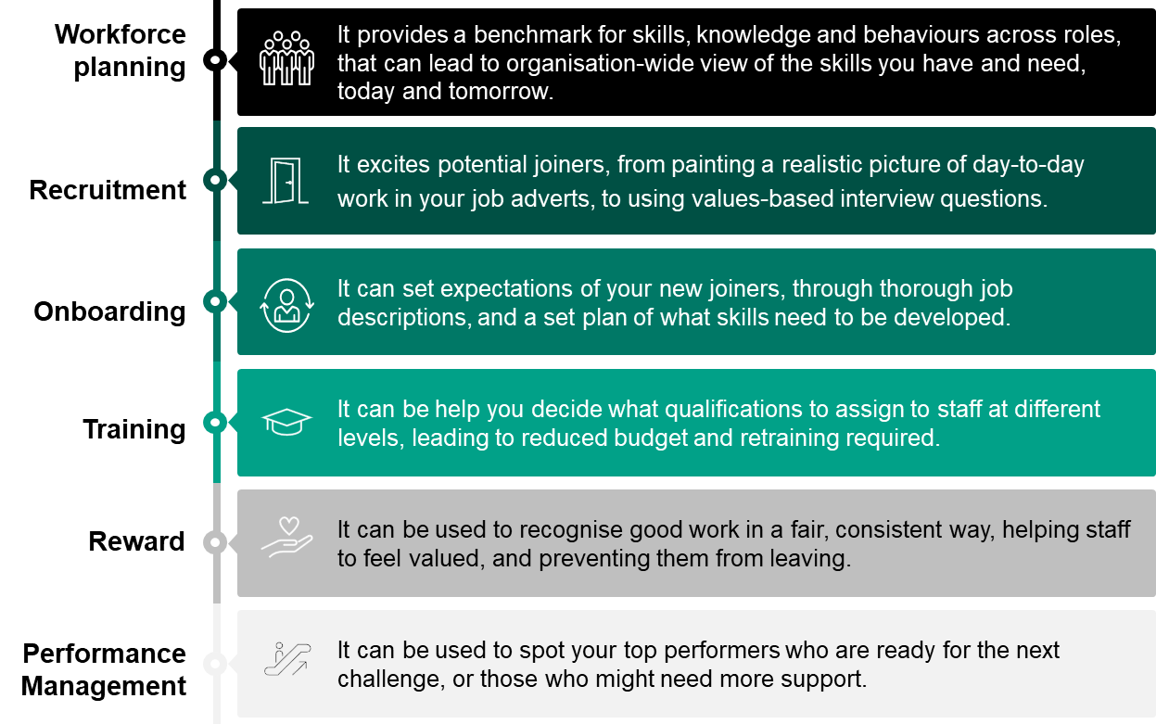
Discover how the Pathway can
support with recruitment and retention
We know that implementing something new can feel daunting or hard to prioritise when everyone is busy, we have worked to make this process as clear and structured as possible. The discussions with some Early Adopters informed us that they also felt apprehensive at first, but having piloted the Pathway to test the benefits and impact internally, they have shared the following insights from using the Pathway:
“The Care Workforce Pathway brings a much needed and valuable opportunity to professionalise the sector and recognise the work our colleagues do.” Mencap
“This clarity will attract talented individuals who are looking for a well-defined and rewarding career in social care, and it will support our commitment to professional development and excellence.” Avenues Group
“It has meant an individual otherwise thinking of leaving the sector, felt happier knowing they have in-role opportunities and a future in social care.” Glassmoon Services Ltd

Slide 7
Section 1:
Pathway adoption

Slide 8
The Pathway adoption
guiding principles
The Pathway adoption guiding principles are a set of signposts of things to consider for successful adoption
Guiding principles to think about for adopting the Pathway
1. Remember the Pathway is a flexible framework for organisations to adopt This can range from adopting some aspects (light touch) to wholesale adoption (full adoption). The critical thing is that your organisation feels the areas of the Pathway you are adopting will address your workforce challenges, e.g. improve recruitment / retention, standardise skills, knowledge and behaviours internally, succession planning for progression or future skills.
2. Be clear on your workforce challenge and the impact you want to create internally, and for the sector The aim for the Pathway is to improve recruitment and retention overtime, and to help people feel valued and see a future in adult social care as a profession. Be clear on the specific workforce challenge you’re looking to address to help you monitor how the Pathway is helping to overcome these. Example of workforce challenges include, improving your recruitment pipeline, or improving development opportunities for increased staff retention, or addressing the skills gap by role to align with Pathway etc.
3. The team leading your Pathway adoption could be from HR, Operations or Learning and Development departments It all depends on how your organisation is structured to oversee the responsibility of managing recruitment, performance, people processes/polices etc as part of the day to day running of your organisation. Agree which team is best to lead and how everyone can ensure the Pathway is adopted.

Slide 9
The Pathway adoption
guiding principles
Guiding principles to think about for adopting the Pathway
4. Collaborate with key departments and create a working group of line managers and employees Involve critical teams who can support decision making, update relevant policies/systems etc, and help to guide you how best to align in a way that works for the organisation too. You may include teams such as, Learning and Development, Health & Safety, Assurance teams, alongside your leadership team. Managers and employees are your Pathway consumers and it’s critical they feel the Pathway is bringing value to their career aspirations and development. By including them every step of the way, they feel part of something greater, and this will create a sense of excitement and belonging.
5. Use the Pathway to help you create links to the wider elements of workforce reform opportunities and support available for your organisation. The Pathway will help you to identify early on the demand for training and qualifications by your staff, whether that’s new Level 2 Adult Social Care Certificate, OMMT, Digital Skills, or leadership development etc, along with the funding routes available for you, such as the Learning and Development Support Scheme.
6. Give people time and capacity to help with adopting the Pathway This includes time to complete your pilot activities right through to managers conducting career conversations with their team on an ongoing basis. Help managers create a connection with the team by supporting their career goals. The duration for adopting the Pathway will differ from organisation to organisation. For some it’s a programme of work that can take between 12- 18 months. Plan your activity of work accordingly.

Slide 10
The Pathway is a national
workforce framework
The Care Workforce Pathway is a national workforce framework that can be adopted to meet your workforce needs. To help you decide on the best approach for your organisation, you could pilot the Pathway to help you gain insights to then decide the extent of Pathway adoption best suited for your organisation’s workforce needs.
Each adoption level builds on the previous one. Example of activities by adoption type (light, medium, full) can be in the appendix 3. The Pathway is for all adult social care organisations, regardless of size and services provided.
 | 1. Light adoption | 2. Medium adoption | 3. Full adoption
What the level of adoption could mean for your organisation | You’re likely to be updating relevant people documents, such as job descriptions, to align with the Pathway | You’re then making changes to existing people processes, such as performance reviews, to include the Pathway | Here you’re likely to be transforming aspects of your operating model as part of wider strategic change and will integrate the Pathway on new people structures, talent management, pay and reward, etc
Some examples benefits the adoption can bring to your organisation | Standardised the role descriptions for staff in official documentations | Improved engagement with staff seeing a career in adult social care | Pathway is embedded in the organisation supported by a culture that recruits and retains staff
Choose the approach that best suits your workforce and organisational needs. This will vary across organisation, as for example small sized care providers will not have capacity for a dedicated team or standard HR infrastructure to adopt the Pathway.
The Early Adopters started by conducting a small pilot to test the Pathway. As a result, most organisations have begun with light adoption which includes some medium adoption activities such as updating job adverts and creating a network of internal career coaches.

Slide 11
Section 2:
The 5 stages to planning for the
Care Workforce Pathway
Overview and practical checklist for small, medium and large adult care organisations

Slide 12
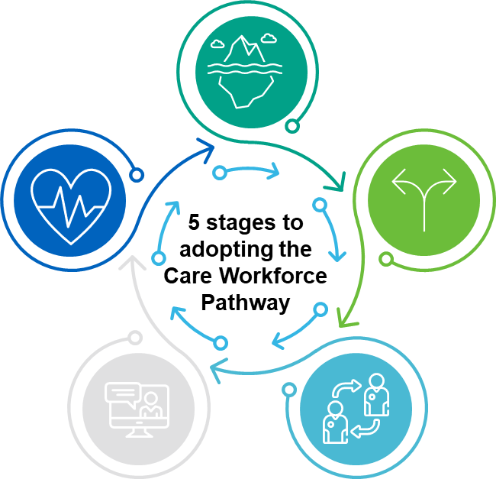
The 5 stages to plan for
Pathway adoption
Whether you've decided to adopt the Pathway or not, there should be effective decision making that involves key internal stakeholders along with a process to guide you to achieving your Pathway goals. Pages 12-19 provide further information on each of the 5 stages, below, setting out suggested activities to ensure that locally, the Pathway has a structured approach, much like any project delivery, to progress from deciding to implementing the Pathway.
1. Identify workforce challenge and decision needed
Understand the benefits of the Care Pathway
Know the workforce challenge and options
Collect baseline data you need to inform your decision to engage with the Pathway
5. Monitor and embed the Pathway
Continuous learning on using the Pathway
Integrate the Pathway with standard processes, policies etc
2. Governance and decision making
Inform and work with your leaders
Set up internal governance for the Pathway
“Do we want to proceed with a pilot to test if our workforce challenge can be addressed?”
4. Adopting the Pathway
Plan, set up and deliver the Pathway project
3. Deliver and learn from the Pathway pilot
Agree scope and timings
Conduct exercises and gain insights
How much of the Pathway do you want to adopt?
“Do we want to proceed with adopting the pathway? What does this look like for us?”

Slide 13
Section 2a:
Checklist for small sized organisations
(Less than 20 staff)

Slide 14





A practical checklist for small organisations with less than 20 staff
Stage | Suggestions to consider for Pathway adoption | Complete?
Identify your workforce challenge and decision needed | Speak to your staff to understand what’s working well or not so well in terms of their career experience and development. Use the insights to consider any enhancements in areas such as how your recruit and retain, manage and develop your people, and overall employee engagement.
Governance and decision making | Consider who needs to be involved in the process of adopting the Pathway – will you make all the decisions and tell your staff, or will you consult them through the process?
Deliver and learn from the Pathway pilot | Consider if or how you’d like to test the Pathway through a pilot. You could complete the Pathway mapping template and/or ask 2-3 of your staff to pilot using the Pathway’s skills self-assessment, having a career conversation with them, and completing the career development plan. Ask for their feedback and see what was most useful that you’d like to take forward. (See the Skills for Care website for templates).
Adopting the Pathway | When you’ve decided how you’d like to adopt the Pathway, start planning for this with the appropriate resource, time, and budget.
Monitor and embed the Pathway | Check-in with your managers and staff to understand the impact Pathway is having on their career development and experience of being in the care sector. Consider how these are improving the workforce challenge you initially identified, i.e reduce staff attrition, increase development etc. If relevant, publish your Pathway success stories on your website and internal communication channels.

Slide 15
Section 2b:
Checklist for medium to large sized organisation

Slide 16

1. Identify the workforce challenges
 | Suggestions for organisations to have in place | Tips | Complete?
1 | Pathway benefits and organisation goals: There is clarity on the intent and benefits of the Pathway for your organisation, and these align with your goals for workforce or talent management strategy | Refer to the Skills for Care website for information on the Pathway benefits, Pathway stories from the sector etc. Share these with your leadership teams and organisation.
2 | Baseline employee data: Understand the current employee data you have, such as: Reasons why people leave or were retained – anecdotal information and/or exit interviews Insights from your employee surveys on development and progression opportunities Recruitment gaps and pipeline In-role development opportunities: No. of qualified employees Promotion opportunities: planned vs actual Frequency of supervisions across the year Feedback on performance management process | By considering your current workforce challenges through this data, this will allow you to use the Pathway in a targeted area, and focus on specific ways of adopting.
3 | Considered the investment needed to adopt the Pathway: The potential costs have been weighed against the expected benefits, as a result of adopting the Pathway, through a cost/benefit analysis. | Your cost/benefit analysis could cover: Costs of resources, suggested qualifications, implementation costs etc Benefits: workforce development opportunities, retention rates, organisation reputation Alignment with organisation goals: strategic fit, competitive advantage Market trends: future workforce and skills needed, understanding how similar organisations are benefiting from Pathway
4 | Early thoughts on decision needed and the options available to you: Having reviewed the above, consider if other options may exist to address workforce challenge, along with the Pathway or as the alternative for your organisation | Test your thinking and recommendation(s) with those outside your team, in case they can bring further insight. This can be Team leaders / Leads so you get a business perspective too.

Slide 17

2. Pathway governance and
decision making
 | Suggestions for organisations to have in place | Tips | Complete?
5 | Pathway governance and process in place: Pathway governance and process is in place: Standard project management set up i.e., risk/issues logged and managed and escalation route is clear if there are problems Actions and decisions are stored somewhere for team to access Regular team meeting is booked in to support Pathway pilot and adoption | Spend time to set up Pathway governance internally for the Pathway to integrate successfully with a dedicated governance body to oversee the work.
6 | Pathway leadership identified: HR, Operations and senior stakeholders can collaborate and set aside time for discussing and delivering the Pathway. An individual is elected to be the central lead or point of contact for Pathway adoption. | The leadership role should ensure work on the Pathway aligns with organisation goals; they communicate the change and foster culture of engagement among employees for continuous feedback; and role model development aligned with Pathway.
7 | Pathway team identified and check availability: The structure you have in place to make decisions related to Pathway adoption ensures member(s) of your team have enough capacity to support. | At minimum, depending on organisation, a core Pathway team may include 1 x HR lead, 1 x L&D, 1 day per week. Ensure the team supporting Pathway have dedicated time. This will vary by organisation. Use the online Pathway resources to guide and plan your activities for piloting and rolling out the Pathway.
8 | Estimating time needed to adopt Pathway: The duration can vary depending on size of organisation and commitment to introducing the Pathway | The Pathway testing programme highlighted at least 12 weeks a needed to pilot the Pathway, specifically for when piloting with line managers and teams. Use the online Pathway resources to guide and plan your activities for piloting and implementing the Pathway.
Decision point:
Do we want to pilot the Pathway or plan for actual adoption?
Yes: use the Pathway Adoption Planner template to create your plan
No: are there areas you can re-consider to make it feasible to pilot?

Slide 18

3. Deliver and learn from the
Pathway pilot
 | Suggestions for organisations to have in place | Tips | Complete?
9 | Agree scope, timings and plan your pilot: Ensure a plan is in place with clear tasks, deadlines and owners, and the plan has been shared with key people. This will include scope of pilot, duration and areas you want to draw insights on. | Use the template Pathway Adoption Planner template and regularly review and report against it to your Pathway governance team.
10 | Pilot to identify gaps and alignment with your People policies, processes, systems etc and the Pathway: Conduct the mapping activities against the planned areas (job descriptions, career framework, L& policy etc). The Pathway Mapping template Review of identified gaps taken place with relevant teams/departments, and actions have been agreed whether to align with Pathway or not. Pathway alignment might look like: Formalising a role-based knowledge or skill in documents (to clarify role expectations that you already knew existed, but were not documented) Sourcing a new knowledge and/or skill, that needs to be part of the eligibility criteria for new staff, or taught to current incumbents. | Remember the workforce challenge you’re trying to solve by adopting the Pathway – i.e., will updating your paperwork or how you source training be enough to address your workforce challenge? Refer to the Pathway personas to see where your staff are likely to fit. Consider involving someone currently the equivalent role to support with a mapping exercise, as their lived experience will highlight the opportunities and realities for aligning.

Slide 19
4. Rolling out the Pathway to the organisation
When your pilot is complete, consider the following:
Do we want to proceed with adopting the pathway?
What does this look like for us? (e.g light, medium or full adoption?)
Yes: consider using the Pathway Adoption Planner template to structure your activities for adoption
No: consider if there is an opportunity to adopt aspects of the Pathway that demonstrated benefits during your pilot.
 | Suggestions for organisations to have in place | Tips | Complete?
11 | Agree scope, timings and plan for the Pathway adoption: Much like with the pilot, ensure a plan is in place with clear tasks, deadlines and owners, and the plan has been shared with key people. This will include scope of your adoption, planned duration for the implementation and monitoring impact overtime. | Use the template Pathway Adoption Planner template and regularly review and report against it to your Pathway governance team.

Slide 20
Appendices

Slide 21

5. Monitor and embed the Pathway
 | Suggestions for organisations to have in place | Tips | Complete?
12 | Agree scope, timings and plan for implementing the Pathway: Ensure a plan is in place with clear tasks, deadlines and owners, and the plan has been shared with key people. This will include scope, duration and areas you want to draw insights on. | Use the template Pathway Adoption Planner template and regularly review and report against it to your Pathway governance team.
13 | Monitoring Pathway implementation and evaluating impact: Pathway performance metrics and baseline employee data are place aligned to the workforce challenge initially set out, that can be tracked during and post-Pathway implementation The Pathway governance is maintained as a separate. However, the project often meets with a wider range of stakeholders, such as Team Leaders, or Heads of Departments etc, to discuss progress and for their feedback. | Ensure the employee data set is monitored and organisation goals are being realised. If not, consider actions needed to address improvements through your Pathway governance Consider holding quarterly review meetings to discuss progress and address any issues
14 | Continue telling your stakeholders about the Pathway: Learnings from Pathway implementation is continuous with positive impacts communicated to everyone and where there are areas for improvements these have assigned actions in place | Consider how Pathway adoption can be used as evidence for Workforce Development in your CQC ratings. You may want to promote your alignment to the Pathway with your external stakeholders
15 | Ongoing Pathway compliance and assurance: Post-implementation there is governance with regular reviews of the People policies, processes etc to ensure Pathway alignment is maintained | The regular reviews could be quarterly or bi-annual. It is for the organisation to decide.

Slide 22
Appendix 1: detailed overview on what Early Adopters did to gain insights on the Pathway in their organisational context
Using the Pathway as a mapping exercise to identify any gaps in documents / people processes. For example, job descriptions and learning and development policies | Piloting the Pathway with a group of line managers and line reports to gain insights how it can support meaningful career development and change perception of having career in adult social care for staff
Early Adopters mapped their current job descriptions and/or other documents against the Pathway values and each role description. They used the Pathway Mapping Template to apply a RAG (Red, Amber, Green) rating against the role description. This helped them identify shortfalls and begin planning for alignment with the core set of skills, knowledge, behaviours and training in the Pathway. It also led to internal departmental collaboration for consensus-based decision making with teams such as L&D, health, safety and assurance, operations etc. So that everyone owned the decisions and changes. | Early Adopters selected a pilot group of around 12 pairs of staff and their managers. They completed a pre and post pilot survey to gauge their initial perceptions of a career in adult social care. The pilot involved three tasks: Staff completed a Pathway skills assessment equivalent to their role, some did this as a joint exercise with the line manager – which is recommended. They then discussed their skills assessment gaps, strengths and areas they want to develop during a career conversation with the line manager. Actions and plans to address these gaps were formalised in a Career Development Plan, to be reviewed regularly. Then a post pilot survey was conducted to track changes in career perceptions and gather feedback on the Pathway, toolkits, and templates.

Slide 23
Appendix 2: Feedback from the Early Adopters
that informed the guiding principles
Feedback on using the Pathway by the 30 Early Adopter organisations |  | Guiding principles to think about for adopting the Pathway
Early Adopters felt the sector needed clarity on how much of the Pathway was expected to be adopted |  | 1. Remember the Pathway is a flexible framework for organisations to adopt This can range from adopting some aspects (light touch) to wholesale adoption (full adoption). The critical thing is that your organisation feels the areas of the Pathway you are adopting will address your workforce challenges, e.g. improve recruitment / retention, standardise skills, knowledge and behaviours internally, succession planning for progression or future skills.
Early Adopters found piloting the Pathway helped clarify the benefits it can bring for addressing their specific workforce challenges and align this with their organisational goals and budget accordingly |  | 2. Be clear on your workforce challenge and the impact you want to create internally, and for the sector The aim for the Pathway is to improve recruitment and retention overtime, and to help people feel valued and see a future in adult social care as a profession. Be clear on the specific workforce challenge you’re looking to address to help you monitor how the Pathway is helping to overcome these. Example of workforce challenges include, improving your recruitment pipeline, or improving development opportunities for increased staff retention, or addressing the skills gap by role to align with Pathway etc…
The points of contact from the Early Adopter organisations had different roles and remits, but ultimately were responsible for managing people policies/processes, such as recruitment, development etc or overseeing the operations of service delivery which includes people management. |  | 3. The team leading your Pathway adoption could be from HR, Operations or Learning and Development departments It all depends on how your organisation is structured to oversee the responsibility of managing recruitment, performance, people processes/polices etc. Agree which team is best to lead and how everyone can ensure the Pathway is adopted.

Slide 24
Appendix 2: Feedback from the Early Adopters
that informed the guiding principles
Feedback on using the Pathway by the 30 Early Adopter organisations |  | Guiding principles to think about for adopting the Pathway
Early Adopters reported the importance of including other departments on decision making, if their area of responsibility is impacted too. Along with line managers and line reports to pilot the practical use of the Pathway for increased adoption success. |  | 4. Collaborate with key departments and create a working group of line managers and employees Involve critical teams who can support decision making, update relevant policies/systems etc, and help to guide you how best to align in a way that works for the organisation too. You may include teams such as, Learning and Development, Health & Safety, Assurance teams, alongside your leadership team. Managers and employees are your Pathway consumers and it’s critical they feel the Pathway is bringing value to their career aspirations and development. By including them every step of the way, they feel part of something greater, and this will create a sense of excitement and belonging.
The Early Adopters found that the Pathway also helped them plan for broader workforce development opportunities. For example, they could anticipate the uptake on Level 2 qualifications, Oliver McGowan Mandatory Training, and identify the necessary funding routes to be accessed. |  | 5. Use the Pathway to help you create links to the wider elements of workforce reform opportunities and support available for your organisation. The Pathway will help you to identify early on the demand signals for qualifications by your staff, whether that’s Level 2, OMMT, Digital Skills, leadership development etc, and the funding routes available for you, such as the Learning and Development Support Scheme.
Early Adopters were testing and piloting the Pathway with no protected time. |  | 6. Give people time and capacity to facilitate adoption of the Pathway This can include time to complete pilot activities, to deliver the Pathway as a project team or even to conduct career conversations with their team on an ongoing basis. Help managers create a connection with their teams through supporting careers.

Slide 25
Appendix 3: Examples of adoption
activities by adoption type
 | 1. Light adoption | 2. Medium adoption | 3. Full adoption
What the level of adoption could mean for your organisation | You’re likely to be updating relevant people documents, such as job descriptions, to align with the Pathway | You’re then making changes to existing people processes, such as performance reviews, to include the Pathway | Here you’re likely to be transforming aspects of your operating model as part of wider strategic change and will integrate the Pathway on new people structures, talent management, pay and reward, etc
Some examples benefits the adoption can bring to your organisation | Standardised the role descriptions for staff in official documentations | Improved engagement with staff seeing a career in adult social care | Pathway is embedded in the organisation supported by a culture that recruits and retains staff
Suggested example of activities you could be doing under each level of adoption. Refer to the Pathway Adoption Plan for other suggested activities too. | Update job descriptions to align with some or all the role categories’ knowledge, skills and behaviours | Incorporate Pathway into recruitment process, such as job adverts, to structure interviews etc | Redesign organisational structure to align with Pathway roles A - F, such as job structure, standard progression route etc
 | Use Pathway guides/toolkits to include in existing career guidance | Integrate Pathway into performance reviews and supervision to ensure career development is constant | Pathway incorporated into strategic workforce and succession planning i.e. budgeting, skills uplift, strategy for future skills needs, recruitment, accessing Learning and Development Support Scheme etc
 | Update relevant people policies or manuals to align with aspects of Pathway | Learning and development is partially aligned with Pathway and continued professional development conversations are the norm | Full alignment with Pathway learning and development, i.e. Level 2 Care Certificate qualification
 |  | Staff communications to promote Pathway and to encourage career conversations, goal setting and plans | HR systems updated to align with Pathway
 |  |  | Culture of continuous learning and development with employees encouraged to own career goals and development opportunities

