Slide 1

Culturally Appropriate
Care
Part 2: Supporting individuals from ethnic minority groups and backgrounds​
ESCC Adult Social Care Training Team 2022

Slide 2
NOTE: This is part 2 of 3 training sessions.
Aim: To know about culturally appropriate care, focusing on supporting individuals from ethnic minority groups and backgrounds.
Outcomes: By the end of this session you will;
have an overview of the Equality Act and protected characteristics.​
know the difference between direct and indirect discrimination.​
understand how the Covid-19 pandemic may impact culturally appropriate care​
have an awareness of the possible impact of having dementia and/or a learning disability if you are from an ethnic minority group.​
considered ways you can learn more about the person you are supporting.​
Have a broader understanding of how to relate and to work more effectively with people from diverse cultures.

Slide 3
Domestics
Refreshments
Comfort breaks (including location of toilets)
Smoking
Fire procedures
Mobile phones
Ground rules
For Online Learning
Online instructions such as cameras, microphones, use of messaging box, etc
Introductions

Slide 4
A note on terminology​
Terminology around race, ethnicity and sexuality evolves continuously. It is important that you learn about preferred terminology used in your organisation and with the individuals you support. It is also important to remain actively conscious of changes. ​
For the purpose of this document, we have used ‘people from ethnic minorities and backgrounds’ to refer to all ethnic groups except the white British group. This is in-line with current government guidance (December 2021) on how to write about ethnicity. Ethnic minorities include white minorities, such as Gypsy, Roma and Irish Traveller groups. ​
Other terms have been used in some reports referred to in this document.

Slide 5
Legislation​
Equality requirements in England, Scotland and Wales are governed by the Equality Act 2010. ​
Individuals must not be discriminated against on the basis of their race. ​
The Act protects people from direct and indirect discrimination.​
Health and social care services must not discriminate unlawfully in providing their services on the grounds of several protected characteristics, including race.​
Watch this 3 minute film to learn more about protected characteristics: ​
Protected characteristics​
​
​
​
Notes:
ww

Slide 6
What is Direct and Indirect Discrimination?
Direct Discrimination is when someone is treated differently and worse than others because of a protected characteristic, such as race. | Indirect discrimination is when there's a practice, policy or rule which applies to everyone in the same way, but it has a worse effect on some people than others.
Example: Not catering for religious dietary requirements | Example: A care home providing generic toiletries that may not be suitable for racial skin and hair types.
Other examples- | Other examples-
Notes:
Trainer notes: Print this slide as an activity handout.

Slide 7
Direct Discrimination
Direct Discrimination is when someone is treated differently and worse than others because of a protected characteristic, such as race.
Example: Not catering for particular religious dietary requirements.
Other examples-
​A person is refused a place in a care home and it's because they are transgender.
Not hiring a person because of their disability.
A team of people at a company consisting of four men and one woman, all doing the same work, but the woman gets a lower salary.
A team leader regularly puts down a disabled employee as they can’t perform certain tasks quickly because of their disability.
​
​

Slide 8
Indirect Discrimination
Indirect discrimination is when there's a practice, policy or rule which applies to everyone in the same way, but it has a worse effect on some people than others.
Example: A care home providing generic toiletries that may not be suitable for particular racial skin and hair types.
Other examples-
​Having a policy where all female and male patients must be given care by someone of the same gender – some people may prefer certain carers of the opposite gender or transgender people may want to be seen by the gender they identify with.
Serving lunch to service users at a certain time each day without flexibility – this may not be accommodating of people who are fasting as part of their religious beliefs.
Having a policy where all staff are required to work on Sundays – this may disadvantage Christians that attend Church.
An employer has decided that all staff must start working for a few hours on Saturdays. However, one member of staff is Jewish and cannot work on Saturdays as he observes Sabbath.
​
​

Slide 9
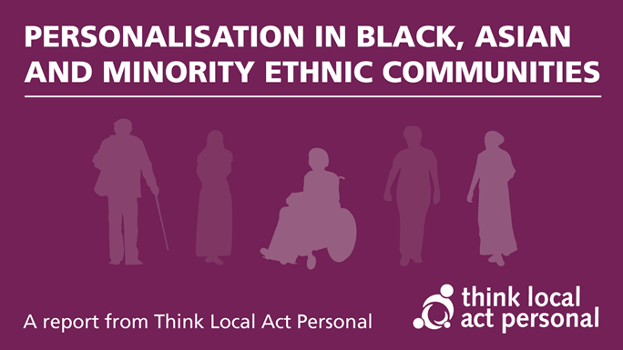
Personalisation in black, Asian and minority ethnic communities
The Covid-19 pandemic has had a disproportionate impact on people from Black, Asian and minority ethnic communities.
Think Local Act Personal commissioned some specific work as a contribution to addressing this.
The aim of their project was to find examples of promising practice that demonstrate what good personalised care and support looks like for people in ethnically diverse communities.
This included identifying the factors that support high quality care and support, and the barriers that stand in the way.
The project was undertaken during the Covid-19 pandemic and so the work also highlights how organisations responded to this enormous challenge.
The report outlines key aspects of personalisation.
Notes:
wv

Slide 10
Key aspects of personalisation
Focusing on the whole person and holistic support; rather than relying on diagnosis or narrow assessments of care needs.
Flexibility of provision and creative responses; meeting the needs of an individual within the context of their life experience.
Cultural complexity and competency; attitudes towards illness and disability and challenging stereotypes.
Building community capacity; drawing on the strengths of the people being supported, their families, and their communities
Commitment to support learning and development; creating opportunities for people to learn and develop.
Take a look at the report to read some good practice examples:
Personalisation in Black, Asian and Minority Ethnic Communities

Slide 11
In October 2020 Black, Asian and Minority Ethnic Communities Advisory Group, were established to make recommendations to feed into the work of the Social Care Sector COVID-19 Support Taskforce.
Their findings included:
During the pandemic ‘social distancing’ caused difficulties within a cultural context; this included mourning and grieving in a culturally appropriate manner.
Information was not translated and what was available was usually online, adding another barrier to access
There was a lack of services and for multi-generational carers
Service users and carers could not obtain PPE, including culturally appropriate equipment. They also did not know where to seek advice if the person that were caring for contracted COVID-19.
Participants indicated a strong believe that they experienced differential treatment in social care because of their ‘race’. For some, the pandemic ‘magnified’ existing differences
Examples included appointments being cancelled without explanation and ‘struggling’ to have their symptoms taken seriously by professionals.

Slide 12
They identified that good practice occurred where a member of the community, sometimes a faith leader, or an organisation, acted as a ‘trusted person’ to:
‘filter’ and signpost people to sources of information
translate guidance and other information
act as an advocate to breakthrough barriers to access
support people during bereavement by ‘translating’ guidance on funerals into cultural practices
​

Slide 13
Black, Asian, Minority Ethnic service users and carers involved in the consultation suggested the following action points for the government:
‘myth-busting’ about the stigma that BAME people are ‘super-spreaders’
training of the health and social care staff about how institutional discrimination within health and care services operate
public information campaign explaining to BAME communities the conditions under which they have rights to care and support
provision of culturally appropriate services
provide priority slots in hospital and GP appointments for older people and carers from BAME communities with specific cultural and religious needs
a helpline with options for languages that people can access for information about services
the NHS ‘one size fits all’ health screening should be adjusted so that where BAME communities experience certain conditions earlier, for example higher rates of high blood pressure and diabetes, they can access screening
require hospital and care homes to add vitamin D for BAME residents following regular blood tests
​

Slide 14
Dementia
In the general UK population, 3 per cent of people with dementia are from black, Asian and ethnic minority communities; around 25,000 people.
This number is expected to double by 2026 with the steepest increase expected in South Asian communities.
Research suggests these communities often face delays in dementia diagnosis and barriers in accessing services.

Slide 15
Learning Disability and Dementia
Compared to the rest of the population, people with learning disabilities are at greater risk of developing dementia at a younger age.
One in three people with Down's Syndrome develop dementia in their 50’s.
They may experience a more rapid progression of dementia.
They may take longer to receive a diagnosis of dementia due to the communication difficulties they may already have.
In 2013 an All-Party Parliamentary Group on Dementia produced a report ‘Dementia does not discriminate: The experience of black, Asian and minority ethnic communities’.
The report highlighted that it is likely that dementia is more common among Asian and Black Caribbean communities.
This is because high blood pressure, diabetes, stroke and heart disease, which are risk factors for dementia, are more common among these communities.

Slide 16

The report also highlighted that some support is not appropriate and does not address needs relating to faith or culture.
Families can be reluctant to use some services and try to carry on alone.
​
​

Slide 17
In 2016, Skills for Care produced a guide for leaders and managers on dementia and diversity.
The guide highlighted:
there may be a stigma connected with dementia and diagnosis in some cultures/communities.
some languages and cultures do not recognise dementia - research has found that simple explanations are the best way to manage this.
people may be more reluctant to access advice and services - sensitive communication will be needed.
Some events may have a significance for some cultures. An example would be the Holocaust for people of Jewish faith.
As the dementia progresses, people will regress to a previous time/times in their life. If this was in a different culture, country or language, this is likely to have a profound impact.
It is particularly important to engage family and friends in finding out as much information as possible
NICE clinical guidelines state that heath and social care staff should identify the specific needs of people with dementia and their carers arising from various characteristics, including ethnicity.
Care plans should record and address these needs.

Slide 18
Matching care staff with clients
Matching care staff with clients on the basis of ethnicity can be beneficial, but it is not an essential component of good care
Families may have concerns about stigma and prefer not to be matched from someone from their community.
Decisions about culturally matching staff should be made on a case-by-case basis.
Equipping staff with the skills to understand and respond to people’s individual cultural needs would help them provide good care to people regardless of their background
Consider other interests that staff and clients may have in common, such as art, gardening, shopping, cinema, music.

Slide 19
Life Stories
It is essential to understand the life story of people you support, particularly for those living with dementia.
For someone with learning disabilities and limited verbal communication, a life story can support conversations.
Talk to the person, friends and family to help put together a life story.
Life stories can help support personalised care.
Reminiscence can be used alongside meaningful activities that are sensitive to the persons background and culture.
Be mindful that people who migrated to the UK during the mid-twentieth century may have experienced hostility and racism; reminiscence work may stir up memories of a difficult period in people’s lives.
For someone not originally from the UK it may be helpful to consider the following areas of their earlier lives:
Did the person speak another language
Where they lived
Who they lived with
Their culture and religion
Food they enjoyed
Home and work life
Who are or were the important people in their life

Slide 20
Tools for talking
Tools for talking were developed to help individuals think and talk about their culture and what it means to them.
Clients complete a worksheet in discussion with their support worker to detail aspects of their culture. They then rate each aspect to indicate its importance to them.
A poster provides examples to help stimulate discussion (next slide).

Slide 21
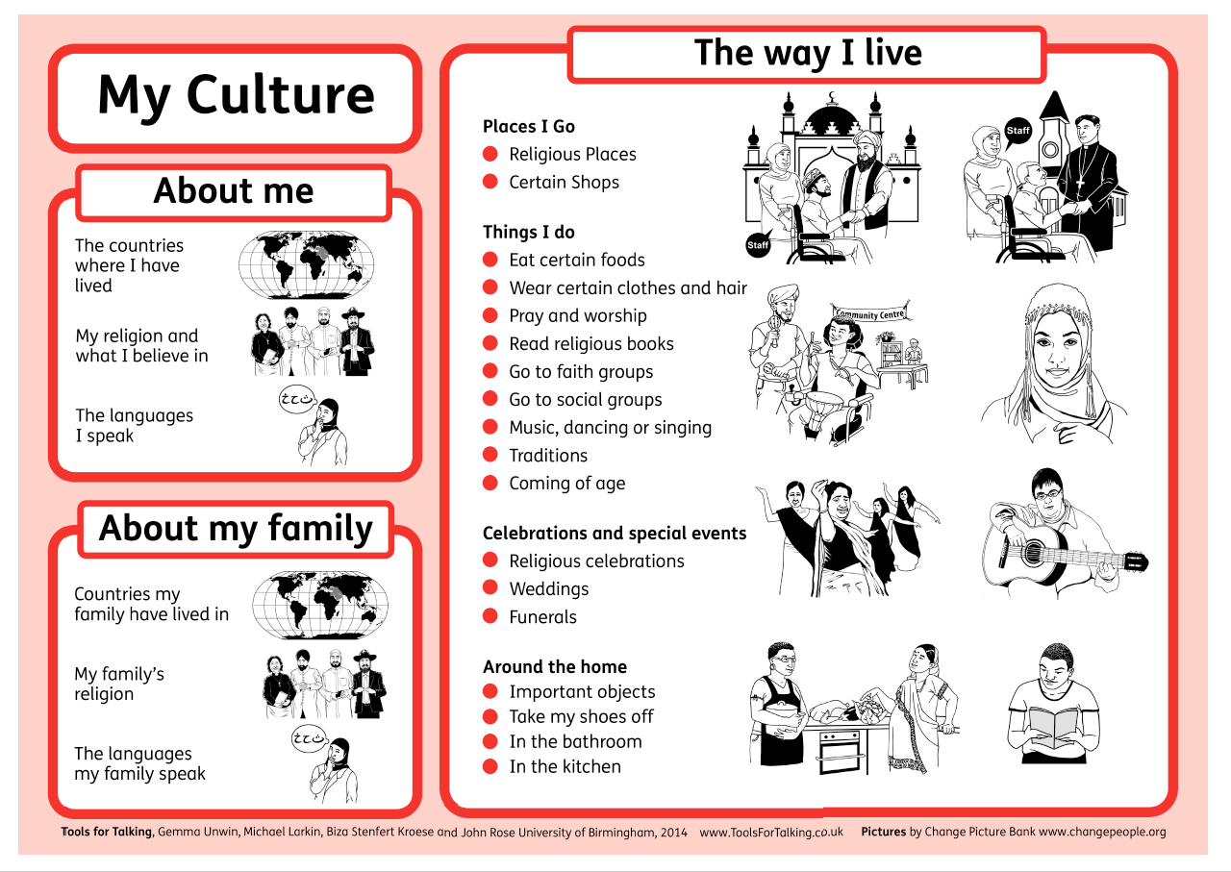

Slide 22
Activity 2​
Read through the case study about Casho and consider the questions.
This activity can be done as
a whole group discussion (via zoom / Microsoft Teams)
By individuals or small groups in a classroom setting (see downloadable activity sheets)
Notes:
w

Slide 23
Feedback from Casho’s Case study
Did you consider:
Casho’s mother’s language barrier and how that can be supported, such as from Adult Social Care or the Somali resource centre.
Obtaining as much information as possible from Casho’s mother
Having familiar items around the home and in Casho’s bedroom, pictures, photos, personal belongings.
Creating a life story book with Casho and her mother
Communication: learning the words that Casho uses and their meaning, finding out what her facial expressions and body language and what they generally mean.
What is Casho’s daily routine?
What are her likes and dislikes?
What food does she enjoy, are there any dietary requirements?
Does she have any hobbies, cooking, favourite music, television?
Does Casho observe any religious holidays such as Ramadan (the month of fasting)?
Supporting Casho with her behaviours, observing, recording, consider what helps when
she is distressed, distraction techniques, different activities.
Record all information in a person-centred support plan and ensure all staff are familiar with it.

Slide 24


