Slide 1

Culturally Appropriate
Care
Part 1: Stereotyping​
ESCC Adult Social Care Training Team 2022

Slide 2
NOTE: This is part 1 of 3 training sessions.
Aim: To know about culturally appropriate care, focusing on stereotyping.​
Outcomes: By the end of this session you will;
know what culturally appropriate care means.​
have explored what culture means.​
have an understanding of the Equality Act and protected characteristics​
understand how the Covid-19 pandemic may impact culturally appropriate care​
have explored what unconscious bias and stereotyping means​
have considered how to challenge stereotypes​
Understand how stereotypes are not culturally appropriate and is a form of othering

Slide 3
Domestics
Refreshments
Comfort breaks (including location of toilets)
Smoking
Fire procedures
Mobile phones
Ground rules
For Online Learning
Online instructions such as cameras, microphones, use of messaging box, etc
Introductions

Slide 4
What do we mean by ‘culturally appropriate care’?​
Culturally appropriate care (also called 'culturally competent care') is being sensitive to people's cultural identity or heritage. ​
Cultural identity or heritage can cover a range of things. For example: ​
  Race​
  Nationality​
  Religion​
  Sexual orientation (for example, lesbian, gay and bisexual people) ​
  Gender identity (for example, transgender people)​

Slide 5

Legislation​
Culture is a word for the 'way of life' of groups of people, meaning the way they do things. ​
​
Different groups may have different cultures or ‘habits, for example:
Notes:
ww

Slide 6
Activity 1​
Can you think of any culture examples?​​
This activity can be done as
a whole group discussion (via zoom / Microsoft Teams)
By individuals or small groups in a classroom setting (see downloadable activity sheets)
Notes:
w

Slide 7
Activity feedback
What culture examples did you think about / discuss?
Notes:
wv

Slide 8
Culture Examples
The number 8 is believed to be the luckiest number in China because '8' is associated with wealth. Chinese people would like to choose ‘8’ as the time and/or date of important events. For example, the opening ceremony of the 2008 Beijing Olympic Games commenced exactly at 8 minutes and 8 seconds past 8 pm on the 8th of August 2008.​
Many Muslim women wear a hijab (the word means "veil"), symbolising modesty and respect for Allah, and many Muslim men dress modestly to pray too.
Family, extended family bonds and networks are very important to the Gypsy and Traveller way of life. Family anniversaries, births, weddings and funerals are usually marked by extended family or community gatherings with strong religious ceremonial content. ​
Plant-based eating is deeply rooted in three of the prominent religions practiced in India – Hinduism, Jainism and Buddhism. All these religions believe in the concept of kindness and non-violence towards all living things.

Slide 9
The Equality Act 2010​
Anti-discriminatory practice is fundamental to care provision and critical to the protection of people's dignity. ​
​
The Equality Act protects those receiving care from being treated unfairly because of any characteristics that are protected under the legislation.​
​
It is against the law to discriminate against someone because of a protected characteristic.​
​
Watch this 3 minute film to learn more about protected characteristics: Protected characteristics
We don’t support different cultures just because the law says we must – we support different cultures because it’s the right thing to do!

Slide 10
Culturally appropriate care during the coronavirus (COVID-19) pandemic…
People using services may:​
​
have less contact with people that understand and affirm their culture - for example, family and friends​
have no opportunity for contact with their culture or community outside their home​
spend more time with people who do not share their culture - for example in a care home​
experience more life events that have cultural significance - for example, they may be at the end of their life or lose someone close to them
CQC 2021​
While we strive to provide care and support that is appropriate, sometimes staff may make assumptions around a persons needs depending on their cultural identity or heritage…
​

Slide 11
What is unconscious bias?
How a person thinks can depend on their life experiences and sometimes they have beliefs and views about other people that might not be right or reasonable.​
This is known as 'unconscious bias' and includes when a person thinks;​
  better of someone because they believe they're alike​
  less of someone because that person is different to them, for example, they might be of a different race, religion or age​
This means they could make a decision influenced by false beliefs or assumptions. Sometimes it's also called 'stereotyping’.​
Everyone can think in a way that involves unconscious bias at some point, but it's important to be aware of it and not let it affect behaviour or decisions.
​

Slide 12
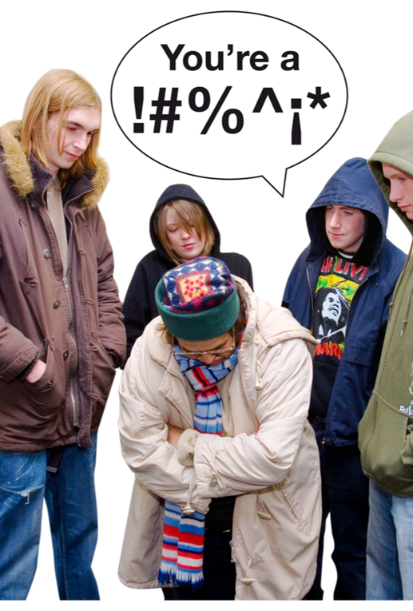

Terminology​
Terminology around age, disability, ethnicity and sexuality evolves continuously. It is important that you learn about preferred terminology used in your organisation and with the individuals you support. It is also important to remain actively conscious of changes. It’s important to ask the person how they would like to be referred to and not to make assumptions​.
Some terms are very outdated and are sometimes used as verbal abuse towards someone.​
Can you think of any examples regarding someone with a learning disability?
Made With Photosymbols ​

Slide 13
Did you think of….

Slide 14
Where did some of these terms come from?
Mentally handicapped:​
Learning disability replaced the term ‘mentally handicapped’ in 1990 and is the official term used in England.​
In general, a learning disability is a condition which affects learning and IQ across all areas of life, for example, a person with Downs Syndrome.
Loony / idiot​:
In 1845 the Lunacy Act made no clear distinction between learning disability and mental illness stating that ‘Lunatic shall mean insane person or any person being idiot or lunatic or of unsound mind’.
Idiot / imbecile
In 1886 Idiots Act came into force and for the first time legislation was dealing with the educational needs of those with a learning disability. It made a clear distinction between ‘lunatics’ on one hand and ‘idiots and imbeciles’ on the other.
​
​

Slide 15
Where did some of these terms come from?
Spastic / spaz​:
The medical term ‘spastic’ was used to describe people with cerebral palsy; the Spastics Society was founded in 1951 and was changed to SCOPE in 1994.
Mong / Mongol​:
The Victorian physician Dr John Langdon Down is best remembered for having, in 1866, identified a specific group of patients whose characteristics were similar in character. They had upward slanting eyes, flattening of the back of the head and poorly controlled tongues. ​
He thought that people with this disorder shared facial features with people of Mongolian ethnicity, so he named this group of people ‘Mongolian’ or ‘Mongol’
Other terms​
Many other terms are made up by different generations along the way. Even the term ‘special’ is used in a derogatory way, stemming from ‘Special Educational Needs’
​
​

Slide 16
If you found that activity difficult, imagine how it must feel to have those words directed at you while in the community, at home, school or work.​
​
What impact could that have on someone with a learning disability?
Examples: Low self-esteem, fear, anxiety, feeling worthless, isolation.
​
​

Slide 17
Activity 2
Agree or disagree?​
This activity can be done as ​
a whole group discussion (via zoom / Microsoft TEAMS)​
by individuals or small groups in a classroom setting (see downloadable activity sheets)​

Slide 18
Example
Siblings are always happy or able to carry on giving help and support when their parents are unable to.
​
Some people remove shoes before entering some rooms at home, as well as a Mosque, etc.
It is good practice to ask the individual to confirm their Christian name and surname before administering medication.
​
Wealthy families will not need support.
Agree
Disagree
Some may be able to and some may not. Choices must be respected.
This is true for some, therefore it is polite to ask the individual or follow their lead. This can include bedrooms in care homes.
It is best to ask for the persons first and last name rather than ‘Christian’ name.
Support comes in different forms; anyone may need support, no matter what their level of wealth..

Slide 19
Example
You should ask the person if there any cultural things they don’t do such as drinking alcohol, going to pubs, etc.​
People in some communities won’t accept support.
It is more appropriate for individuals to be identified in terms of their national origin such as Indian, Pakistani, Mauritian, or region of origin, such as Bengali rather than a general ‘Asian’ ​
You should start off with addressing people formally e.g. Mr/Mrs but then ask them how they would like to be addressed.
Agree
Disagree
Yes, this is good practice. Always record the persons wishes.
Every family is unique and assumptions shouldn’t be made.​
This is often the case, however you should ask the individual what their preference is.​
Yes, this is good practice. ​
A recording should be made of their preference.​

Slide 20
Example
You should try to link different families together from their community who have a relative with learning disabilities.
Its good practice to do research on cultural differences so you know what peoples likes and dislikes are.
Issues affecting the persons family, such as housing, financial concerns and health issues are not important as you must focus on the individual.
It’s okay to use the term ‘coloured’ to describe someone.
Agree
Disagree
This should only happen after discussing with the family. Some families are very private and may not like this to happen.​
It is good practice to do some research on cultural differences, however always remember each person is unique with their likes and dislikes.
It is important to take into account issues affecting the wider family as they may also have a big impact on the individual you are supporting.
This is not appropriate. Many people find it offensive. The terms ‘black’ or ‘person of colour’ are more appropriate. (The term ‘blacks’ is not appropriate)​

Slide 21
Example
You should explore what good support would look like for the person you support, specifically:​
- gender requirements, faith practices, food requirements, dress codes, relations with the opposite sex.
The term ‘half-cast’ is appropriate.
The term ‘non-white’ is appropriate.​
Mixed-Race is a generally accepted term, but can sometimes have negative connotations.
Agree
Disagree
Yes, these are all really important areas of support and all relevant information should be recorded in the support plan.
This term is regarded as offensive by many people due to its origins within the Hindu Caste System, in which being half-caste could mean social exclusion for the individual concerned.
Many people may find this term deeply offensive, as its origins relate to apartheid. (A system of segregation or discrimination on grounds of race and in the past, widely practiced in South Africa)​
More appropriate alternatives are ‘people with a mixed ethnic background’ or ‘people from the mixed ethnic group’.​
Notes:
§

Slide 22
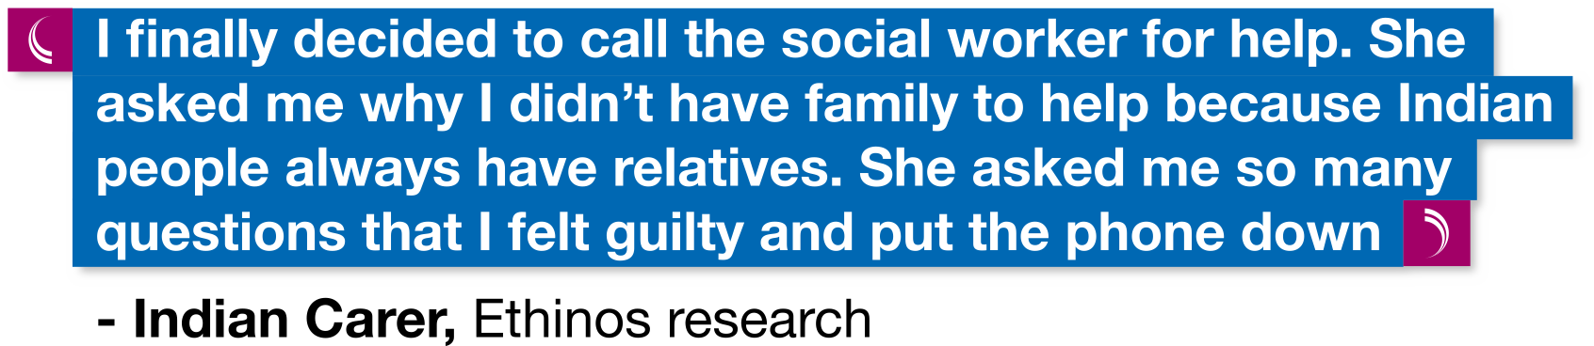
Challenging stereotypes and discrimination​
Some families come across unhelpful assumptions among staff that black and ethnic minority communities will not seek outside help: ​
​
​
Dementia does not discriminate: The experience of black, Asian and ethnic minority communities (Alzheimer's Society)
Notes:
w

Slide 23
What can YOU do?​
Everyone working in Health and Social Care can help to reduce the chances of
discrimination happening by working in ways that promote equality, diversity and inclusion.​
Challenging discrimination can be difficult, however as a support worker you may need to help someone speak up about discrimination or speak on their behalf.
​
Respect diversity by providing person centred support.​
Treat individuals that you support as unique. ​
Work in a non-judgemental way.​
Provide and displaying easy read materials which include information and images that promote inclusion.​
Follow agreed ways of working in your workplace to create an environment that is free from discrimination but feel empowered to challenge practices that may be discriminatory.​
Be confident to challenge, confront and report discriminatory behaviours if you see this is happening in your workplace.​
Reassure the individual involved that they have every right to challenge discrimination and that you will support them.

