Slide 1
Delegated healthcare activities - Guiding principles October 2023 This information was correct at time of writing and will be reviewed regularly.
Notes:
This presentation is useful for external audiences and provides an overview of the principles of delegated healthcare activities and where you can find further resources and reading.

Slide 2
Introduction to the principles
A delegated healthcare activity, usually of a clinical nature, is activity that a regulated healthcare professional delegates to a care worker.
Tailored to people’s individual health outcomes for a better experience of care with greater choice and control.
It’s not new; this has been happening for many years.
Voluntary guiding principles support person-centred, safe and effective delegation and decision-making.
No statutory requirement for social care providers or care workers to undertake delegated healthcare activities.
Notes:
A delegated healthcare activity, usually of a clinical nature, is activity that a regulated healthcare professional such as a registered nurse, nursing associate or occupational therapist delegates to a social care worker or a personal assistant across a range of social care settings. These could include a variety of activities tailored to people’s individual health outcomes and can enable people accessing care and support to have a better experience of care with greater choice and control.
We know that delegation to social care has been happening for many years and through engagement and contribution from sector stakeholders, we’ve developed these voluntary guiding principles to support person-centred, safe and effective delegation and decision-making. There is no statutory requirement for social care providers or care workers to undertake delegated healthcare activities.

Slide 3
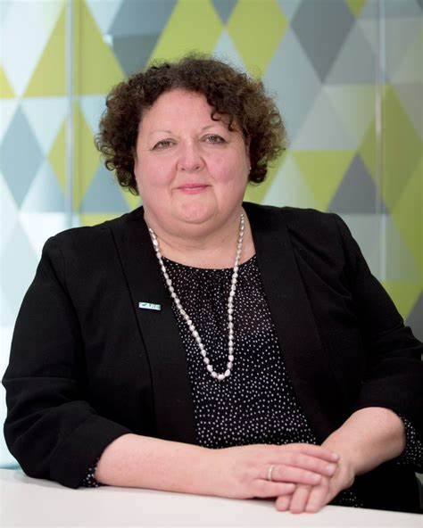
"Given members of our profession have been providing comprehensive health and care support for many years, not to mention the ever-closer alignment of clinical and social care services, the time feels right to share and embed this best practice across the sector."
Deborah Sturdy, Chief Nurse for Adult Social Care, Department of Health and Social Care

Slide 4
Guiding principles
Delegated healthcare activities (skillsforcare.org.uk)
Notes:
The Guiding principles include an Easy Read and a short animated video. All available at Delegated healthcare activities (skillsforcare.org.uk)

Slide 5
Supporting resources
Delegated healthcare activities (skillsforcare.org.uk)
Notes:
The guiding principles are supported by resources including a toolkit, decision tree, ADASS key findings and sample policies. Some products have been designed to support implementation by providing examples of how delegation can work in practice with sample templates. These have been designed to be adapted to local systems and organisations, rather than a ‘one size fits all’. All available at Delegated healthcare activities (skillsforcare.org.uk)

Slide 6
Short videos
Delegated healthcare activities (skillsforcare.org.uk)
Notes:
There are also videos sharing learnings from sector partners and perspectives from people with lived experience. These include an employer of PAs, a falls impact reduction pilot, the experience of people involved in the blended roles programme in Tameside and a case study of developing safe operating procedures for telehealth monitoring. All available at Delegated healthcare activities (skillsforcare.org.uk)

Slide 7
Aim of the four principles
Enable a person-centred approach supporting safe and effective delegation.
Designed to be adapted locally.
Suitable for a wide audience.
Notes:
There’s a recognition that delegation to care workers by regulated healthcare professionals isn’t new and has been happening for several years. Delegation can work well where there’s a person-centred approach with the right learning and development, skills, competency, supervision and governance, resulting in a positive impact for all those involved.
Research has highlighted that effective delegation can mean timely and flexible delivery of activities, resulting in better continuity and person-centred care. Safe and effective delegation to care workers can bring wider benefits to the person including greater choice and control and quality of life, providing more flexibility to suit their needs and lifestyle.

Slide 8
1. Person-centred care
Key message and first principle is person-centred care
Involving people, their family members and/or representatives.
First question to ask is why the activity is being delegated?
Other questions include:
Have people accessing care and support had the opportunity to be involved in decisions?
How will the delegation impact on their quality of life?
What are the expected benefits and outcomes?
How will they be involved in the activity?
Notes:
Delegation decisions must always have a person-centred approach involving people, their family members and/or representatives.
One of the first questions to ask is why the activity is being delegated?
Have people accessing care and support had the opportunity to ask questions, be involved in decisions with their family members or representatives about what’s important to them? How will the delegation impact on their quality of life? What’s the expected benefits and outcomes? How will they be involved in the activity?

Slide 9
1. Person-centred care

Slide 10
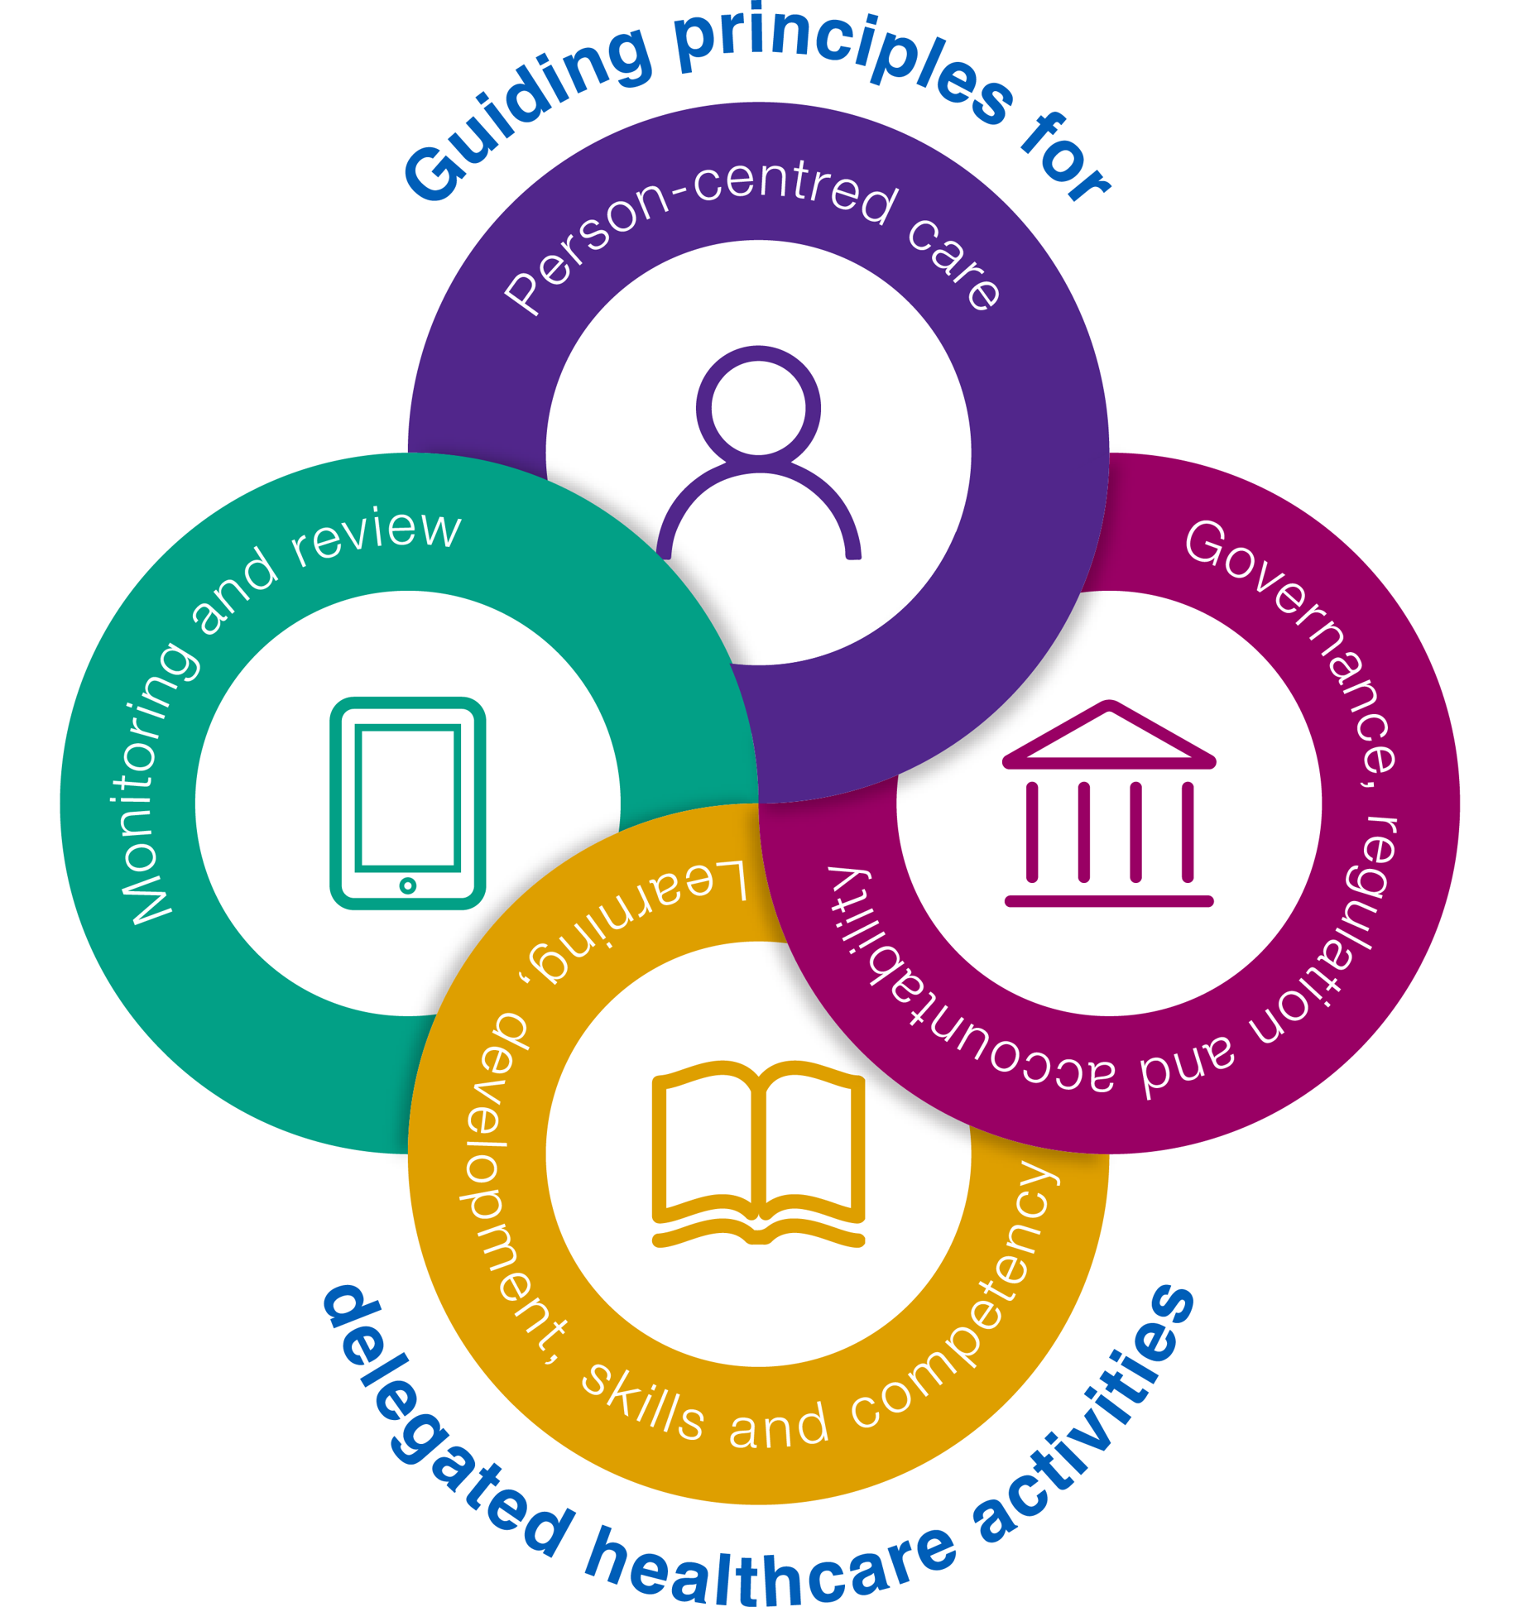
2. Governance, regulation and accountability
Effective delegation requires building trust
Questions to consider:
Is there a clear understanding of accountability, roles and responsibilities?
Is there robust governance for providers to support delegation?
How are risks identified and mitigated?
Notes:
Effective delegation requires people and organisations to build trust and create the right conditions to work across boundaries.
Is there a clear understanding of accountability, roles and responsibilities?
Is there robust governance for providers to support delegation such as regulatory requirements, commissioning and legislative arrangements and organisational policies?
How are risks identified and mitigated? Everyone involved must be empowered to speak up if they feel the delegated activity cannot be carried out safely.

Slide 11
2. Governance, regulation and accountability

Slide 12
3. Learning, development, skills and competency
Activity should only be delegated when:
care workers have access to the right learning and development, skills and competency, considering confidence as well as competence
learning is tailored to a person’s individual health needs and outcomes, with health and care systems working together to agree learning and development.
Notes:
Activity should only be delegated when care workers have access to the right learning and development, skills and competency, considering confidence as well as competence.
The level of support, training and competency depends on the delegation and how learning is tailored to a person’s individual health needs and outcomes with health and care systems working together to agree learning and development.

Slide 13
3. Learning, development, skills and competency

Slide 14
4. Monitoring and review
Must have clinical oversight of a regulated healthcare professional
Regulated healthcare professional retains responsibility for monitoring and review of healthcare plans.
Questions to consider:
Are there open channels of communication?
How will ongoing support and supervision be delivered?
Has this been agreed with the delegator, the care provider and care workers?
Notes:
Delegation must take place with the clinical oversight of a regulated healthcare professional who retains responsibility for the monitoring and review of peoples’ healthcare plans.
Are there open channels of communication to maintain safety and quality, particularly where there is changing or fluctuating needs?
Ongoing support and the type of supervision required and how this will be delivered should be agreed with the delegator, the care provider and care workers

Slide 15
4. Monitoring and review
Notes:
Farrah Amjad, Blended Roles Facilitator, Tameside and Glossop Integrated Care NHS Foundation Trust

Slide 16
Hayley Robertshaw
Director of Care and Development, St Martins Care

Slide 17
We need your feedback
We’re interested in feedback on the guiding principles and what works and doesn’t work in the supporting resources.
Please send your suggestions and proposed improvements to:
delegatedhealthcare@yorkconsulting.co.uk

