Slide 1



Reflections on end of life care (EoLC)
Materials created in partnership with Lois Bentley of Bridgesfm
Notes:
Guidance for presenter:
Suggested introduction for presenters to use: “Today our purpose is to listen to those who work at the front line of providing care to people who are approaching end of life. We will use a short film and presentation”.
Help for presenter: The materials were co-created in Yorkshire and the Humber region by a local enterprise Bridgesfm. Lois Bentley led that work and can be contacted by presenters with any questions about the materials lois@bridgesfm.com. Skills for Care can be contacted via info@skillsforcare.org.uk

Slide 2
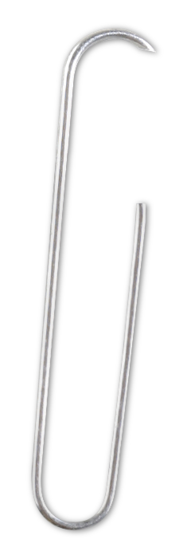
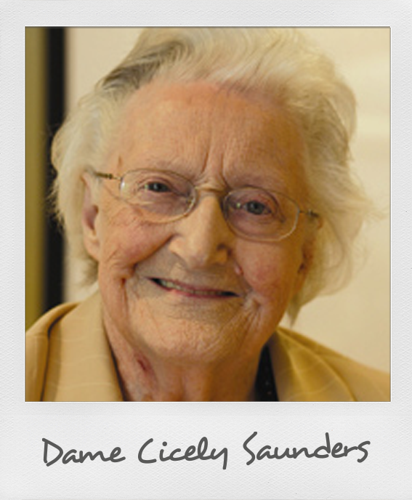
Dame Cicely Saunders is credited with founding the modern hospice movement.
We know her statement to be true.
Notes:
Guidance for presenter:
Read out the quote from Cicely Saunders.
We suggest that you add your own local comment here such as:
“Here in [insert name of your local service or location] we are working together to provide quality end of life care.”
You could talk about whichever example you choose in more detail if you wish.

Slide 3

Notes:
Guidance for presenter:
If you are unable to play the video from the PowerPoint presentation, it is available separately on the enclosed disc. Please check to see whether or not you can play the video from here before you start your presentation.
We will now watch a short film which showcases the work with social care partners undertaken by NHS Hull and NHS Wakefield district. It shows how domiciliary care workers can be key, within a multi-disciplinary team, in providing good quality end of life care.
The film was created to illustrate the findings of a report for the NHS National End of Life Care Programme. The report was entitled ‘Real Stories: Real Insight’.
Now play the video.

Slide 4

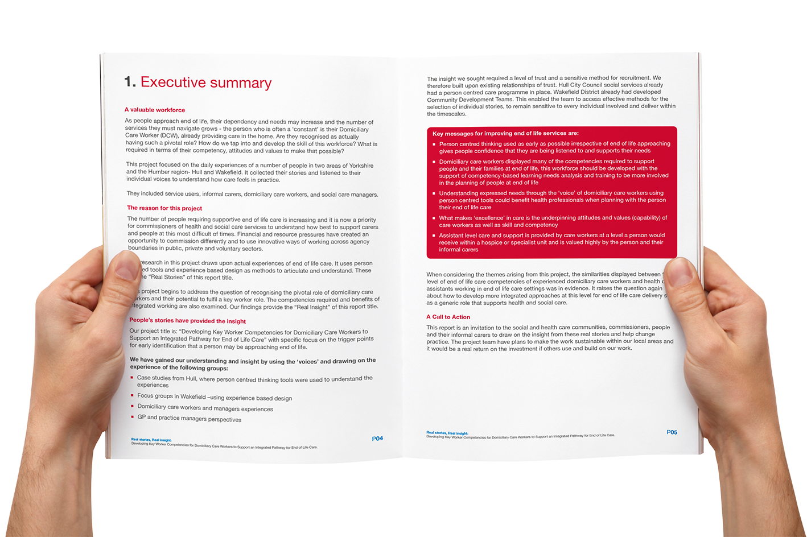


Real stories: Real insight
Developing key worker competences for domiciliary care workers to support an integrated pathway for end of life care (EoLC).
Work funded by:
Notes:
Guidance for presenter:
The name of the report that prompted the making of the film you have just watched, is ‘Real stories: real insight – developing key worker competences for domiciliary care workers to support an integrated pathway for end of life care (EoLC)’ (which is what is on the screen). This is also the title of the research project.
The research project was conducted in 2011 to develop and test a working model for improved care by defining the competences required for domiciliary care workers to have a key role in the care of people within an end of life care pathway. The research was to catch stories and experience on film and then for an expert in the competences to analyse. The analysis was to look for evidence in the film footage of the core competences listed on this slide.
Whilst the focus is care in people’s homes (domiciliary), the approach and findings apply to care homes and other health and social care places.

Slide 5
Elements of a key
worker
EoLC Common
Core Competences
Co-ordinating a person’s care
Promoting continuity
Empowering the person
Signposting
Effective team member
Communication skills
Assessment and care planning
Symptom management
Advance care planning
Overarching values and knowledge
Notes:
Guidance for presenter:
The National End of Life Care Programme (NEoLCP) wanted to understand the enablers and barriers to making strategy for end of life care effective at local level.
The research question was:
Is there evidence that care workers could be a key worker within an integrated pathway for end of life care?
In order to answer the question, the elements of a key worker were identified and they are listed on the slide. When all of the film footage was analysed, it was found that all the elements of a key worker could be mapped across to the end of life care common core competences.

Slide 6
What we found
Evidence of 72% (21 of 29)
of the competences required in supporting people in end of life care already taking place in practice, by loved ones, care home staff and domiciliary care workers.
Notes:
Guidance for presenter
There are five Common Core Competences shown on the earlier slide. These are further broken down into 29 more detailed competences. Indicated by the numbers in brackets
Communication skills (5 more detailed competences)
Assessment and care planning (5)
Symptom management (7)
Advanced care planning (7)
Overarching values and knowledge (5)
Total 29 more detailed competences.
When mapping the definition of key worker against the common core competences for end of life care, we found evidence of 72% (21 of 29) of the competences required in supporting people in end of life care already taking place in practice
This indicates that there is a solid foundation for immediate change and upon which to build further skills and practice.
In the training pack there is a document called Real stories: real insight report – competences which gives definitions and a more detailed understanding of the competences.

Slide 7
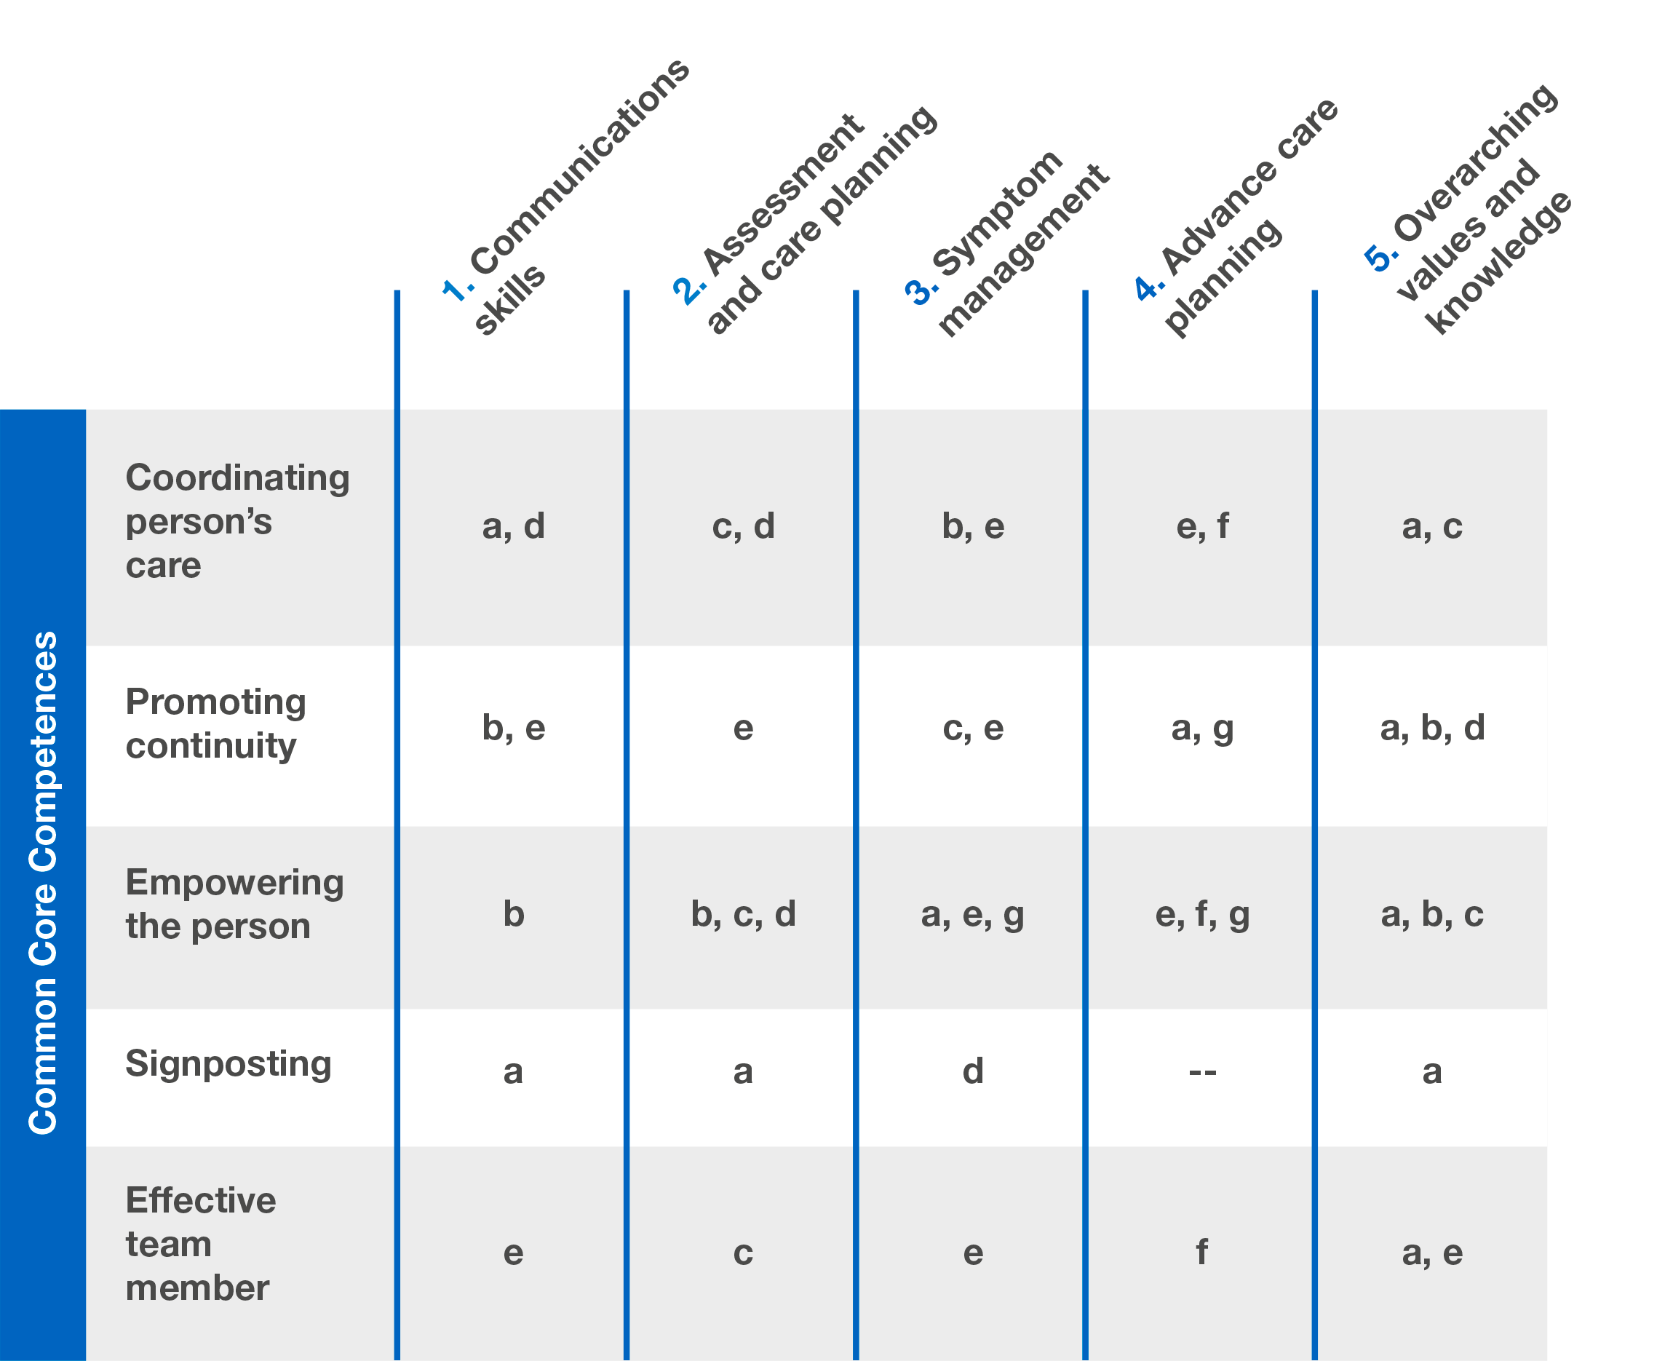
Key worker definition – Health & social care
Not a specified role. Defined in terms of competences for a generic worker role which could operate within various management systems in any sector, public, private or voluntary and community.
Key worker role defined in terms of the elements of health and social care roles mapped to the Common Core Competences:

Slide 8
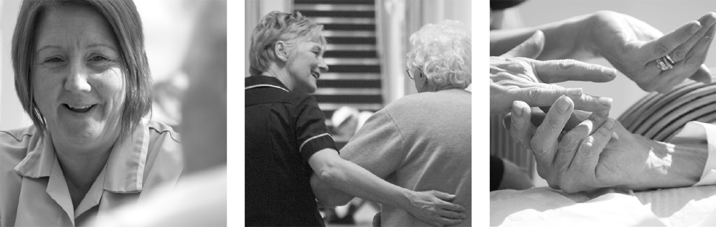
What we saw
High quality (competent) care
…is delivered when people employed as domiciliary care workers (DCW) have values and beliefs based in 'care’.
Notes:
Guidance for presenter
Watching the film and also throughout the project, many examples of working with the client to understand their needs were shown .
One of the end of life care common core competences is “Overarching values and knowledge”.
The clear message from the evidence suggests that:
training and competency are supportive of a role in care, and yet
underlying that the strong personal values of the care worker are a crucial factor in understanding the needs (both physical and psychological) in caring for an elderly person at the end of life.

Slide 9
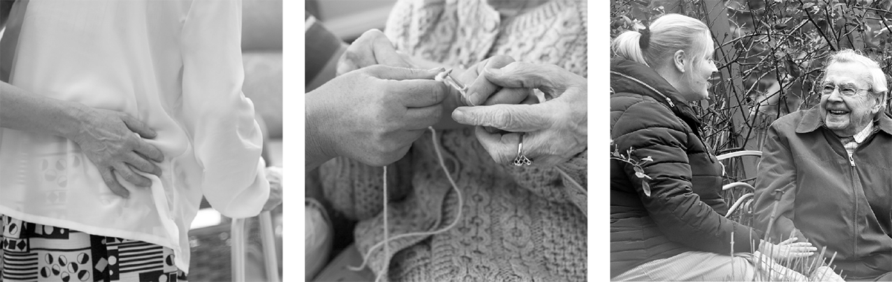
What we saw
Domiciliary care workers working at their best show
…confidence and experience in their knowledge of what 'good' support looks like for the person.
Notes:
Guidance for presenter
Research showed that competences are present in care workers and the experience to know what would improve a person’s life.
Discuss:
If many of the competences are there, is it because of the systems in place that people may not achieve their wishes at end of life?
If we developed ways of working in the future that were based on the findings, would we start to understand how to achieve excellent care for more people?

Slide 10

What we saw
Positive outcomes when residential homes use person centred thinking.
It makes the home a place that gives a person choices about how they live, spend their days and can help them to feel like a member of their community (citizenship).
Notes:
Guidance for presenter
This slide looks at person centred care.
When a person is put at the centre of their care, staff start to understand their ‘voice’.
In understanding preferred priorities of care, planning for end of life can then include other teams that may be required to support a person to achieve those preferred priorities in the last months and days of life.
Decisions and knowledge of care workers at the person-facing side of care, makes a difference to how care is delivered.
Discuss:
How do we enable this to be communicated to all those involved in a person’s care? This can make the difference in improving outcomes for people at the end of their life.

Slide 11
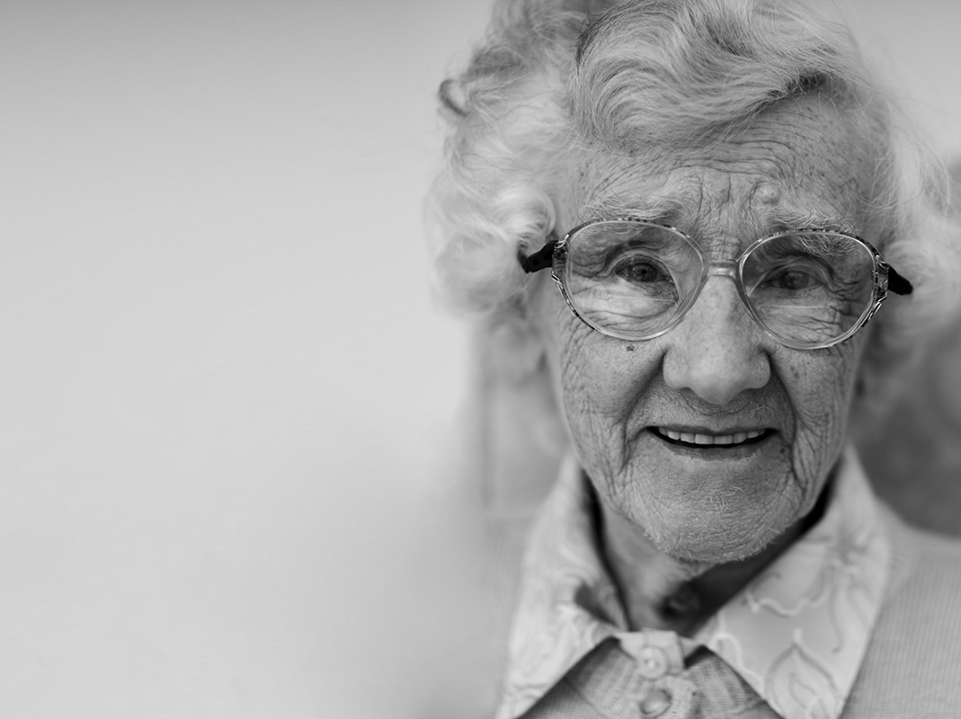
What matters is positive outcomes
Why re-invent the wheel when what we seek in order to improve people’s experiences at end of life and provide choice may be right in front of us?
Notes:
Guidance for presenter
A valuable workforce
As people approach end of life, their dependency and needs may increase and the number of services they must navigate grows. The person who is often a ‘constant’ is their domiciliary care worker (DCW), already providing care in the home.
Thinking about care workers in your local area/organisation:
Are they recognised as having such a pivotal role?
How do we tap into and develop the skill of this workforce?
What is required in terms of their competency, attitudes and values to make that possible?

Slide 12
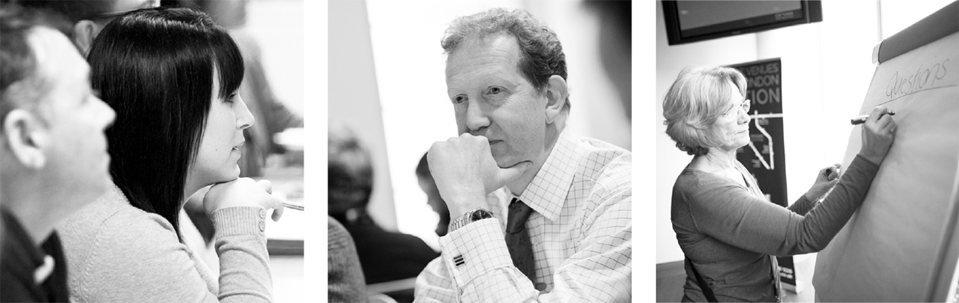
In light of the film and findings from the research…
Discuss how we all make a difference and how we can apply the findings to the work we do.
Our discussion session is next, but before that may I say thank you.
Notes:
Guidance for presenter
Throughout this presentation questions and points to discuss are given in the Guidance for presenters.
At the end of the presentation, do take time to discuss the application of the findings to your local services.

Slide 13
Thank you
Skills for Care
West Gate
6 Grace Street
Leeds
LS1 2RP
Tel: 0113 345 1716
Fax: 0113 243 6417
Email: info@skillsforcare.org.uk
Bridge FM
Web: www.bridgesfm.com
Email: lois@bridgesfm.com
Tel: 07973 837828
Skype: bridgesfm
Notes:
Guidance to presenters
If you would like to give your contact details to the people you are presenting to, please do so here.
If you have any questions about the presentation or supporting resources, please contact Skills for Care or Lois Bentley from Bridges FM.
All materials have been created in partnership with Lois Bentley of Bridges FM.

