Slide 1


Signs that someone may be unwell and what to do
RESTORE2 mini

Slide 2

Our plan for the session
By the end of the session you will be able to:
Spot when someone may be unwell or getting worse (deteriorating) using ‘soft signs’.
Tell someone that you are worried in order to get the right help using SBARD (situation, background, assessment, recommendation, decision).
Be able to communicate your findings to a health professional.

Slide 3
Session outline
Spotting ‘soft
signs’
Introducing RESTORE2 mini
Telling someone
you are worried using SBARD
Q&A
Close

Slide 4


After the session we will send you:
the slides we have used today
a copy of the RESTORE2 mini tool
links to the videos used in the training
information on how to give feedback and get involved in the research
a certificate of attendance*.
*Please write your name in the chat and indicate that
you would like to receive a certificate.

Slide 5
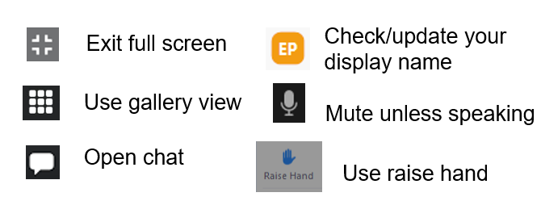
Virtual housekeeping
Exit full screen
Use gallery view
Open chat
Check/update your display name
Mute unless speaking
Use raise hand

Slide 6
How are you today?

Slide 7
In this resource we are using the term ‘carer’ to describe a person carrying out care and support functions. This could be where the care and support is being undertaken by a paid or unpaid carer, a care worker, a personal assistant or support worker.

Slide 8
What are ‘soft signs’ of deterioration?
You may recognise ‘soft signs’ in someone you know
Often families, friends and care workers will pick up on the subtle changes in a person’s behaviour, manner, or appearance.
They are the early indicators that someone may be becoming unwell. Therefore, their concerns should always be taken seriously, even if you think the person is fine.
Sometimes it can be obvious that someone is unwell, but at other times it might be much harder to spot.
It’s important to understand what is usual for the person.

Slide 9
‘Soft signs’ of pain
People with a learning disability feel pain as much as people without a learning disability. However, their pain is often missed, particularly if the person cannot communicate their pain. People with a learning disability may not understand what their symptoms mean.
People in pain may have a change in their behaviour. They may:
be more quiet than usual or appear to be more agitated
be more irritable or tearful
not be able to sleep
be reluctant to move
be restless
People may experience pain and show distress in different ways.

Slide 10
Examples of ‘soft signs’
‘Soft signs’ can be different for different people. Make sure you and other carers know what is usual behaviour for the person you support and what their ‘soft signs’ might be. These could include:
Changes in physical presentations
not going to the toilet as often or not passing much urine
being unsteady while walking
self-injury behaviour, such as nail biting
Changes in sleep patterns
not wanting to get up in the morning
not wanting to go to bed, being restless
Changes in behaviour and communication
being more anxious or agitated
being unusually quiet or withdrawn
being unusually confused
being more irritable than usual
lack of appetite
Pacing around or unusually active
Making more or less noise than usual

Slide 11
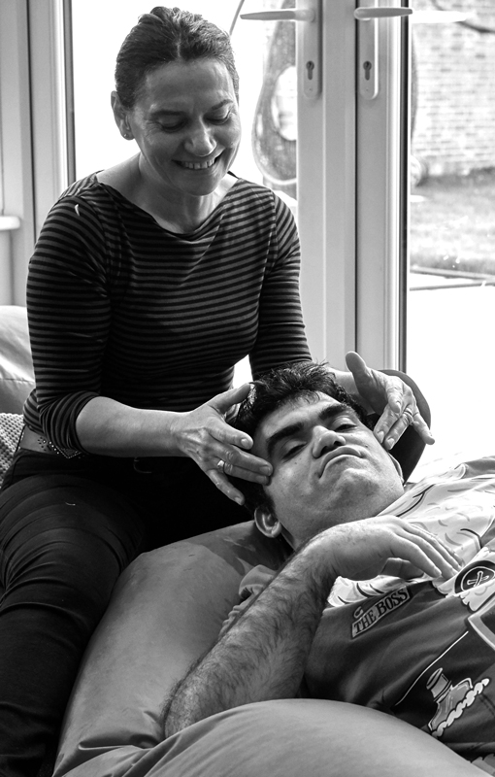
When we say deterioration, what do we mean?
Managing deterioration means noticing that someone you support is showing signs of becoming ill and knowing what to do to get help.
Why use deterioration tools?
Helps recognise deterioration early – the earlier, the better the outcome for people.
Helps identify that a person has changed and is not as well as they were.
Helps gather information so you can give a clear and full report of the person who is unwell.
Helps communicate confidently and clearly with your team.
Supports healthcare professionals and services to respond as quickly as required.

Slide 12
Background
The RESTORE2 tool was originally developed by Hampshire and Isle of Wight ICS and was adapted for carers of people with a learning disability. Through a commission by the NHS England Learning Disability and Autism team, this training content was created in partnership with West of England and Wessex AHSNs; Hampshire and Isle of Wight ICS; the South West Learning Disability Collaborative; and experts with lived experience of a learning disability.

Slide 13
Research findings
The NHS patient strategy supports Restore2 and Restore2 Mini. Northumbria University studied the use of tools to help carers recognise ‘soft signs’ of illness and communicate their concerns to health professionals. They found using the tool is a good idea because carers found:
training on identifying deterioration was useful
using the tool helped them to identify deterioration
using the tool gave them the confidence to raise concerns
the tool gave them a professional language for talking to health professionals.
A large project in the Midlands found similar themes. This project looked at using several different tools. The project found it didn’t matter which tool was used, but using a tool was beneficial.

Slide 14
What is RESTORE2 mini?
?
RESTORE2 is a physical deterioration and escalation tool for care homes, people who live in supported living and supporting people who live in their own homes. It’s based on nationally recognised methodologies.
RESTORE2 has also been adapted for use by carers wanting to use a ‘soft signs’ approach as a pre-diagnostic indicator of concern to facilitate earlier treatment and avoid unnecessary transfers to hospital. This has been named as RESTORE2 mini.

Slide 15
What is RESTORE2 mini?
RESTORE2 mini is one of many tools. We think it’s a widely accessible tool. It doesn’t matter which tool is used as long as there is a tool and people understand how to use it properly.
The training gives you the knowledge of where and who within the health services you should contact.
It helps you to use the right language so you can get the person who draws on care and support the right care at the right time.
People need to communicate which tool they are using and it must refer to ‘soft signs’ and SBARD.
?

Slide 16
Activity 1: Sharing experience
Think of a time when you or someone you know was unwell.
What was the situation?
How did you know the person was unwell?
(What did you see, hear, feel etc.?)
What happened to get
them help?
What did you already
know about this person
and their history?
What went well with that call for help?
What did you observe
that was different?
What could you have
done differently?
We will refer back to your experiences when we talk about SBARD

Slide 17
The importance of understanding when someone is unwell
We know that for people with a learning disability:
“people with a learning disability continue to have a much shorter life expectancy than the wider general public, with 6 out 10 dying before age 65, compared to 1 out of 10 for people from the general population” 2021 LeDeR report.
they may have health problems which make them more vulnerable to infection
they may have difficulty recognising and saying when they are unwell
carers are often able to tell when a person is unwell because of their behaviour or personality
carers and health care professionals can be helped to better communicate with each other about a person’s health.
carers can be more aware of how to make reasonable adjustments for sensory needs such as smells, sounds and lighting

Slide 18
What factors could ensure the best outcome?
Recognise the ‘soft signs’ of someone becoming unwell early. | Making sure we get the response that is needed from healthcare professionals. Timeliness so that healthcare services can get to us as quickly as possible.
Communicate with people who are unwell to ensure reasonable adjustments are made. Improve communication between carers and healthcare staff. | Good skills that meets the persons needs.

Slide 19

Find out if the person you’re supporting is feeling unwell
New or increased confusion / agitation / anxiety / pain
Changes to usual level of alertness / consciousness / sleeping more or less
Extreme tiredness or dizziness
‘Can’t urinate’ or ‘no urine’, change in urine appearance
Diarrhoea, vomiting, dehydration
Increasing breathlessness, chestiness or cough/sputum
Change in usual drinking / diet habits
Reduced mobility – ‘off legs’/ less co-ordinated or muscle pain
A shivery fever - feel hot or cold to touch
If YES to one or more of these triggers – take action

Slide 20
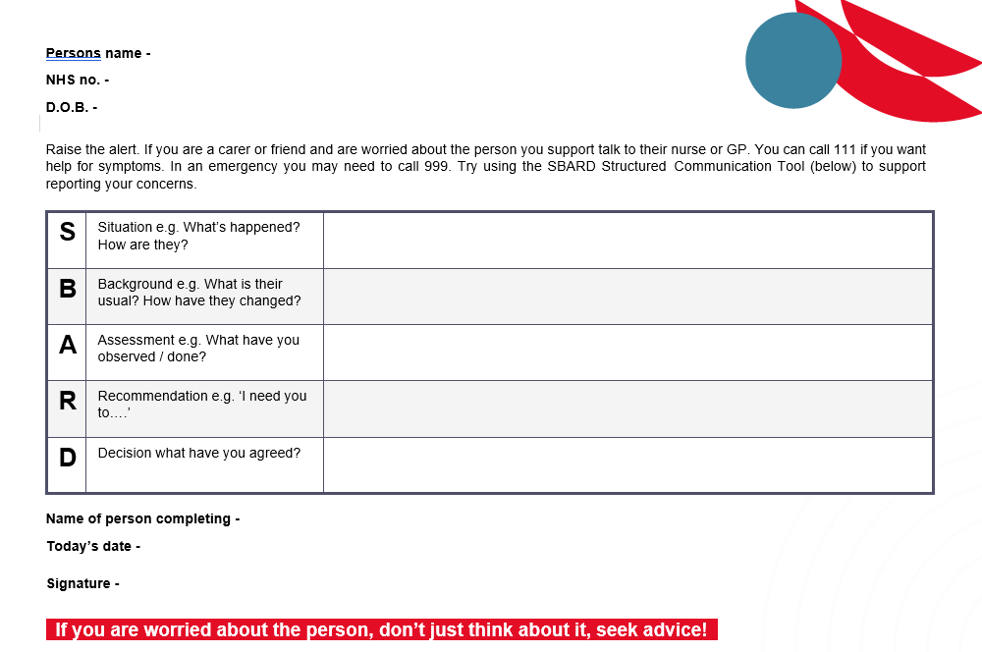
SBARD is a way of communicating when someone is unwell, especially with medical professionals.
You can us SBARD in all sorts of circumstances.

Slide 21
Annual health checks
It is important that a person with a learning disability is on their GPs learning disability register.
This means people with a learning disability aged 14 and older will be offered a health check each year from their GP surgery.
The check helps people to stay well and find any health problems early so that the problems can be sorted out.
You do not have to be unwell to have the check, in fact, most people have their annual health check when they are feeling well.
If you’re feeling unwell, it’s important not to wait for your annual health check!

Slide 22
Spotting signs of cancer
Red flags for cancer include:
Having a cough for more than three weeks.
Tummy discomfort / bloating.
Unexplained weight loss.
Blood in poo or urine.
Bleeding from the bottom.
Blood when you cough.
Blood in vomit.
New lumps and bumps (especially in the breast, underarm, groin or testicles).
Changes to moles.
Heartburn / acid reflux.
Vaginal bleeding between periods or a year or more after the menopause.
Research tells us that we do not always spot cancer early enough in people with a learning disability. This means that early treatment opportunities can be missed.
It is very important that people with a learning disability are supported to access cancer screening tests such as cervical screening, breast cancer screening and bowel cancer screening. People should not be excluded from tests just because they have a learning disability.

Slide 23




Medical emergencies
There may be occasions when the early signs of deterioration may be a medical emergency. In these cases, contact 999 immediately. Such occasions include:
  where the person is unable to breathe.
  chest pain or suspected heart attack. Remember that symptoms of a heart for in women are different to those in men.
  where the person is displaying signs consistent with having a stroke (FAST)
  prolonged seizure where the person does not have a care plan in place to manage it or they are finding it hard to breathe
  where the person has sustained a significant injury – e.g. a fracture or head injury
How one person interprets pain may be different to how another person interprets it.
Facial
weakness
Arm
weakness
Speech
problems
Time
To call 999
If in doubt, get it checked out. Remember to use SBARD when contacting 999.

Slide 24
Comfort break
(time for a stretch)

Slide 25

Do you know who to tell if you are worried about someone you care for?
Telling someone you are worried (SBARD)
Telling someone you are worried (SBARD) - YouTube

Slide 26
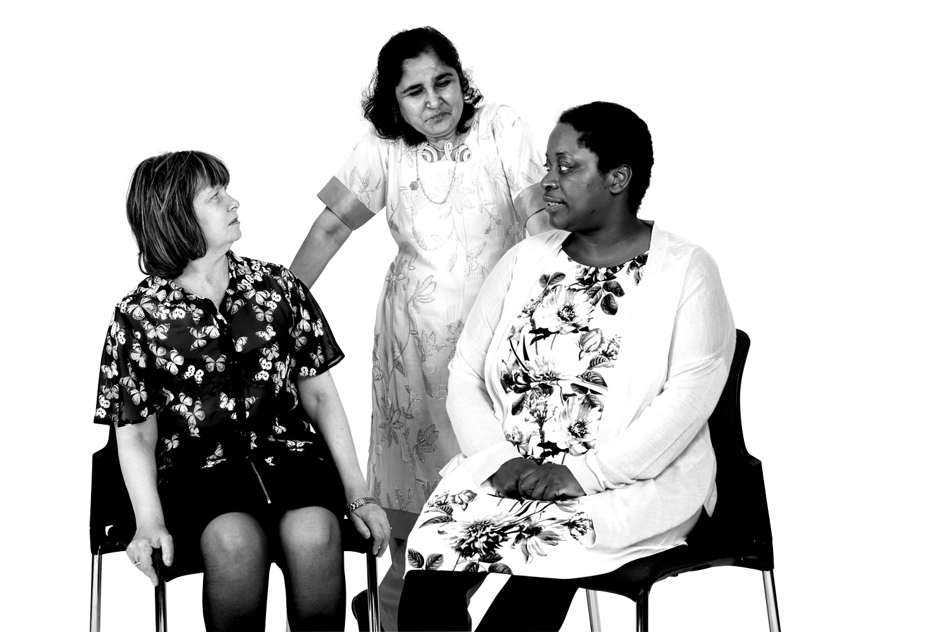
How could you do this?

Slide 27
What do you do if you don’t feel listened to?
What are the non-verbal signs you can look out for?

Slide 28
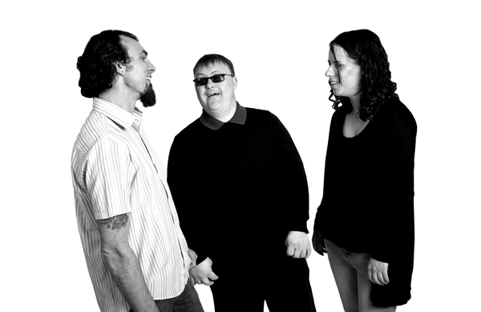
If you are worried about someone’s health, call for help without delay.
SBARD helps us to think about:
What changes have you noticed? How is the person different to usual?
What ‘soft signs’ and/or symptoms have you noticed?
What response/help do you need for the person?
How someone might explain pain can be different to how someone else explains it.

Slide 29

SBARD example: Sarah
Sarah is 24 years old and has a learning disability. She does not have any
additional health needs. Sarah is usually very chatty and has a wicked sense of
humour. She is able to make her needs well known and can be assertive.
You notice that in the last two days Sarah has not been ‘herself’, appears restless, pacing, irritable and snappy with carers and housemates. She seems to have lost the sparkle in her eyes and is avoiding eye contact. She also has been not interested with her meals, eating and drinking very little.
Using the SBARD framework, how would you communicate your concerns to the GP?
Situation
Background
Assessment
Recommendation
Decision

Slide 30
Situation
“Hello, I am Jon, Sarah’s Care Worker. I am calling because I am concerned about Sarah. She hasn’t been ‘herself’ over the last two days and appears restless, pacing, irritable and snappy with other carers. She’s not eating her meals and drinking.”.
Background
“Sarah has a learning disability. She is usually fit and well. She is usually very chatty and outgoing and quite assertive about her needs. She does not have any specific medical history and is not taking any regular medications”.
Assessment
“Sarah usually tells us if she’s feeling unwell. I am concerned it is a physical illness which isn’t getting any better.”
Recommendation
“Sarah doesn’t like hospitals or GP’s so I would like you to come and see Sarah for an assessment. Could you tell me if there is anything I should do in the meantime?" (It is likely the doctor will ask various questions during the assessment and make recommendations).
Decision
The GP agrees to visit today. Continue to monitor and call back if Sarah’s condition gets worse before the GP arrives.

Slide 31
SBARD example: Ishan
Ishan is a 32 year-old man with a learning disability and additional health needs. He lives in a
residential home and visits his family every other weekend. Ishan has some visual impairment.
He loves to jump, especially when excited. Ishan communicates non-verbally and usually responds
by smiling or flickering his eyes and making high-pitched vocalisations. Ishan loves his food and never
misses an opportunity for a pudding.
Carers who finished the day shift reported that Ishan has been hyperactive; jumping, burping and slapping his chest repeatedly. They also noted he refused dinner and didn’t drink much. Ishan often gets cold sores. Changes in behaviour have been noted during previous illnesses.
Using the SBARD framework, how would you communicate your concerns to the GP? Do you want any additional information first?
Situation
Background
Assessment
Recommendation
Decision

Slide 32
Making sure your concerns are taken seriously
If you are concerned that you are not being taken seriously and there is immediate concern for the person’s health ask to speak to the practice manager in the case of a GP practice or a ward manager in the case of a hospital.
If the person is in hospital, speak to PALS (patient advice and liaison service) and ask if the hospital has a learning disability liaison nurse.
If you want to raise a concern about the quality of healthcare, speak to the NHS local or regional team as they will be closer to issues about services to individuals which means they can answer questions quicker. Find your regional team at: https://www.england.nhs.uk/about/regional-area-teams/
If you have any complaint about any health care service in the ICB including your GP, community or hospital care you can complain to the ICB. To find your ICB please use the following link: https://www.nhs.uk/nhs-services/find-your-local-integrated-care-board/
If you want more information about NHS complaints processes - have a look at this website. https://www.england.nhs.uk/contact-us/complaint

Slide 33
What else should a carer consider?

Slide 34
Person centered care
With the person involved in decisions about their care or supported by others to make decisions, you can spot when something doesn’t appear usual about the person.
As a carer, you should;
Build a relationship with the person in your care, which is built from meaningful communication, and is strongly influenced by how we say things, how we listen and our non-verbal communication.
If the person wishes, their family and friends may be included – respect the persons wishes and emotions

Slide 35
As a carer…
Know a person’s views and decisions about treatment if they become unwell.
Support people in having conversations about ‘what matters to them’.
Know what decisions have been made.
Review regularly to ensure plans are up to date.
Note DNACPR does not mean that the person cannot be treated for other conditions. It is never acceptable for a DNACPR to be made because someone has a learning disability.

Slide 36
Advanced care planning
Advanced care planning is a person-centred discussion between a person and their care providers about their preferences and priorities for their future care.
For the person…
They can consider and share with others who, and what, matters most to them in life and how this might change were they to become unwell.
They should be able to expect to receive care and treatment which is more in keeping with what matters to them.
They can be more confident that what matters most to them will be known and taken into account as part of treatment decisions.

Slide 37
As a carer…
They will be more content and confident in knowing that the person had ownership of the process and was able to make what matters most to them known while the person has capacity to do so.
They will be less likely to have to contribute to decisions on behalf of the person without the person’s needs and preferences being explored earlier.
If they become unwell, there is a reduced risk of doing something that the person would not want or delivering care in a way they would not wish.

Slide 38

Summary
You are often the expert on the person you look after, and you know when something is not right.
Think about ‘soft signs’ for that person and share them with other people.
Think about how to tell others when you are worried.
Remember, if you are worried about someone, don’t just think about it, seek advice.

Slide 39
Reference list
King’s College Fund (2021), Learning from Lives and Deaths - people with a learning disability and autistic people (LeDeR): https://www.kcl.ac.uk/research/leder
Public Health England (2020), Deaths of people identified as having learning disabilities with COVID-19 in England: https://assets.publishing.service.gov.uk/government/uploads/system/uploads/attachment_data/file/933612/COVID-19__learning_disabilities_mortality_report.pdf
Skills for Health, Health Education England and Skills for Care (2017), Person-centred approaches: https://www.skillsforhealth.org.uk/wp-content/uploads/2021/01/Person-Centred-Approaches-Framework.pdf
Skills for Care (2021), Do Not Attempt Cardiopulmonary Resuscitation (DNACPR): https://www.skillsforcare.org.uk/Developing-your-workforce/Care-topics/Do-Not-Attempt-Cardiopulmonary-Resuscitation/Do-Not-Attempt-Cardiopulmonary-Resuscitation-DNACPR.aspx
Skills for Care and partners (2021), Universal Principles for Advance Care Planning (ACP): https://www.england.nhs.uk/wp-content/uploads/2022/03/universal-principles-for-advance-care-planning.pdf

Slide 40
Thank you!
Do you have any questions?
Please make sure you have typed your name in the chat, so you receive a certificate.

