Slide 1
Supporting individuals with face coverings
ESCC Adult Social Care Training Team

Slide 2
Aim:
To know how to support individuals to become familiar with wearing a face covering
Outcomes:
By the end of this session you will;
understand the reason for face coverings
know who is exempt from wearing face coverings
have an understanding of why it may be difficult for some people to tolerate a face covering
understand what desensitisation means and how to support someone through the process
be able to discuss how it feels to be anxious about something
be familiar with different types of face coverings
know about best interest decisions

Slide 3
DOMESTICS:
Refreshments
Comfort breaks (including location of toilets)
Smoking
Fire procedures
Mobile phones
Ground rules
FOR ONLINE LEARNING:
Online instructions such as cameras, microphones, use of messaging box, etc
INTRODUCTIONS

Slide 4
Seeing people wearing face coverings and having to wear one is a new experience for many of us.
For people with dementia, mental health problems, learning disabilities and/or autism, this may be a particular challenge.

Slide 5
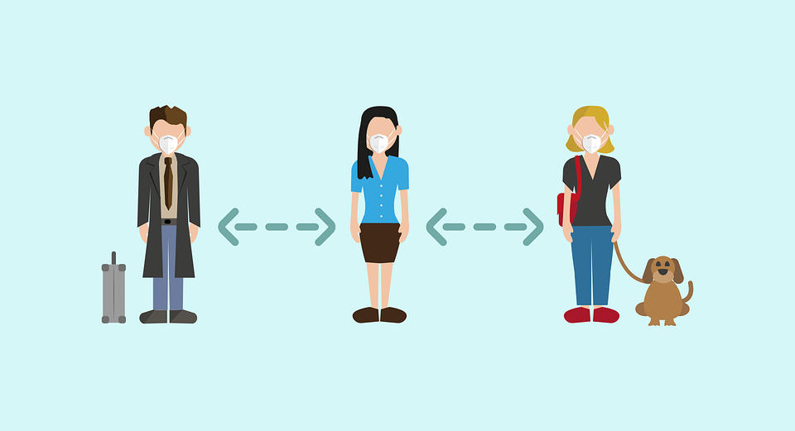
Why use face coverings?
Coronavirus (COVID-19) usually spreads by droplets from coughs, sneezes and speaking.
These droplets can also be picked up from surfaces, if you touch a surface and then your face without washing your hands first.
This is why social distancing, regular hand hygiene, and covering coughs and sneezes is so important in controlling the spread of the virus.
It is important to follow all the other government advice on coronavirus (COVID-19)

Slide 6
What is a face covering?
Face coverings are largely intended to protect others, not the wearer, against the spread of infection because they cover the nose and mouth, which are the main confirmed sources of transmission of the coronavirus.
The government has been careful to use the term ‘face covering’ rather than ‘face mask’ - with surgical masks kept for medical use.
You can use a scarf, bandana, religious garment, hand-made cloth covering or disposable mask, but these must securely fit round the side of the face.

Slide 7
Who is exempt from wearing a face covering?
The Government has produced advice on when individuals do not need to wear a face covering, which includes:
children under the age of 11 (Public Health England do not recommended face coverings for children under the age of 3 for health and safety reasons)
people who cannot put on, wear or remove a face covering because of a physical or mental illness or impairment, or disability
where putting on, wearing or removing a face covering will cause you severe distress
if you are speaking to or providing assistance to someone who relies on lip reading, clear sound or facial expressions to communicate

Slide 8
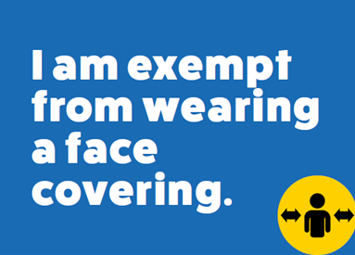
Exemption cards
Those who have an age, health or disability reason for not wearing a face covering should not be routinely asked to give any written evidence of this, this includes exemption cards.
No person needs to seek advice or request a letter from a medical professional about their reason for not wearing a face covering.
Some people may feel more comfortable showing something that says they do not have to wear a face covering. This could be in the form of an exemption card, lanyard, badge or even a home-made sign.
But remember, this is a personal choice and not necessary in law

Slide 9
Activity 1
Tolerating face coverings
Why might someone find it difficult to tolerate a face covering?
Notes:
This activity can either be done individually or as a group discussion. Activity notes pages and trainer guides are within the training pack if required.

Slide 10
They may not understand the reasons for the face covering
They may find it difficult to recognise people
They may rely on seeing people’s faces to help with communication and understanding
Difficulty with making eye contact
They may experience sensory challenges which make it hard to tolerate wearing a face covering; the new feelings of elastic over your ears, material across your face, or the heat caused by the mask can be uncomfortable and overstimulating

Slide 11
They may find the smell of the mask difficult to tolerate
Wearing a mask can make it feel like your airflow is being restricted, and for some individuals this could cause feelings of increased anxiety or claustrophobia
Wearing a mask can reduce peripheral vision and be distracting when looking down
Normal social routines may feel disrupted by the need to wear masks
Seeing people covering their faces might make them feel uneasy or scared
Desensitisation may help some people…

Slide 12
Getting used to something
Adapting
Feeling comfortable
What do you mean by desensitisation?
Relaxing with something
Familiarisation

Slide 13
Desensitisation
Desensitisation is a method to teach a person to associate feelings of relaxation with something they previously felt anxious about.
A common example is where a therapist will help someone who has a fear of spiders, often using relaxation and breathing exercises. Slowly building up from talking about fears, introducing pictures of spiders, being in a room with a spider and eventually holding one.

Slide 14
Desensitisation can be used in many other ways, for example, slowly introducing a face covering to someone, allow the person to see and feel it, wearing it for short periods of time in a safe and comfortable space and gradually building up to wearing while out.

Slide 15
Activity 2
Think of a time when you felt anxious or scared about something, such as a job interview.
How does your body react when you are anxious or scared?
What techniques do you use to help overcome anxiety?
Imagine having difficulty in expressing these anxieties if you had limited communication skills; how might you communicate them instead?
Notes:
This activity can either be done individually or as a group discussion. Activity notes pages and trainer guides are within the training pack if required.

Slide 16
Why use desensitisation?
Some people may be able to learn to tolerate wearing a face covering. Supporting someone to get used to seeing people wearing face coverings or wearing one themselves may make life less stressful for them.
It may mean that they are able to return to activities and routines they enjoy sooner. Care providers might feel more confident in supporting someone in the community and to have contact with family if they can wear a face covering.

Slide 17
Communication
Supporting someone to understand why a face covering is important can be a good starting point with desensitisation.
Consider the persons usual method of communication, can you find, create or adapt something?
Take a look at the resource list and framework for more information on communication methods and ideas.
Example of now and next

Slide 18
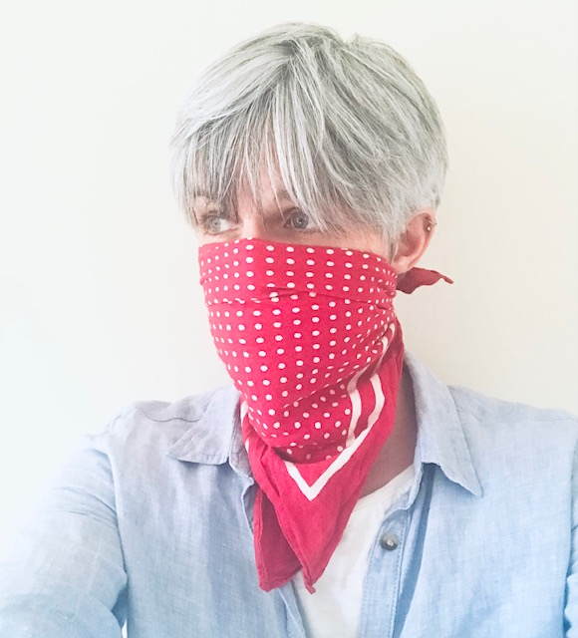
Consider sensory aspects and the type of face covering
Different types of fabric, cloth, and linen
Different shapes of face masks - some sit closer or further from your face, others are more rounded, and some have elastic that goes behind your ears or around your head
A bandana that covers your nose and mouth but allows for more airflow from below
A circular scarf or headband pulled up over your nose and mouth
Transparent face masks that are clear around the mouth
Notes:
Sensory aspects discussed earlier in activity 1

Slide 19
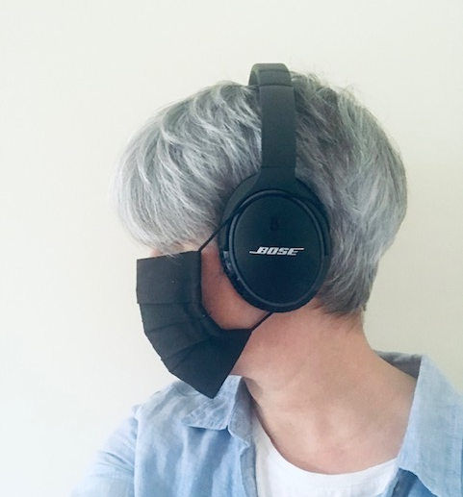
Clip the loops behind the head
Tie the loops around headphones (someone may wear noise reduction earphones)
Tie tightly or loosely with knots

Slide 20
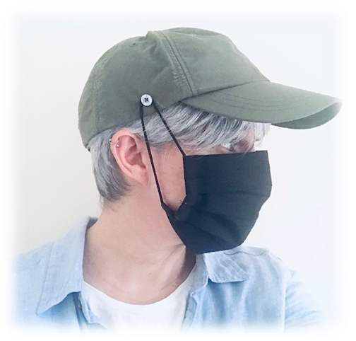
Clip the loops to a hat or headband (buttons can easily be sewn on)
Choosing one that is most comfortable
Choosing their preferred design
Choosing preferred fabric to make their own face covering

Slide 21
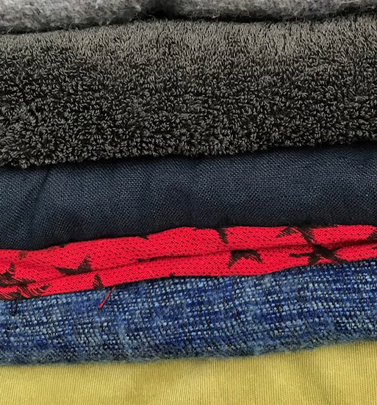
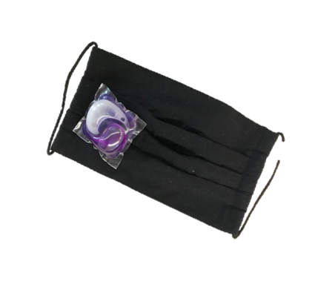
Sensory moment…
Take a moment to feel different types of fabric around you. The clothing you are wearing, what you are sitting on.
Touch the fabric with the inside of your wrist or on your face.
Some people don’t mind the feel of different fabrics, but for some, certain materials can be difficult to cope with.
Smell some of the fabric around you – can you smell perfume, aftershave or washing powder? Do you like the smell?
Some people, including those with autism, can be hypersensitive to smells so consider how the face covering smells.

Slide 22
Activity 3
Group discussion: Styles of face coverings
We have all had to get used to wearing a face covering; what style is your preference?
Is there a reason for this, such as comfort or fit?
Show us your favourite face
Covering!

Slide 23
Ideas for desensitisation
Look at pictures / videos of people wearing face coverings
Holding the mask
Bringing the mask toward their face
Touching the mask to the face, rubbing the fabric on cheek
Slowly fitting the elastic over the ears
Keeping it on for specified amounts of time; start with a short amount of time, even if only a few seconds
Once it is on, a visual timer may help to indicate how much time remains (start with just a few seconds and work up).
It may help if you wear one during these practices as well

Slide 24
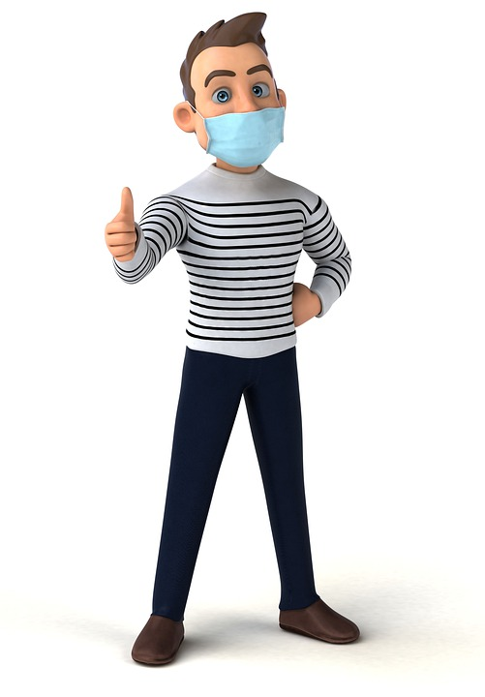
It might be useful to practice with the person in front of a mirror
Wearing the mask during a favourite activity such as watching TV, playing a video game, baking etc
Make the first outing outside short such as a walk around the block
Have an incentive such as buying something from a local shop
IMPORTANT…
Don’t rush
Try each step slowly
Observe the persons reactions carefully
Keep anxiety to a minimum
Try and make it a fun experience / activity
Don’t leave the practice until absolutely necessary e.g. going to hospital

Slide 25
Activity 4
Case study: Tayo
Read through the case study and discuss ideas.

Slide 26
Best Interest decisions
Some people may lack the capacity to make a decision to wear a face covering, for example:
They may not be able to understand the reasons for wearing one
They may not be able to communicate a decision about wearing one
In addition, they may not be able to put on and take off the face covering themselves.
In these situations, a proportionate best interest decision may need to be made.

Slide 27
Before deciding that someone lacks the capacity to make a decision, all practical and appropriate steps must be taken to help them make the decision themselves:
Provide relevant information - including choices e.g. different types of face coverings
Communicate in an appropriate way - such as pictures, visual aids, etc
Make the person feel at ease - the right environment, time of day etc
Support the person – who may be able to help e.g. family, friends, carers who know the person well
Notes:
For more information on the Mental Capacity Act and Best Interest decisions, please refer to the framework that goes with this PowerPoint.

Slide 28
Activity 5
Group discussion
If a best interest decision has been made to support someone to wear a face covering, its important to consider the most comfortable and dignified ways of providing support.
What sort of things might you need to consider?

Slide 29
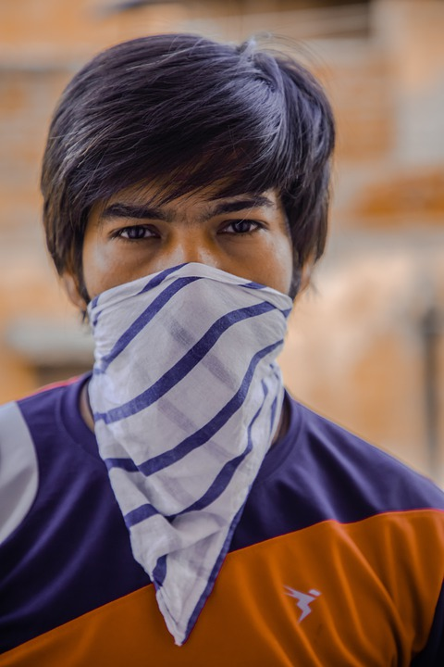
Consider the type of face covering used, for example, what may be most comfortable, maybe a bandana that provides air flow, rather than a mask the loops around the ears
Consider when and where the person wears the face covering. For example, while inside a shop they may wear one, but remembering to help them remove it when back outside, just as we may do so ourselves.

Slide 30
When removing someone’s face covering, be gentle and explain what you are doing.
They may need support to dry their face around their nose and mouth after wearing a covering, ensuring this is done in a dignified manner.
Ensure you keep a regular check on the person and are able to recognise any subtle clues of discomfort, this may be through their vocal sounds or sometimes just subtle eye movements; keep a record of any signs of possible discomfort and ensure other support workers are aware of them.

Slide 31
Keep the person informed of what you are doing, no matter what level of learning disability.
Use the face covering as a visual clue (object of reference) to show the person before putting it on, explaining what you are doing and why
Provide plenty of reassurance

Slide 32
Activity 6
Case study: Sally
Read through the case study and discuss ideas.

Slide 33
AND FINALLY… REMEMBER THE EXEMPTION RULE!
This may not work for everyone!
You may try lots of different approaches and the person may still find it very difficult to tolerate a face covering.
Remember the exemption rule, you mustn’t put anyone under undue pressure to wear a face covering.

