Slide 1
Relationships and sexuality awareness training for social care staff

Slide 2
Aim: To equip staff who work in care and support settings to be comfortable and confident in discussing and addressing sexuality and intimate support needs
Learning outcomes
To be knowledgeable about the impact of sex and relationships on wellbeing
To be clear about the role of social care staff in supporting opportunities to develop healthy relationships and positive sexual expression
To have a basic understanding of legislation in the area of social care and sexual activity
To gain an understanding of the key issues to consider when faced with a dilemma involving relationships and/or sexuality
To have considered the role of family members in supporting independent, adult relationships
To understand safeguarding, sexual safety and positive risk taking, in respect of sexuality and relationships

Slide 3
Group agreement and ground rules
It’s important when talking about such a sensitive topic that we have a group agreement
Treat other's opinion with respect
Maintain a safe and open space for people to ask questions and discuss freely
Retain the confidentiality of the people you support – do not share their names/location so they could be identified
Do not share confidential information shared by others outside of this session
No interrupting
Camera’s on while speaking and in discussion groups
During discussions, value other participants' contributions
Arrive back on time after breaks
Keep an open mind

Slide 4


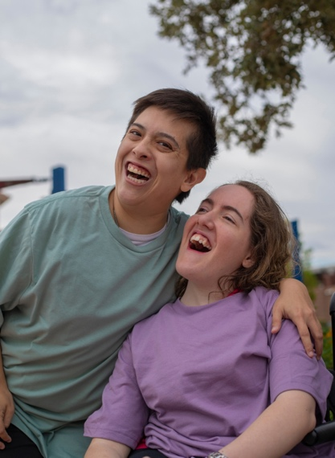

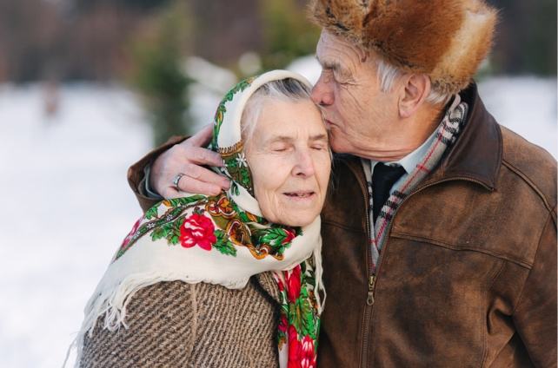


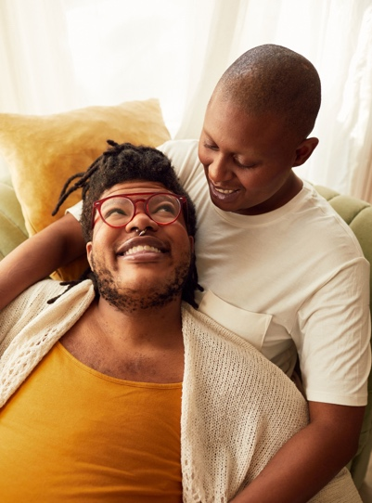
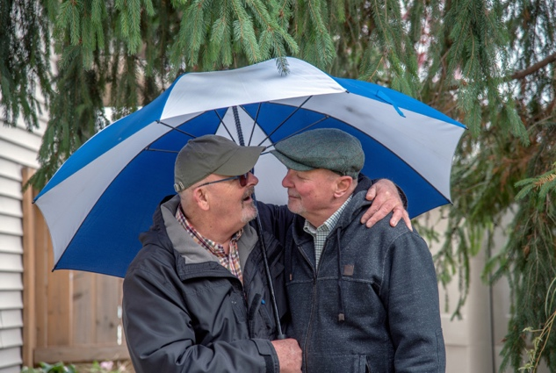
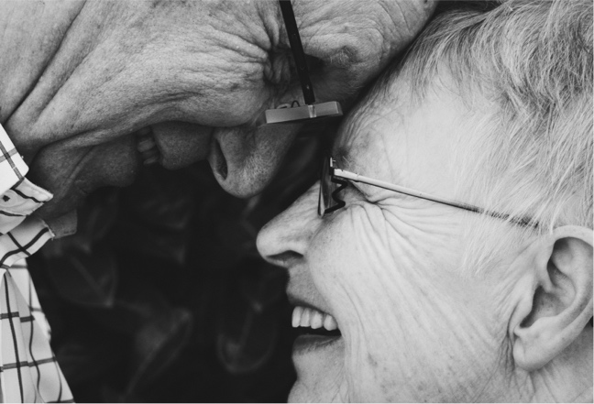
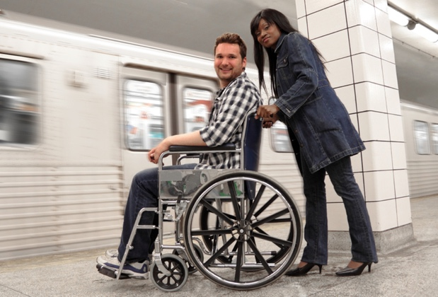

Icebreaker
4
5
1
2
3
6
7
9
10
11
12
8

Slide 5
What are the key challenges you face addressing relationships and sexuality issues in your role?

Slide 6
Understanding sexuality and relationships: barriers, benefits and the impact of staff values
Aim: To increase participants’ awareness of the values and attitudes that underpin attention to relationships and sexuality support in social care settings
Learning outcomes:
Be aware of the term sexuality and how this relates to holistic, person-centred support
Understand the relevance of sexual orientation and gender identity
Highlight the importance of relationships to physical and emotional wellbeing
Be aware of the barriers and benefits impacting on the ability of people you support to develop and/or maintain relationships
Understand the impact of personal and professional values on effective communication and intervention

Slide 7

How would you define human sexuality?

Slide 8
The World Health Organisation:
“…a central aspect of being human throughout life encompasses sex, gender identities and roles, sexual orientation, eroticism, pleasure, intimacy and reproduction.
Sexuality is experienced and expressed in thoughts, fantasies, desires, beliefs, attitudes, values, behaviours, practices, roles and relationships. While sexuality can include all of these dimensions, not all of them are always experienced or expressed.
Sexuality is influenced by the interaction of biological, psychological, social, economic, political, cultural, legal, historical, religious and spiritual factors.” (WHO, 2006a)
Key messages
Sexuality is a natural, inherent part of the human condition and has relevance for all people, across their life span
It is expressed in many ways, not just through intercourse or sexual relationships
Sexuality is influenced by internal aspects of an individual, alongside external factors

Slide 9
Gender and sexual identity
People who identify as LGBTQ+ with a disability
felt their needs were either not or minimally considered when their needs were assessed/ reviewed.
People who identify as LGBTQ+ do not always have good experiences within social care
Care workers are sometimes reluctant to acknowledge same-sex relationships
A third of people who identify as LGBTQ+ and have a disability said that they had experienced discrimination/received poor treatment
Over half of people who identify as LGBTQ+ with a disability never or rarely disclosed sexual orientation or gender identity
Many older LGBTQ+ people need formal care and support but are reluctant to access this due to concerns about how they will be treated
Mainstream care tend to assume that everyone is heterosexual

Slide 10

What could you do to support LGBTQ+ people in care and support settings?
What are you already doing?

Slide 11
Good support in this area can include:
asking people how they identify/what pronouns they use and treat all relationships/partners equally
taking reports of all forms of prejudice, discrimination or bullying seriously
never assuming someone’s sexual orientation or gender identity - if they cannot communicate sexual orientation, it is ok to put ‘don’t know’ in documentation
creating a non-judgemental space so people feel comfortable and safe, and staff should receive training to help with this
being aware of local LGBTQ+ organisations to signpost people to if necessary
an awareness of how factors such as age and/or culture impact on how confident someone may feel about being ‘out’ about their sexual identity/orientation or gender

Slide 12
Barriers and benefits
From the film, identify the barriers faced by people to developing relationships
From the film, what benefits did a relationship bring
Discuss how the films relate to your own experiences in social care

Slide 13
What does the current research tell us are the main barriers to developing relationships?
Mental capacity -
unable to consent
Taboo nature
Restrictive practice
Lack of relationship education and skills
Inability to travel/ communicate independently
Family restrictions
Lack of staff training and support
Vulnerability to abuse/safeguarding culture
Lack of privacy

Slide 14
Values driving positive sexual expression
Values are central to work in social care and are equally significant in thinking about sex and relationships.
It is fundamental that staff have the correct values to support people respectfully in a way that recognises their human right to love, intimacy and sexual expression.
Staff need to be accepting, non-judgmental and open-minded surrounding sexuality and intimate relationships.
A failure to hold these values places people at risk of prejudice and being denied their rights to have positive relationships and a fulfilling sex life, if this is what they want.
Staff need to reflect on their own values but be aware that the focus should be on those of the individual being supported

Slide 15
Values exercise - adults
Look at the worksheet and consider each of the statements:
A. For the general population
B. For the people that they support
Are there any differences between A and B and if so, why?

Slide 16
Values exercise - older people
Look at the worksheet and consider each of the statements:
A. For the general population
B. For the people that they support
Are there any differences between A and B and if so, why?

Slide 17
Roles, regulations and the law
Aim: To have an understanding of your role including the legal and regulatory issues which govern sexuality and relationships and how they impact practice
Learning outcomes:
Understand your role as a social care worker in this area
Be aware of the legal issues which can impact on relationships and sexual activity
Understand how to uphold/support people’s human rights in this area
Know how to meet CQC’s guidance on supporting relationships and sexuality
Understand the criteria for assessing capacity to engage in sexual activity

Slide 18
Different aspects of the role of a support worker Ann Craft (1994)
Look at the case studies and identify examples of where the support worker played each of the roles?
Educator
Counsellor
Networker
Empowerer
Protector
Role model
Intervenor
Advocate

Slide 19
Policy and theory framework- Why this is important?
Regulatory guidance
Skills for Care guidance ‘Supporting people who need care and support to have meaningful and safe relationships’ reflects the current issues staff face and provides practical support.
CQC published ‘Relationships and Sexuality in Adult Social Care Services’ that sets out what registered providers need to do to meet individual’s sexuality and relationship needs.

Slide 20
If a CQC inspector asked you these questions, would you be able to answer?
Policy
Does the organisation have a relationship and sexuality policy, including an easy read version?
Training and support for staff
Are staff trained to support people with their personal relationship needs?
Sexual Health / Relationship Education
Is there accessible information about, and links with, sexual health services?
Are people using the service given information and support about relationships and sexual health or signposted?
Supporting difference and personal preferences
Does the organisation recognise that people have different ways of experiencing and expressing sexuality?
How do sexual needs form part of assessments/ reviews

Slide 21
If a CQC inspector asked you these questions, would you be able to answer?
Practical Support for Relationships
Are there examples that demonstrate positive support for relationships?
How are people encouraged and supported to develop relationships?
Positive risk taking and safeguarding
Are staff aware of what action to take if they have concerns that someone is at risk of harm or abuse?
Are sexuality needs (and any associated risks) documented clearly in support plans and RA’s?
Environmental issues (such as privacy / double beds)
How does the setting accommodate people who are in existing relationships?
Upholding human rights regarding sexuality
What is the policy for allowing people to have guests staying over for the night?
Are peoples’ sexual rights and needs reflected in support documentation and followed in practice?

Slide 22
The World Health Organization Working Definition of Sexual Rights (2002) states all persons, free of coercion, discrimination and violence, have a right to:
the highest attainable standard of sexual health, including access to sexual and reproductive health care services
seek, receive and impart information related to sexuality
sexuality education
respect for bodily integrity
choose their partner
decide to be sexually active or not
consensual sexual relations
consensual marriage
decide whether or not, and when, to have children
pursue a satisfying, safe and pleasurable sexual life

Slide 23
Human Rights
Within the UK, we must abide by the Human Rights Act (1998) (HRA) which contains articles that cover our rights relating to sexuality and intimate relationships
There are three articles in the HRA that relate directly to sexuality and intimate relationships.
Article 8 - Privacy-related rights, including the right to consensual sexual expression in private. The right to develop relationships normally, free from interference as much as possible.
Article 10 - Freedom of expression, including sexual expression. This includes the right to receive information and ideas to make decisions (e.g. information about sex).
Article 12 - The right to marry / have a civil partnership and to start a family

Slide 24
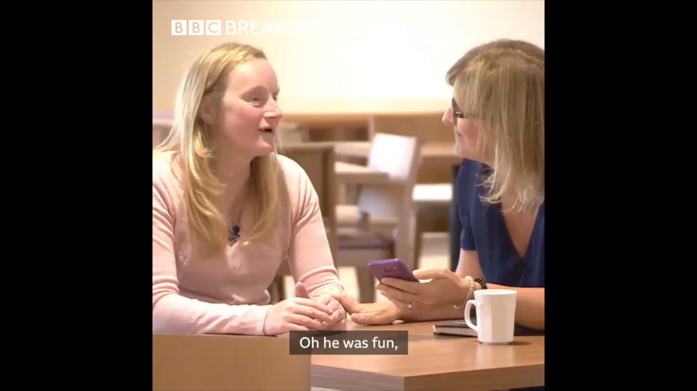

Slide 25
Are the statements legal or illegal?
Read the list of statements in the worksheet and record whether you think the activity is legal or illegal.

Slide 26

Sexual Offences Act (2003)
UK legislation which covers sexual offences that could be committed by or against people with a ‘mental disorder’ (which could include – learning disabilities, developmental disabilities including autism, acquired brain injury, dementia, mental health issues) including :
General sexual offences which can be committed by anyone – this includes:
rape (insertion of a penis into mouth, anus or vagina)
assault by penetration (any object other than a penis inserted into a mouth, anus or vagina)
sexual assault (sexual touching)
forcing a person to engage in sexual activity with another.
Offences against a person with a ‘mental disorder’
Sexual activity with a person with a mental disorder who lacks capacity
Making a person with a mental disorder engage in sexual activity
Engaging in sexual activity in the presence of a person with a mental disorder
Causing a person with a mental disorder to watch a sexual act
It is illegal for anyone who works with a person with a mental disorder to have sex with them, including paid or unpaid volunteers

Slide 27
Care Act (2014)
The Act requires local authorities to promote an individual’s ‘wellbeing’. Social care workers are well placed to consider the relevance of relationships to emotional and physical wellbeing.
Reduction of isolation is now an eligible need.
Relationships and sexuality should form part of their social care assessment and reviews.
The assessment may indicate that the person needs support and education around sexuality and relationships and support staff will play a vital role in advocating this for the people they work with.

Slide 28

Capacity to engage in sexual activity
What do you need to know?

Slide 29
Mental Capacity Act (MCA)
The Mental Capacity Act (MCA) protects the rights of all adults to be able to make our own decisions. If a two-stage test shows a lack of capacity to make specific decisions, they must be made for us in our best interests by those best qualified to do this. The test is whether a person can:
understand the information relevant to the decision
retain the information
use and weigh that information as part of the process of making the decision
communicate the decision by any means
Sex is an ‘excluded decision’, which means it can never be decided in a person’s best interest to have sex. Deciding to get divorced and marriage/civil partnership are also excluded decisions.

Slide 30
Mental Capacity Act (MCA)
Decisions can be made around keeping a person safe if they lack capacity to engage in sexual relations, which may mean putting restrictions in place with the appropriate permissions.
A person cannot be considered to lack capacity without attempts being made through education to gain this understanding. There may need to be temporary restrictions put in place while this is sourced as a matter of urgency.
If a person has the capacity to engage in sexual relations, they have the right to do so and should not be restricted from doing so.
If a person disagrees with the outcome of the capacity assessment/best interest decision, they can appeal to the Court of Protection (CoP).
Complex or borderline cases should be taken to the CoP

Slide 31
What would
a person need to know to be considered to have the capacity to engage in sexual activity?

Slide 32
Criteria for assessing capacity to consent to sexual activity
The mechanics of the sexual act and its character (how you have sex depending on the type of sex you might have)
The reasonably foreseeable consequences of sexual intercourse – namely pregnancy
That there are health risks involved in sexual relations (basic knowledge of sexually transmitted infections) and that these risks can be reduced by taking precautions such as condoms
That they can say yes or no to having sexual relations and are able to decide whether to give or withhold consent
The other person must have the capacity to consent to the sexual activity and must consent before and throughout the sexual activity - if not this is committing rape/sexual assault

Slide 33
Sexual safety, safeguarding and autonomy
Aim: To increase participants’ knowledge and understanding surrounding sexual safety, sexualised behaviour and having meaningful conversations about relationships and sex
Learning outcomes:
Define sexual safety
Identify the worker’s role in supporting vulnerable adults’ sexual safety
Understand different causes of sexualised behaviour
Develop effective strategies to address inappropriate sexual behaviour

Slide 34

‘Let’s start talking about sexual safety’

Slide 35
A person I support keeps touching some of the people they live with, mainly hugging them and touching their thighs. I don’t think they like it and they mainly ignore it, but they haven’t told them to stop.
What should I do?

Slide 36
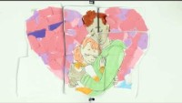
Sexual safety through empowerment

Slide 37
Ideas/ processes that support sexual expression and prevent incidents
People are empowered to speak out about unwanted sexual behaviour and can speak openly about their sexuality
There is a culture, an environment, care planning and processes that keep people and staff safe, and support people’s sexuality and relationship needs
People are supported to form and maintain safe sexual relationships if they wish
There is joint working with other agencies, such as local authorities, health professionals and the police
An awareness that women, particularly older women, are disproportionately affected by sexual incidents
An effort is made to take action designed to help keep people in the service safe from sexual harm
The impact of people’s health conditions on sexual behaviour is well understood
There is an understanding of the emerging use of social media in sexual abuse

Slide 38
Responding to sexualised behaviour
People may experience challenges in sexual function due to long-term/acquired illness/disability.
People may have difficulty in expressing their needs/feelings and their behaviour can be a sign that these are not being met.
People no longer being aware that their behaviours are unacceptable- potentially leading people being less sexually inhibited in their speech or behaviour.
It is important not to jump to conclusions when observing what might appear to be sexualised behaviour.
Close analysis of the cause of the behaviour will assist in deciding on the most relevant support strategy.

Slide 39
Sexualised behaviour framework
Adapted from a framework developed by Dave Hingsburger et al (2010)
1. The environment or living space
2. The role models in the person’s life
3. Opportunities to form relationships
4. Social skills
5. Sexual knowledge and understanding
6. Personal history
7. Sexual frustration
8. Medical needs
9. Medication
10. Social rules and boundaries

Slide 40
Sexualised behaviour framework
Using the framework consider the possible reasons behind these behaviours:
A person undressing in a public space
A person attempting to have sex with someone who also lives at the service, who lacks capacity
A person rubbing their genitals in the lounge
A person making sexually suggestive comments to staff

Slide 41
Risk and Response
Intimacy/Courtship- Kissing, hugging, cuddling Consensual, no evidence of distress
Verbal sexualised communication- Flirting, suggestive language Non-aggressive or threatening
Self-directed sexual behaviours- Masturbation, Undressing in public/exposure No intent to cause harm
Physical sexual behaviours- Sexual touching of others that may or may not be consensual Could relate to a previous partner
Non-consensual, overt physical sexual behaviours directed towards others that are a source of distress- Aggression, coercion, harassment, repeatedly unwanted approaches towards others May be an illegal act e.g. sexual assault, domestic violence
No risk
Low risk
Low risk
Moderate risk
High risk

Slide 42
Responding to sexualised behaviour
Using the framework and the template provided as a worksheet, return to the previous case study example used and decide where it fits in terms of level of behaviour and risk and what action you may take.
If possible, involve the person in discussing and identifying the goals and explain the actions that will be taken. Involve relevant other people, such as family members/ others who support them, with the person’s agreement, so that there is consistency of approach
Use risks assessments to manage risks between people, ensuring that the mix of people living together is appropriate/safe. If necessary, include reference to professional boundaries. Setting boundaries doesn’t mean being unfriendly, but it means clearly stating the role of staff in their life
Think about other professionals/ services that may assist to meet their needs, such as counselling, medical practitioners, voluntary organisations
Note their current understanding and knowledge. Offer information/ training to address gaps. Do not make assumptions about knowledge based on their age/experience
Consider all possible areas of intervention, be creative and aspirational e.g. environmental changes support arrangements, staff responses or new opportunities to learn and connect with others.

Slide 43
Practical approaches to relationships and sexuality support
Aim: To understand how best to communicate and provide information, to understand how to work positively with families and how to develop an organisational culture that supports sex and relationships work.
Learning outcomes:
Have an awareness that everyone has the right to information and/or education surrounding sex and relationships
Understand how you should approach discussing sex and relationships with the people you support and their relatives
Be able to identify the challenges faced by family members in dealing with relationships and sexuality issues
Be aware of key areas of information and/or education required to promote healthy relationships

Slide 44
Top tips to support conversations about relationships and sex
Avoid assumptions
Be proactive in introducing the topic
Use inclusive, person-centred language
Use open ended questions
Consider the person’s cultural and religion background
Provide accessible information
Be trauma informed
Plan ahead
Respect aspirations

Slide 45
The Better Model (Mick et al 2007)
A structured framework that can be used to assist social care workers to have the conversation and provide support and information.
B Bring up the topic.
E Explain that sexuality and relationships are an important quality of life issue and that you/the s. service are equipped to offer support in this area.
T Tell the person that if they have concerns you will find appropriate resources to address them.
T Time. If the person does not want to engage now, explain that they can ask for support or discussion in the future.
E Educate and inform the person regarding the issues that they may be concerned about.
R Record the assessment, review or intervention in the personal care documentation.

Slide 46
Having the conversations…
How would you start the conversation and what else might you want to consider
D. Someone I support keeps making sexually inappropriate comments/ gestures towards me. What should I do?
A. A person I support has asked for help to purchase sex toys. What approach should I take?
C. Someone I support has asked for help to access the internet in order to form relationships. What should I do?
B. The person I support started masturbating in a public place, is that ok?

Slide 47
Assess my needs
Look at the case studies in Handout I.
These people have been referred to the service where you work.
1) What kind of questions would you be asking to identify the support they needed surrounding relationships and/or sexuality?
2) Would you need any other resources to assist you?

Slide 48
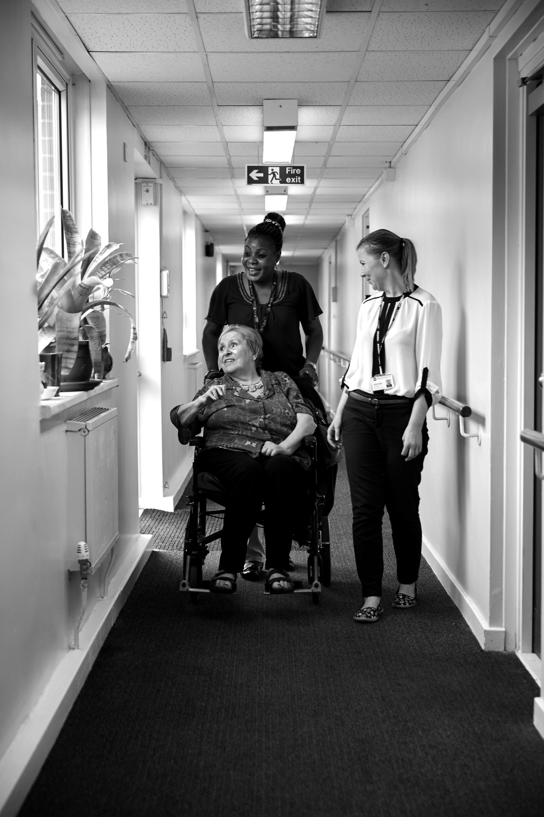
Working with families and loved ones
Supporting people to maintain positive relationships with their family members is an integral part of the care.
Developing an open dialogue with families may include talking about their loved one’s intimacy needs.
Given the emotional, social, and cultural restrictions around having these discussions, it may be difficult for family members to engage on this topic
Staff will need to be open, welcoming and sensitive in initiating such conversations, working to normalise the content as an integral part of addressing social care needs.

Slide 49
What are the challenges faced by family members in addressing their relative’s sexuality and relationships needs?

Slide 50
Challenges faced by family members
Concern about the individual being exploited, hurt, or abused
Lack of appropriate resources, information, and access to services.
Embarrassment about having the conversation
Taboo surrounding involvement in these discussions
Conflict with religious or cultural family values
A belief that the individual does not have sexual feelings
New relationships offending the memory of past or present relationships
Worries about new or developing physical restrictions
Families’ views and opinions not being taken into consideration

Slide 51
Working in partnership with family members
Make family members aware of your organisation’s relationships and sexuality policy.
Involve them in decision making and planning, but only with the consent of the individual.
Maintain open dialogue, on a continuous basis, not just when there is a crisis
Provide access to information and learning opportunities that may support them in discussing issues about relationships and sexuality
Empower the individual to make their own choices about relationships and sex, including being able to communicate these choices to their relatives
Whilst families may not always agree with their relative’s decision, staff can mediate, explain and assist the family member to come to terms with the decision

Slide 52
We’ve developed a great relationships and sexuality course at the day service, but a few family members have objected.
How should we proceed?
A person living with dementia moved into our care home and they have developed a new relationship with someone who lives here.
How should we proceed?

Slide 53

Videos about family relationships
Watch the film and consider:
The reason behind the family’s response
What approach or action was taken?
How effective were the actions?
How could you apply this in your own work setting?

Slide 54

Any questions

Slide 55
Further Links
Skills for Care – Supported Personal Relationships https://www.skillsforcare.org.uk/Developing-your-workforce/Care-topics/Supporting-personal-relationships/Supporting-personal-relationships.aspx
(including Database of resources, Guide to Resources, Guidance)
CQC - Relationships and sexuality in adult social care services https://www.cqc.org.uk/sites/default/files/20190221-Relationships-and-sexuality-in-social-care-PUBLICATION.pdf
CQC – Promoting sexual safety through empowerment https://www.cqc.org.uk/publications/major-report/promoting-sexual-safety-through-empowerment
Supported loving Toolkit www.supportedloving.org.uk

