Slide 1
Edgbaston Manor
Zoe Steventon GM
Rebecca Kneller DM

Slide 2
Manor Magic Moments

Slide 3
Purpose
If team members are seen going above and beyond or doing something special, they are given a manor magic moment slip.
They can be given out by staff members, residents or relatives.

Slide 4
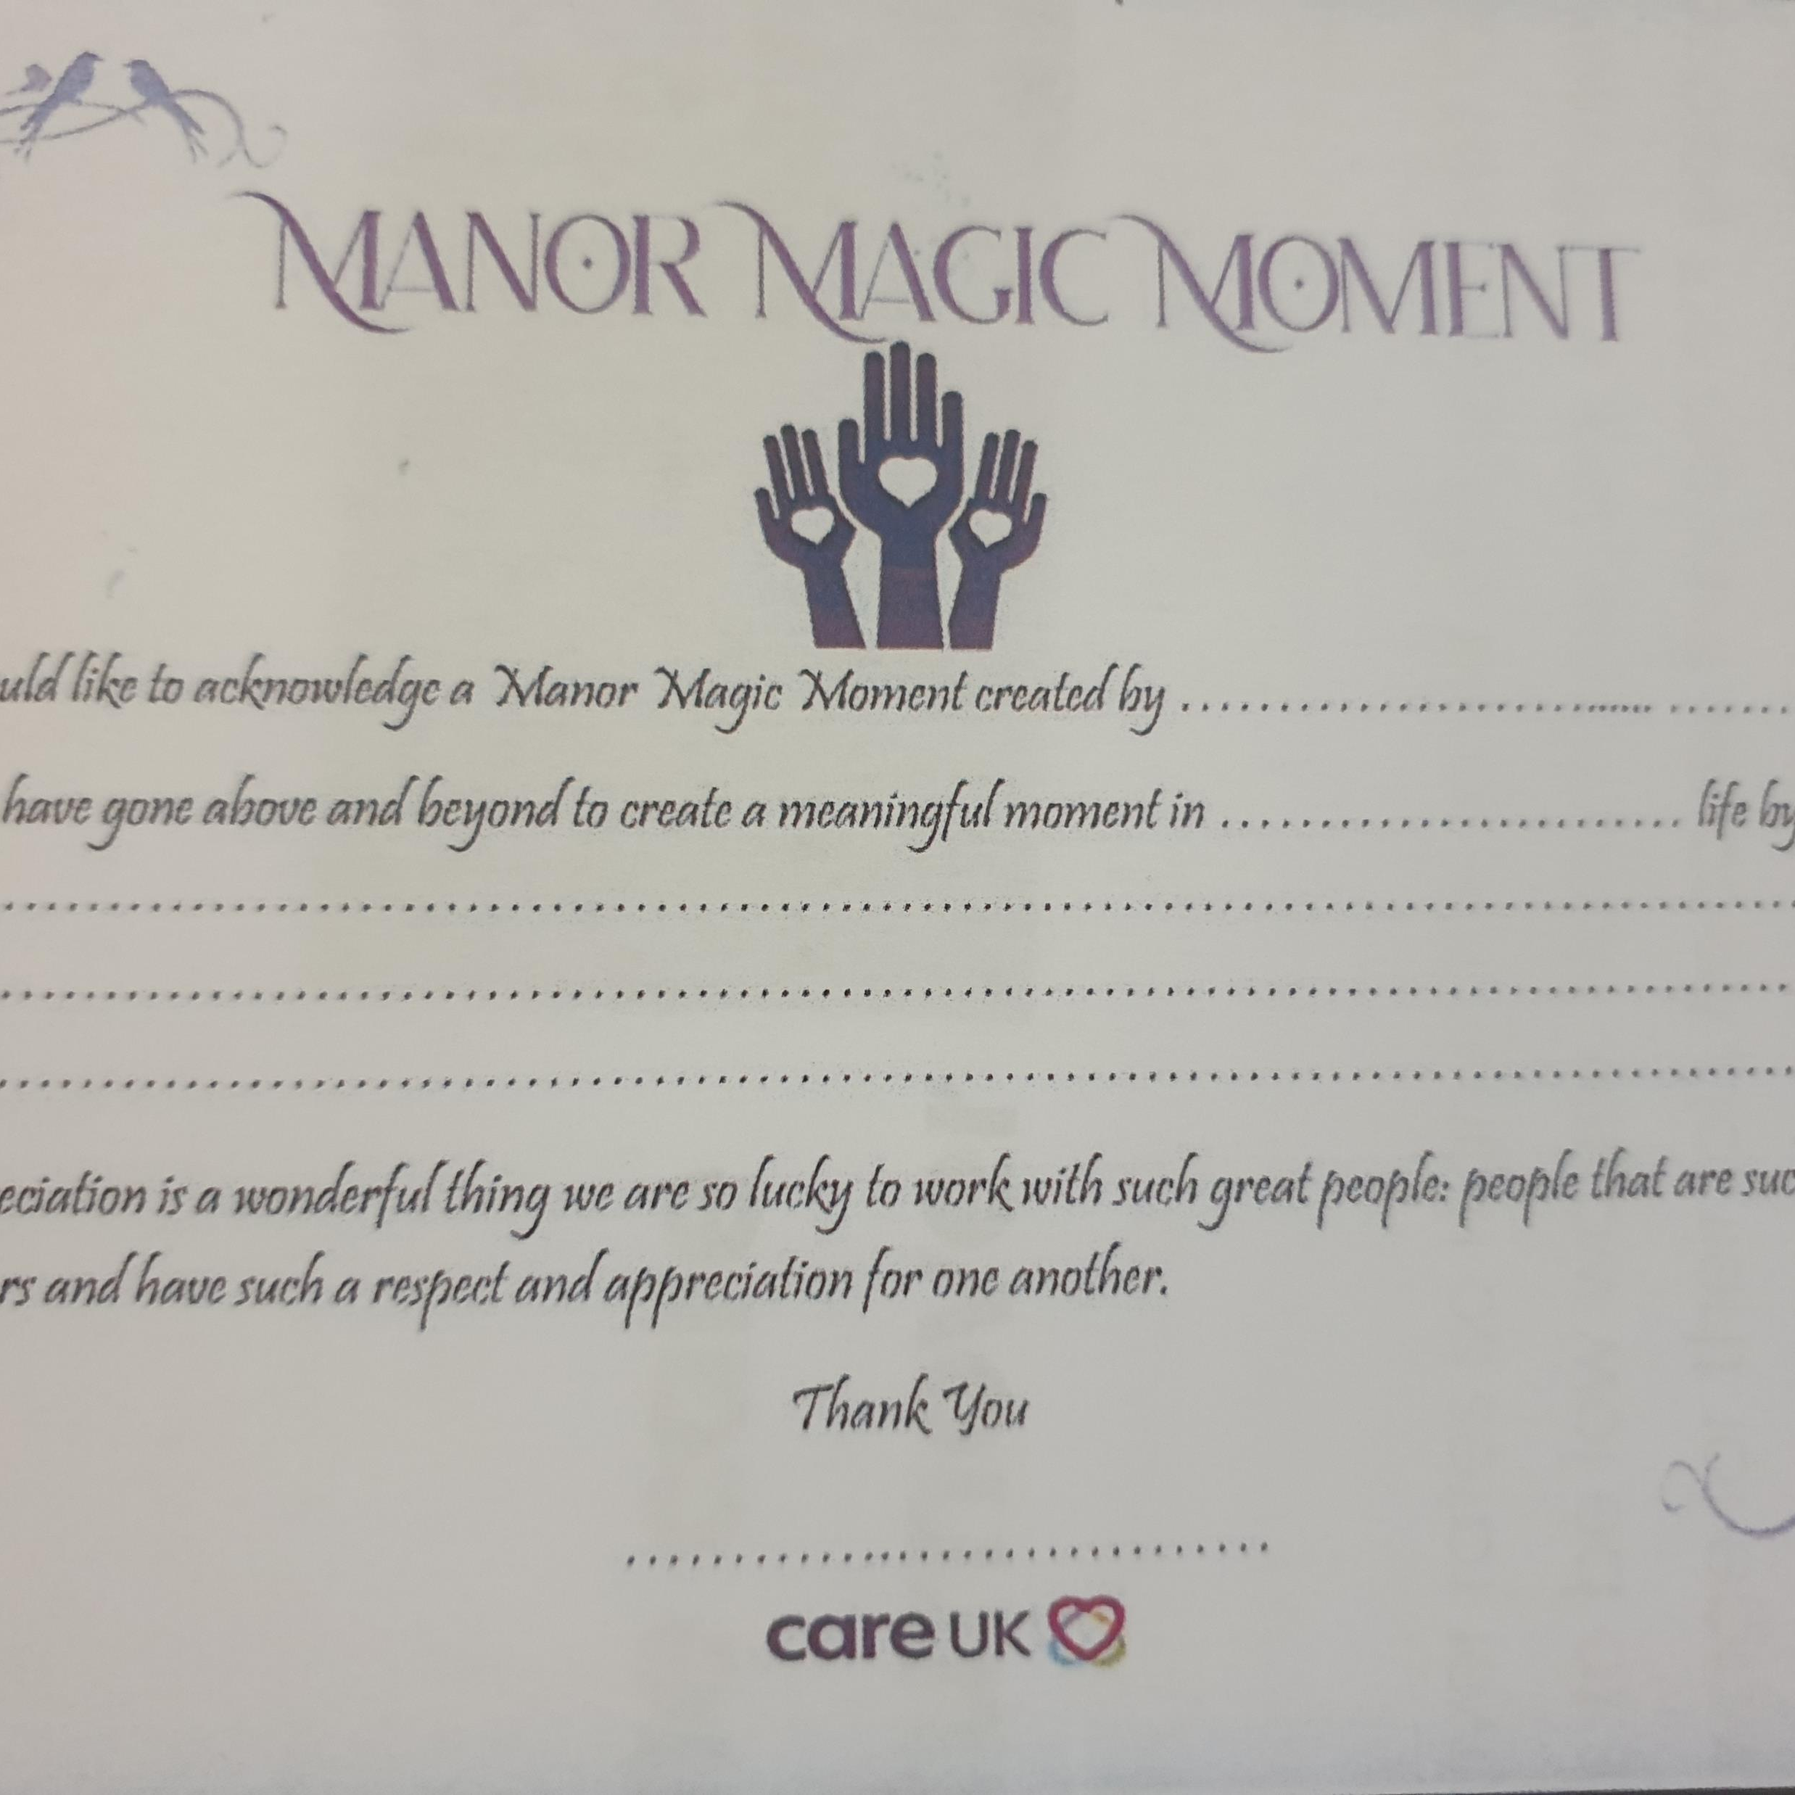
Manor Magic Moment Slip

Slide 5
Gifts
Once a team member has been given a slip they can then bring it to the General Manager and redeem it for a gift.
Each slip is worth one gift so the more slips the more gifts!
A variety of gifts are purchased by the home for the team member to choose from.

Slide 6
The gifts

Slide 7
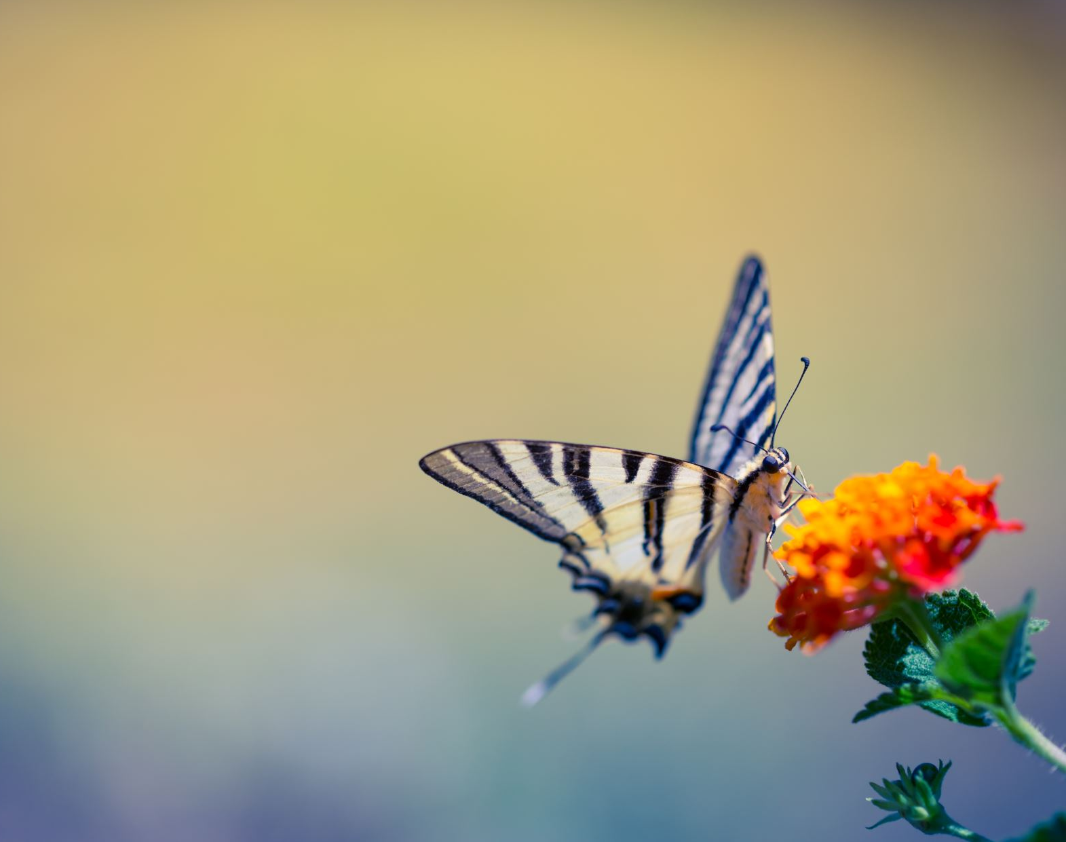
Butterfly moment.
This is given specifically by the DM for a team member that has gone over and above.
This is gift that is specific for that team member, something we know they like.
This is chosen by the DM.

Slide 8
GEM Awards
We have monthly GEM winners (going the extra mile)
Monthly winners get a certificate and a badge. The badges are for passion, teamwork or caring, part of the company vision.
There is also a regional GEM winner decided by the regional director.

Slide 9
Care UK Stars Awards
This is held annually
Covers the whole company
Induvial winners for best nurses etc
Winners for homes, most improved home etc.
Conference and evening of fun.

Slide 10
Why?
Staff retention.
Low turnover.
Staff engagement.
Staff morale.
High quality care.

Slide 11
Current vacancies
Care 0
Nurse 0
Other 0

Slide 12
Turnover
Our turnover last year was 17%

Slide 13
Engagement
Over to you
Our last engagement score was 83%
‘we feel supported and valued’
‘We work as a team’

Slide 14
Residents
Ultimately our residents benefits from all of this.
Continuity of care
A team that really know them
An engaged team
A team that deliver.

Slide 15
Monitoring
A good CQC report April 2023
A green 95% CCG audit January 2023
Occupancy of 92%
Carehome.co.uk score of 9.7

Slide 16
Internal recognition/awards.
We have won home engagement 2018
Excellence award for engagement 2018
Joy in service award 2018
Heart and soul award 2021
Care UK stars award 2022

Slide 17
The Awards

Slide 18
Thank you
Any questions?

