Slide 1
Storytelling

Slide 2

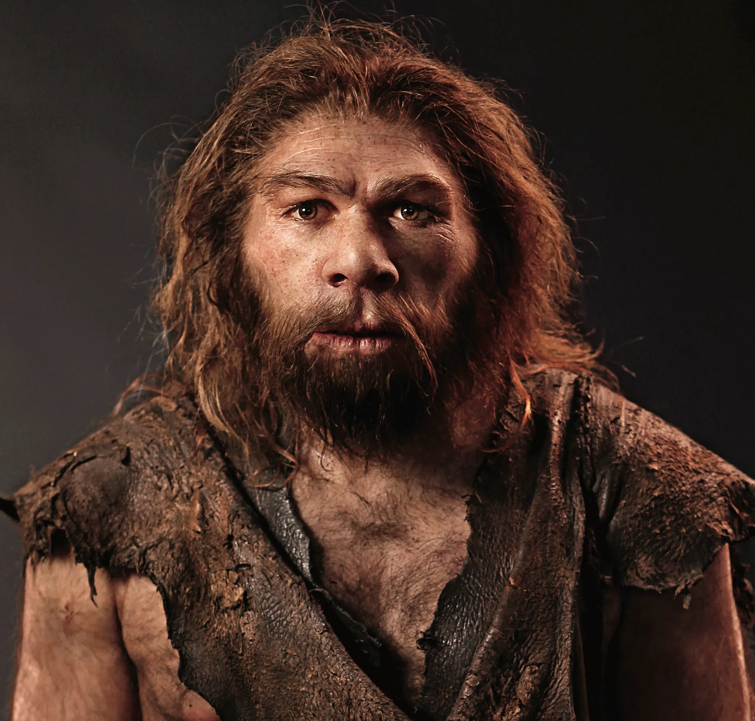

I blame the Neanderthals for
David Walliams

Slide 3
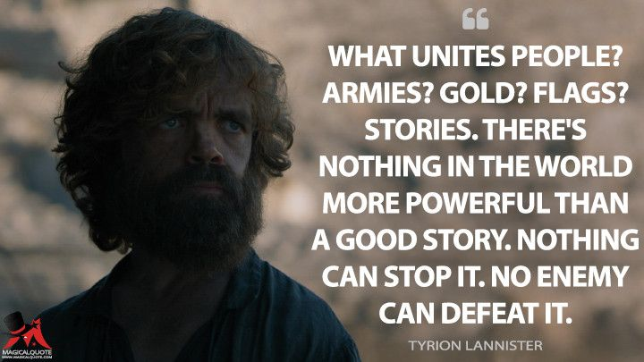

Slide 4

‘Pirates didn’t just tell stories, they creatively weaponized the art of story telling’
Notes:
Gender. Sexuality. Slaves. In death benefits
Reaction of governments

Slide 5

‘I’ve never seen a great military, political or corporate leader who was not a great story teller. Telling stories is a core competency in business, although its one that we don’t pay enough attention to.’
  Brian Ferren
  Futurist, Disney

Slide 6
Why do stories work?
Agreement seems to be:
Sharing experiences and offering meaning
Stories produce hormones. Cortisol – stress. Oxytocin – connection & empathy. Dopamine – hope & optimism
Stories build connection. Connect shared traditions, histories
Build understanding and empathy
Trigger imagination and creativity.
Notes:
We learn from the experiences of others
Cinnection – you tell stories when you first meet someone

Slide 7
Stories convey meaning
Memorable
Even though story plots might be more complex than a set of numbers, the fact that they engage both sides of the brain makes them more memorable
Believable
Stories are more believable than statistics
Inspiring
Telling and listening to stories can help to align individual and company values and goals
Clark & Bartholome. Team-building-bonanza.com

Slide 8
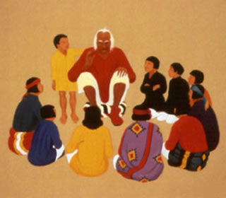
Storytelling tips
You need to tell stories that you like
Take time to prepare
Do not hesitate to remove the slow parts
Use a strong and confident voice
Avoid “the moral of the story” finishes
  Adapted from S Buvala. Storytelling Tips – 9 Tips for Better Story Telling

Slide 9
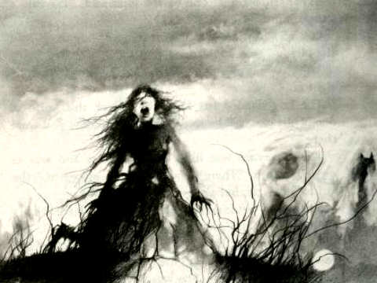
Notes:
Do you really want someone else telling your story for you !

Slide 10
Not everyone is a great story teller, That’s ok.
But someone has to be…
Who is yours?
Notes:
Who in your organization/team is a great story teller? Do they have this as a part of their role?

Slide 11
Storytelling grid
 | Stories you want to tell
Audiences you want to reach

Slide 12
Storytelling grid
 | Stories you want to tell
Audiences you want to reach | Borrow until you have your own (credit)
 |  |  | Does story have a ‘stale by’ date ?
 |  | Where and how to tell the story is as important as the story
 |  |  | Remember how ineffective most corporate communication strategies are
Notes:
If time get people doing this.

Slide 13
A change you want to make ….
 | Stories you want to tell
Audiences you want to reach

Slide 14
Tell us a story. Remember …..
You need to tell stories that you like
Take time to prepare
Do not hesitate to remove the slow parts
Use a strong and confident voice
Avoid “the moral of the story” finishes
  Adapted from S Buvala. Storytelling Tips – 9 Tips for Better Story Telling
Notes:
Pairs or trios

