Slide 1
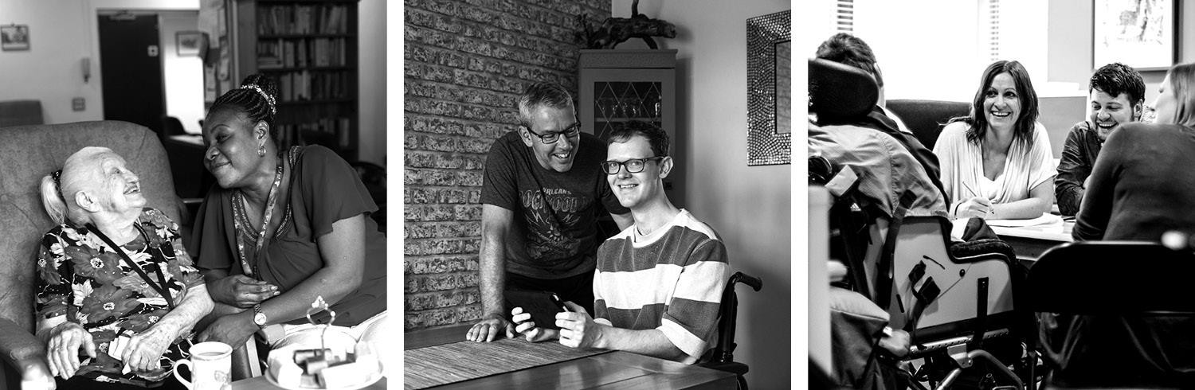
Peer based approaches: empowering connections in adult social care webinar

Slide 2
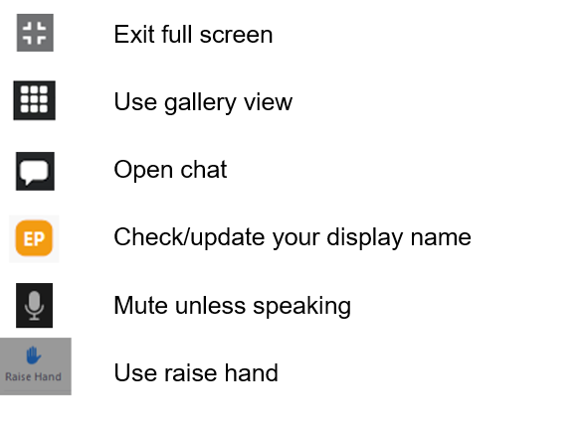
Virtual housekeeping
Notes:
Remind attendees that this session will be recorded.

Slide 3

Agenda
Understanding peer support
The role of social media in peer support
Tools and resources
Q&A session
Conclusion and next steps

Slide 4
Can you share an experience where peer support made a significant difference in your work?
Notes:
Encourage attendees to put their answers in the chat or raise hand and say it out loud.

Slide 5
What is peer support?
Peer support is a mutually beneficial arrangement which is ultimately about people helping and aiding each other through shared experiences.
Peer support aims to:
■ bring together people with shared experiences to support each other,
■ provide a space where people feel accepted and understood,
■ treat everyone’s experiences as being equally important,
■ involve both giving and receiving support.
Notes:
Give a brief overview of each principle and highlight that our resources take them through each principle in detail.

Slide 6
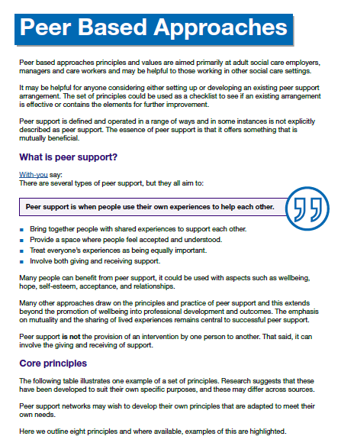
Understanding peer support
Principles and values to prompt you to define which principles and values suit the purpose of your peer support group.
Notes:
Give a brief overview of each principle and highlight that our resources take them through each principle in detail.

Slide 7
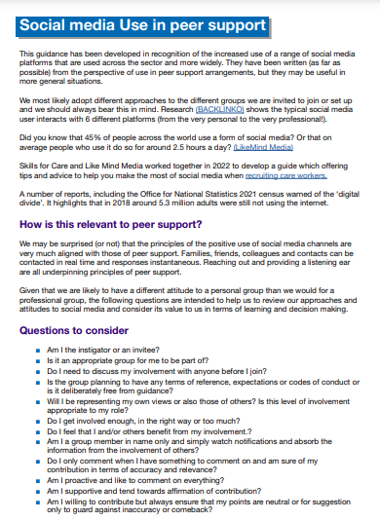
The role of social media in peer support
Social media is a useful tool both for keeping in communication with your existing peer support group as well as reach potential members. This document offers guidance on best practice when using social media.

Slide 8


Tools and resources
Notes:
We’ll circulate a list of resources after the webinar.
Effective supervison guide: Effective supervision supports good working relationships, helps you to address any issues
and celebrate achievements, gives you the opportunity to discuss learning and development. It shares advice and tips about what works well, to help you to
think about how you can make supervision work for you and your staff.
Conversational assessment : This form of assessment enables you to find out what matters most to people. so you can target your resources where they’ll have the most impact. The relaxed and open way of doing a conversational assessment encourages people to explore different and more imaginative ways to meet care and support needs. Sometimes this can lead to people managing for longer with less support.

Slide 9

Q&A session

Slide 10
What do you need?
Pop it in the chat
What are your future requirements for next year?

Slide 11

Are you inclined to look at peer support as part of your future work?
Notes:
Daisy to add Poll on the screen

Slide 12


