Slide 1
Commissioning for a life not a service
Principles of Commissioning for Wellbeing level 5 qualification
Updated September 2024
Notes:
Original qual developed by Skills for Care and other national partners (ADASS, LGA, providers, commissioners) around 2017
We developed and piloted an LD/A version in 2020,with partners inc LGA, ADASS and NHSE (NB: is exactly same qual/cert at end, is just version where content is contextualised to LD/A)
Qualification is managed and awarded by Highfield Qualifications
SfC work with BCE and Hasca (endorsed learning providers) who deliver the qual with input from people with lived experience. Via BCE and Hasca, SfC can offer some funding support towards the cost of the qual.

Slide 2

What – learning outcomes
Recognise the importance of co-production at every stage of the commissioning cycle
Ability to design innovative care and support
Understand:
  The market
  Legislative requirements
  Population needs
Outcomes-focused commissioning
Supporting services to improve
Commissioning in partnership
Note: content is regularly updated/contextualised to current policy/reform developments by both learning providers
Notes:
The qualification focuses on the ‘human’ aspect of commissioning – whilst it does cover practical aspects such as the commissioning cycle, legislation and policy, it does this in the context of co-production and outcomes-focused commissioning practice which results in making a meaningful difference to the lives of people accessing care and support.
This ‘human’ approach is essential to support reform across social care and health, where there is an increasing focus on innovation and doing things differently and on ensuring that care and support are personalised to individual needs
The qualification takes around 9-12 months to complete and is made up of a mix of individual and guided learning
As it’s a level 5 qualification learners must complete a number of assignments in order to gain the certificate. Line manager support to undertake the qualification is important in light of the time commitment.

Slide 3
Learning disability and autism version
Principles of Commissioning for Wellbeing Level 5 qualification
Generic version – suitable for all commissioners
Learning disability and autism version
Covers the same core content, but examples and delivery is contextualised to learning disability and autism
Both versions result in the same certificate
Notes:
As per previous comment, the learning disability and autism version covers the same core content (as per Highfield specification), but delivery and practical examples etc are specifically contextualised to learning disability and autism
These are run as separate cohorts

Slide 4

Who – target audience
Health commissioners
Social care commissioners
Social care providers*
*NB: content is focused on commissioning and so learners need to work in a commissioning role or have links to commissioners for practical examples
Notes:
The qualification is suitable for both new and experienced commissioners
Whilst the focus of the qualification is commissioning, providers with an interest in commissioning may find the qualification valuable (we have heard this from a number of providers who have undertaken the qual). However, providers would benefit from having links to local commissioners, if commissioning isn’t part of their current role as the course includes practical examples of commissioning

Slide 5
Funding support options
Health commissioners
Social care commissioners / providers
LD/A version – full costs met by SfC
Generic version – no funding via SfC
Both versions
Qualification is listed in the DHSC’s new ASC Learning & Development Support Scheme (£2,820)
Visit the DHSC’s LDSS webpage for more details
Visit our webpage for more detail www.skillsforcare.org.uk/L5-Commissioning-for-Wellbeing-Qual
Notes:
Funding support options are complex due to different sources of support. For more detail please visit our webpage for the qualification.
Social care learners may be eligible to claim £2,820 towards the cost of the qualification via the DHSC’s new ASC Learning and Development Support Scheme, this is administered by NHS BSA not Skills for Care. Please visit the web page for detail about eligibility and how to claim.
The cost of the qualification varies slightly depending on the learning provider. However, the full cost is approximately £2,300 +VAT

Slide 6
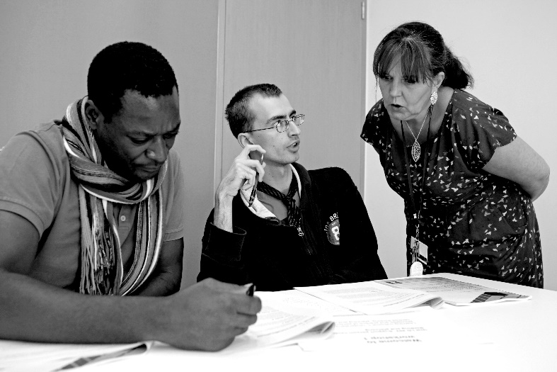
Why – value of the qualification
Better outcomes for people
Improved services
Improved confidence and motivation
More flexible and innovative approaches to commissioning
Connections with others involved in commissioning
“I have learnt what co-production means (really) and the impact it can have on an individual, their family, their community and the Service Provider”
Notes:
We hear lots of positive feedback from people who have completed the qualification, including from experienced commissioners, who still gain a lot from the unique approach that the qualification takes in terms of considering how best to meet the ‘human’/wellbeing aspects of the role.

Slide 7

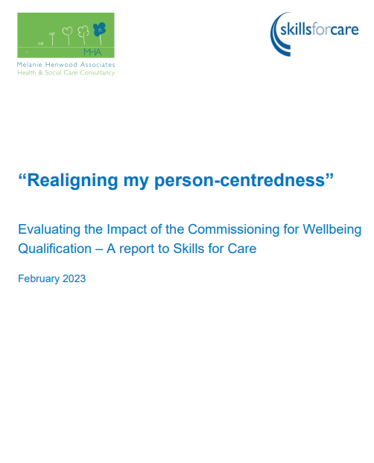
Independent impact evaluation
Qualification highly valued by learners
Increased knowledge of what good commissioning looks like
Increased confidence
Greater commitment to coproduction and outcomes-based commissioning
Examples of improved commissioning practice
“It has given me the confidence to look at that innovative thinking, and not just at what we can commission.” (NHS commissioner)
Link to the full evaluation report

Slide 8
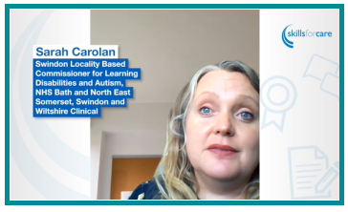
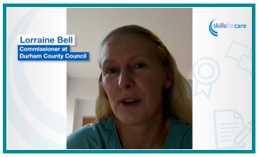

Why – hear from learners
Hear from these learners and other stakeholders.
Visit our webpage:
www.skillsforcare.org.uk/L5-Commissioning-for-Wellbeing-Qual
Notes:
We have included a link on the slide to our webpage for the qualification where you can find lots of information, including the chance to watch a number of short videos with different stakeholder perspectives – we’re about to upload one with a lived experience perspective about the value of this qualification from people who access care and support.

Slide 9

How to access the qualification
If you would like to apply for a place, contact Hasca and BCE to find out more, including dates, and apply directly
There are no set dates for cohorts to start, learning providers organise them throughout the year
For more detailed information about the Principles of Commissioning for Wellbeing qualification please visit our webpage
www.skillsforcare.org.uk/L5-Commissioning-for-Wellbeing-Qual
Notes:
On our webpage we have more detailed information including:
More in-depth description of the qualification (content, length of time to complete etc)
Further detail about funding options (inc link to WDF page)
Link to the Highfield specification for the qual (more detail re: content covered)
FAQ document
Videos where you can hear more about the qualification from; learners, learning providers and people with lived experience of accessing care and support

Slide 10
National Commissioners Peer Network
A new network for people in commissioning roles, currently with around 700 members.
Free access to:
Virtual masterclasses on a range of topics
Interactive virtual peer learning events
Programme of masterclasses & peer learning events Sept-Nov now available to book
Visit our webpage for more information or to register

Slide 11
Thank you
Holly.Irwin@skillsforcare.org.uk

